Slide 1
Spring Flooding Surge Capacity
NRCan Emergency Geomatics Service, April-June 2024

Slide 2
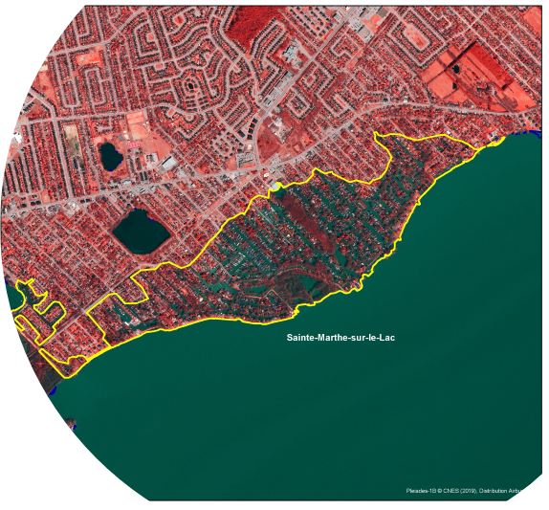
NRCan CCMEO
Emergency Geomatics Service
  Provide subject matter expertise on remote sensing for disasters
  Create satellite-derived situational awareness products in near real time
  Disseminate products to a wide audience using modern and effective distribution channels
Notes:
Talking point on the slide
Photo is 2019 Sainte-Marthe sur le lac flooded area due to dike breach produced by EGS using pleiades

Slide 3
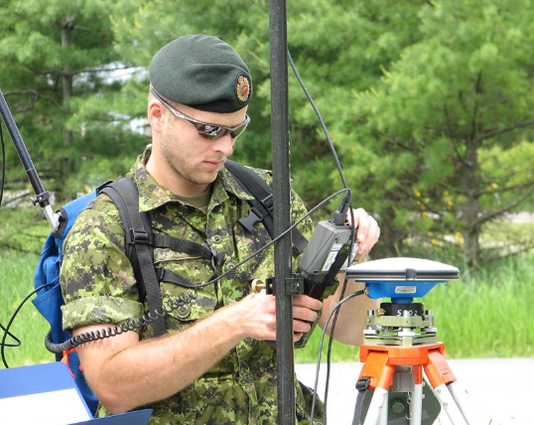




6:00 AM
6:30 AM
7:00 AM
11:00 AM
ACQUISITION
GROUND STATION
EMERGENCY GEOMATICS SERVICE
PRODUCT DELIVERY
PRECISE AREA OF INTEREST COVERAGE
FAST DATA TRANSFER
VALUE ADDED PRODUCT EXTRACTION
DATA DISSEMINATION
Icon made by Freepik from www.flaticon.com
Icon made by Smashicons from www.flaticon.com
Icon made by srip from www.flaticon.com
Icon made by Eucalyp from www.flaticon.com
Style source: PowerPoint School YouTube Channel
Notes:
During event response, the typical workflow is as follow:
RCM data acquisition occurs early in the morning over Canada.
The data is then received by CCMEO ground segment and transformed into an image by the Canadian Space Agency
Once transfered to our emergency mapping team, flooded areas are extracted and the final map are published to our clients within 4 hours.

Slide 4
6:00 AM
6:30 AM
7:00 AM
11:00 AM
ACQUISITION
GROUND STATION
EMERGENCY GEOMATICS SERVICE
PRODUCT DELIVERY
PRECISE AREA OF INTEREST COVERAGE
FAST DATA TRANSFER
VALUE ADDED PRODUCT EXTRACTION
DATA DISSEMINATION
Icon made by Freepik from www.flaticon.com
Icon made by Smashicons from www.flaticon.com
Icon made by srip from www.flaticon.com
Icon made by Eucalyp from www.flaticon.com
Style source: PowerPoint School YouTube Channel

Slide 5
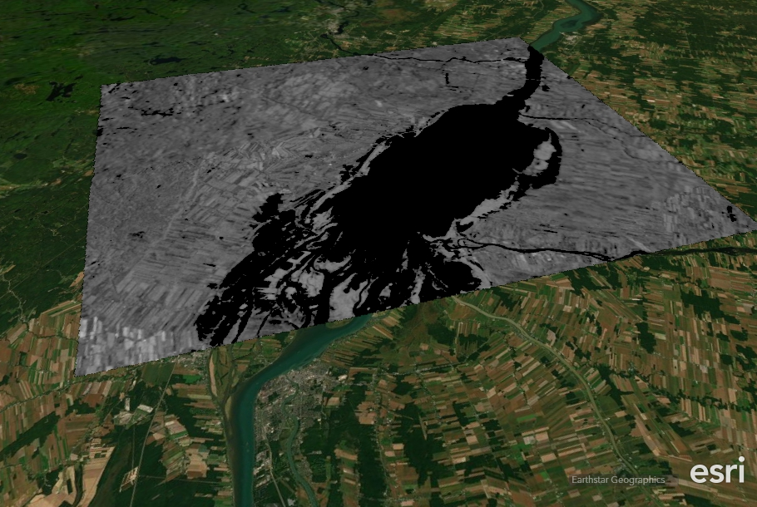
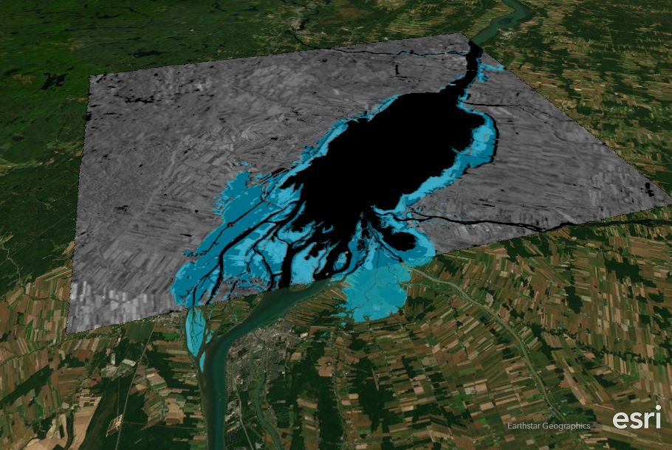
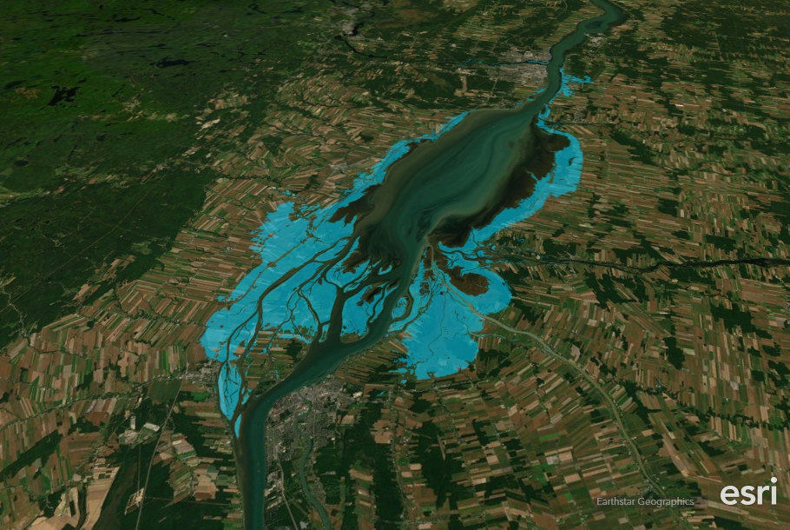
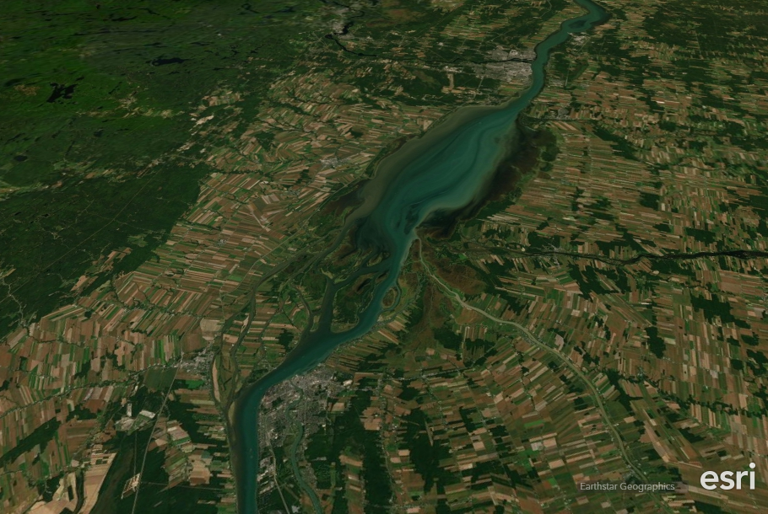
Product Creation
11:00 AM
Icon made by Freepik from www.flaticon.com
Icon made by Smashicons from www.flaticon.com
Icon made by srip from www.flaticon.com
Icon made by Eucalyp from www.flaticon.com
Style source: PowerPoint School YouTube Channel
Notes:
The two main products we currently maintain operationnaly are flood extent and river ice breakup monitoring maps.
In this slide, the steps for flood extraction.
Water is black in a radar image, in bleu the extracted geographic layer distributed to clients
A CCMEO developped river ice classification algorithm is applied to a radar image, it enable the identification of ice jams that could induce flood in our northern communities.

Slide 6
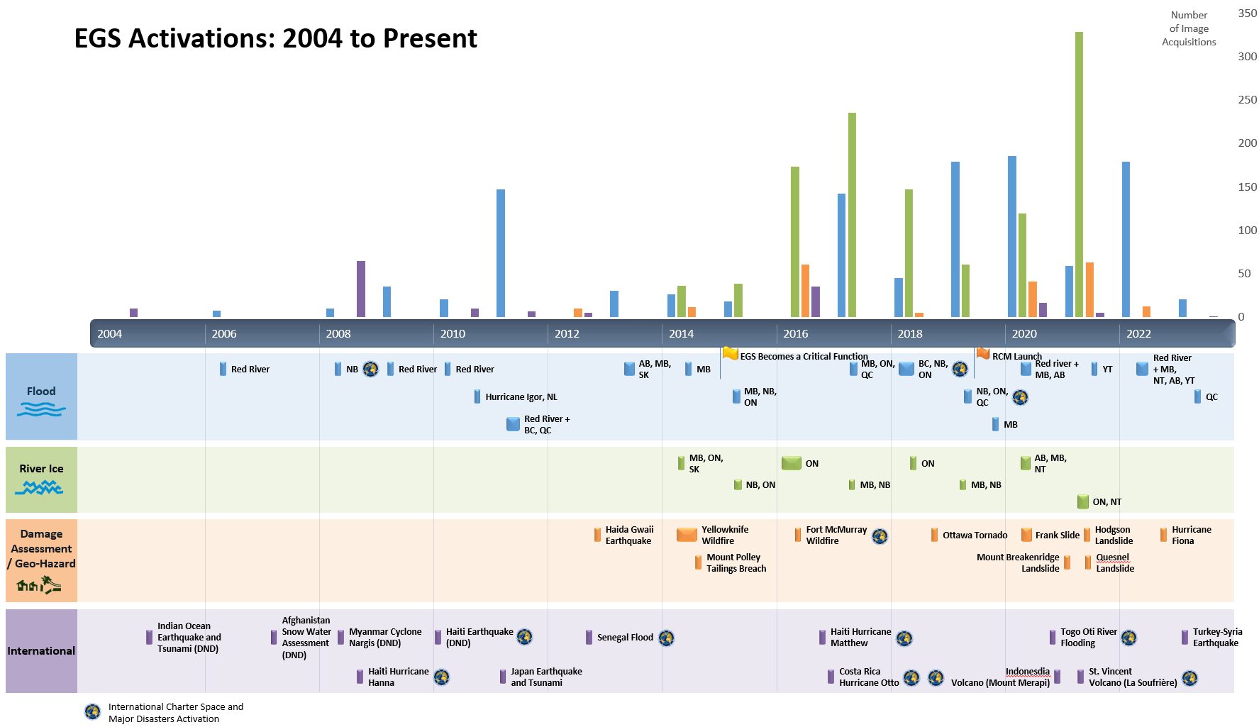
Spring Burnout (2016-2022)
Pre-2020: No surge capacity
2020-2022: Informal surge capacity (rarely used)
2023: First year of Surge Team
(Quiet start)

Slide 7
On-Call Rotation (4 weeks)
EGS Manager
Week 1
Week 2
Week 3
Week 4
Ops Lead 1
Ops Lead 2
Ops Lead 1
Ops Lead 2
Tech Support
Team Lead 1
Team Lead 2
Team Lead 3
Team Lead 4
Operator
Operator
Operator
Operator
Operator
Operator
Operator
Operator
Core Staff
Surge Staff
Notes:
Why 12 weeks secondments?
New Sherbrooke leads and specialists need special more intense training to be able to support their surge.
The on-call team need support from other CORE EGS teams during the week to help with the activation.
4 premières semaines training, traitements, édition, pratique, préparaion données auxiliaires, aider avec les cartes de breffages, demandes spéciales, gérer les problems des produits difficiles. Research and Operation!
Tâches pour Core!?! Timing?
Several CCMEO teams have agreed to support EGS on Policy (FHIMP), Briefings (FHIMP + Geodiscovery) and IT (Geobase, CCMEO IT, EODMS), Scientific (CCRS) needs.
Why 4 teams?
Teams are redundant to each other.
If one team is disrupted then other teams can pick up the slack without working 19 days in a row.
Current resources allow for 3 teams that will hardly be able to handle more than two concurrent activations.
Permet aux employés d’être absent sans avoir un impact opérationnel trop important.
Augmenter la qualité de vie des membres de l’équipe, en réduisant le recours au surtemps “obligatoire”, augmente aussi l’attrait à faire parti du projet
Simon and Elise will Shadow the two new francophone Sherbrooke leads

Slide 8
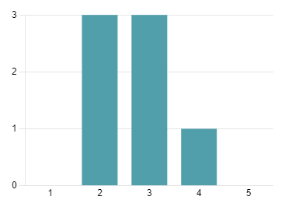
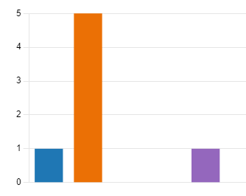
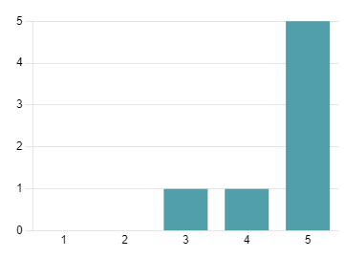
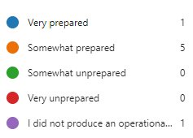

2023 Surge Team Feedback
Before starting training, how much did you know about flood extent mapping?
How prepared were you for your first operational product?
How much did you learn by participating in this year's surge season?

Slide 9
2023 Surge Team Feedback
What's something you enjoyed about volunteering?
“The work is very satisfying; task initiated and completed within a few hours.”
“I enjoyed getting to know different people in the organization and learning new workflows.”
“Getting on board with a good team and compensatory time.”
“Doing something different than my day-to-day job.”
What could be improved for next year?
More in-person hands-on training
More Core Staff oversight for selecting thresholds/parameters
Less chatter in the Surge Team chat
More concrete examples in the SOPs
More fire mapping capabilities

Slide 10
2024 Season Preparation Timeline
  2024-01-24: Call for Volunteers was sent
  2024-02-05: Received 4 responses from CCMEO employees not on last year’s​ surge team. From last year’s team, 6/12 will participate again.
  2024-02-21: Surge Training Kickoff
  Hands-on training sessions will be held in late February and March, with staff to be fully prepared for April 1​

