Slide 1
Presenting Canada’s geospatial information
:
Emergency Management Geomatics Community of Practice – August 22, 2024

Slide 2
Agenda
01
04
Who we are
GEO.ca
02
05
Data Dissemination via GCGeo
Opportunities/Scope & Capacity
03
Implementing Accessibility Standards
Notes:
Today, we will present a condensed overview of our work at the Canada Centre for Mapping and Earth Observation and GeoDiscovery. Hopefully, we will address some of the areas you are looking to understand; however, please feel free to ask follow-up questions after the presentation. We will review how we disseminate and publish data, the standards we use - including implementing accessibility standards, our data dissemination platform GEO.ca, our past and current collaborative work within the Emergency theme, and finally opportunities to collaborate further depending on your needs and our scope and capacity.

Slide 3
GeoDiscovery / GéoDécouverte
03
GeoDiscovery Key Priorities
Disseminate Data & Content
Disseminate data and content in support of CCMEO, NRCan and GC priorities.
Deliver Geomatics Products & Services
Deliver high-quality products and technology, such as the Basemap, the CCMEO Dissemination Toolkit and GeoView.
Advance Communication & Engagement
Engage with stakeholders, partners and users. Deliver exceptional client and user support.
Vision
Mission
To provide world-leading geospatial information through an integrated, innovative and cohesive web presence for CCMEO.
To enable CCMEO’s digital transformation by
providing geospatial technology and products that
promote discovery and analysis, and support decisions.
In 2022, the Federal Geospatial Platform division was reoriented to take on a new role for CCMEO as our centre of expertise for data dissemination. Many of the FGP’s foundational services remain: Depts and partners are still able to publish geospatial data using the FGP’s contributor portal at gcgeo.gc.ca and the GCGeo catalogue & technologies continue to be leveraged by multiple sites including GEO.ca, Canada.ca (Open Maps) and the Open Science and Data Platform (OSDP).
Notes:
GeoDiscovery’s main priorities are to:
Disseminate geospatial and earth observation data and content
Develop and deliver geomatics products, services and technology, such as the Basemap of Canada
And to lead content development and engage with stakeholders, partners and clients in support of our products and services.
In 2022, the Federal Geospatial Platform division was reoriented to take on a new role for CCMEO as our centre of expertise for data dissemination, thus our division’s name changed to GeoDiscovery. However, many of the FGP’s foundational services remain under GeoDiscovery: Departments and partners are still able to publish geospatial data using the FGP’s contributor portal at gcgeo.gc.ca, and the GCGeo catalogue & technologies continue to be leveraged by multiple sites including GEO.ca, Canada.ca (Open Maps) and the Open Science and Data Platform (OSDP). Therefore, during this presentation, when we say GCGeo, we are also talking about what you might refer to as the FGP.

Slide 4
Products & Services
04
Viewer Technology (GeoView, Toporama)
Catalogue (GeoCore, GeoNetwork)
CCMEO Web Presence & online platforms for dissemination (Internal – GCGeo; External - GEO.ca, Atlas of Canada, Canada.ca, OSDP)
CCMEO Web Tools (i.e., Similarity Engine, Semantic Search Engine, etc.)
Online Application Technologies
Basemap of Canada
On-demand custom value-added map products and services (i.e., static and interactive maps, dashboards, story maps, wall maps, etc.).
On-demand natural hazard risk maps
Custom content and map products for Atlas of Canada
GeoProducts
GeoDiscovery
Data processing pipeline and data Integration IT infrastructure & services (i.e., near real-time data processes, GCGEO contributor metadata support, web service creation, etc.)
F/P/T geospatial, non-geospatial and EO data onboarding
CCMEO dissemination applications (CDTK, CZS, DDR, Geolocator API, etc.)
Data
Integration
Content & Engagement
Web Presence and web content for online dissemination platforms (GEO.ca, Atlas of Canada, Canada.ca)
Outreach, engagement, communications and client service to support adoption of CCMEO dissemination platforms and tools
Notes:
Our GeoDiscovery teams provide a range of products and services, provided they are in our scope and there is resource capacity. Just to name a few:
The Online Application technologies team develops leading-edge online application technologies, such as visualization technology through our new viewer called GeoView and by disseminating our catalogue through our online platforms: GEO.ca, Atlas of Canada, Canada.ca and the Open Science and Data Platform.
The GeoProducts team maintains and updates the Basemap of Canada - the foundational map to layer data on. It is used broadly across NRCan, federal entities, P/T governments, the industry and the public - with over 1.4M unique visitors each month. It fully supports both official languages, Canadian place names and Indigenous languages and place names. A renewed Basemap is being launched this fall with improved quality and capabilities. This team also creates and delivers value-added map products and services.
The Data integration team maintains our IT infrastructure and services, onboards CCMEO and F/P/T data and develops data dissemination applications
The Content and Engagement team develops web content for our dissemination platforms and leads our engagement, client service and user support.

Slide 5
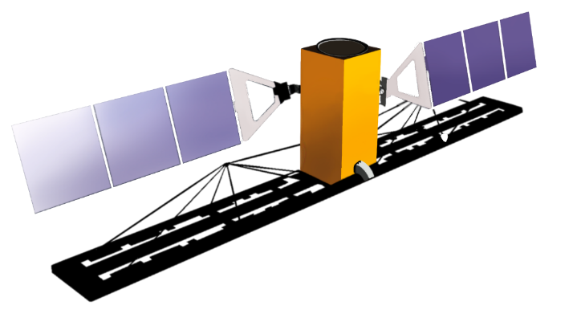
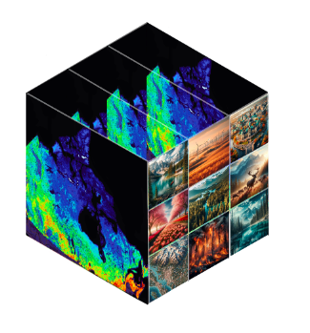
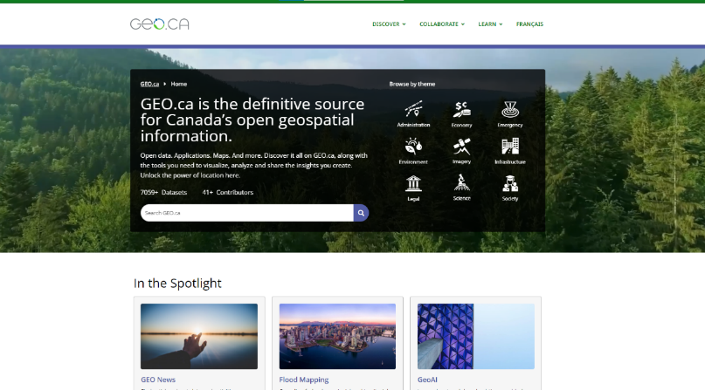
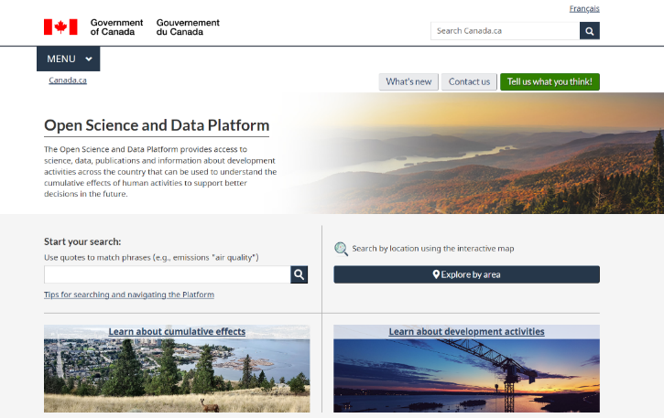
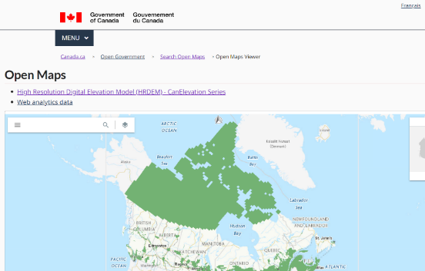
Satellite Imagery
CCMEO Data Dissemination
DataCube
EODMS
Publication & Approval Process
Federated Open Data Search
Catalogues
(GeoNetwork, Spatio-Temporal Asset Catalogue for EO)
CE Data Filtering of GEO.ca
CCMEO Dissemination Tool Kit
(GIS Servers, Web Services, Data Store and File Sharing, External/various sources, flexibility, Dynamic Content)
NRCan
PS
OGDs
Stat Can
ECCC
Standards Based: ISO 19115 for Metadata, OGC APIs
Notes:
To put it simply, data is disseminated onto our main dissemination portal: GEO.ca, and to Canada.ca, the OSDP and other platforms from three main sources: ​
First, CCMEO manages satellites, and scientists collect earth observation data and images. ​
Second, through the Federated Open Data Search project – we have automated the process of linking to provincial and territorial web platforms and integrating their open data into our platforms on a weekly basis. We use AI to automatically translate the metadata and content to support both official languages. ​
Third, We integrate open data from other NRCan sectors and government departments using our own CCMEO Dissemination Tool Kit. ​
From there, it goes into out catalogues, and it’s leveraged by various sites. All of the open data is based on standards so that it can be exchanged across different platforms. ​

Slide 6
Standards we use for publishing geospatial data
06
The TB Directive on Open Government requires open data be released in accessible and reusable formats. All our core platforms help meet this Directive in the geospatial context by adhering to the Standard on Geospatial Data which defines the metadata and data standards to be used for ease of sharing and discovery, in addition to other Standards.
A detailed “data passport” that tells you everything you need to know about a specific dataset or map. Describes geographic information and services (i.e., quality, identification, spatial & temporal details, etc.).
GCGeo (FGP) uses our Harmonized North American Profile (H-NAP): Guidelines to use ISO 19115 for GC geospatial data.
ISO 19115 (International Standard)
OGC APIs (Open Geospatial Consortium)
Modern standards for accessing geospatial data and services online.
OGC WMS (Web Map Service): Provides a way for users to request map images from a server.
OGC API-Records: It is like a “search engine” for finding data, metadata and services for geospatial resources.
STAC (SpatioTemporal Asset Catalogue)
A community-driven standard that provides a consistent way to organize, describe and share satellite imagery, aerial photos and EO data.
CSW (Catalogue Services for the Web)
A “library catalog system” but for geospatial data.
An older standard/system for discovering and retrieving metadata from geospatial catalogs.
Notes:
There are several standards we use for publishing geospatial data to make sure it can be easily accessed, shared, reused, and that it works with other systems, as required by the Treasury Board Directive on Open Government. We also align with the Standard on Geospatial Data which CCMEO developed to ensure consistency and interoperability of geospatial data across the Government of Canada.
The ISO 19115 standard is like a “data passport” that tells you everything you need to know about data that is related to geographic locations like maps or satellite imagery. It includes details on the quality, accuracy, source, geographic area covered, how the data is organized, and how others can access and use the data. H-NAP is CCMEO’s own standard for applying ISO 19115 to the Government of Canada’s geospatial data. All Federal departments distributing geospatial data provide H-NAP metadata via GCGeo. For example, ECCC's GeoNetwork almost exclusively manages H-NAP ISO 19115 metadata, which we then harvest. The provincial and territorial data catalogues that we harvest must first have their dataset descriptions transformed into H-NAP to be compatible with our system and others.
The Open Geospatial Consortium API standards are modern standards for accessing geospatial data and services online. The Web Map Service standard provides a way for users to request map images from a server and the API-Records standard is like a “search engine” for finding data and metadata for geospatial resources.
The SpatioTemporal Asset Catalogue is a community-driven standard that provides a consistent way to organize, describe and share satellite imagery, photos and earth observation data.
Finally, Catalogue Services for the Web is a standard that is like a “library catalog system” but for geospatial data. It helps in discovering and retrieving metadata from geospatial catalogs.

Slide 7
How to publish data to inform analyses using GCGeo
07
Self-Service Dissemination Toolkit
Leverage F/P/T data GEO.ca (Canada.ca) has:
The ability to discover, access, combine and visualize location-based data is enabled through web mapping services. Each dataset in our catalogue has an associated web service. However, geospatial web services are not always easy or intuitive to navigate/understand, especially for new or non-expert users.
Send a request to fgp-pgf@nrcan-rncan.gc.ca
Share your data with us – we will publish a Web Mapping Service
You will be asked to create metadata and publish it on GCGeo/GCGéo.
Any data published on GCGeo is available on GEO.ca, Canada.ca and the OSDP
Use your own or leverage other datasets to create maps, view interactions between layers, inform your analyses, and develop new insights.
Over 3200 datasets from Federal Organizations
Almost 400 NRCan datasets
Over 9,500 P/T datasets (4901 geo, 4900 non-geo)
Notes:
We encourage you to leverage our datasets available on GEO.ca, or to publish your own data. By sending a request to the email on this slide, we can prepare your data for publishing and support you in the process. Any data published through GCGeo will be available on GEO.ca, Canada.ca and the OSDP. You can then use your data or other open federal or provincial datasets to create maps and view interactions between data layers for analysis and insights.

Slide 8
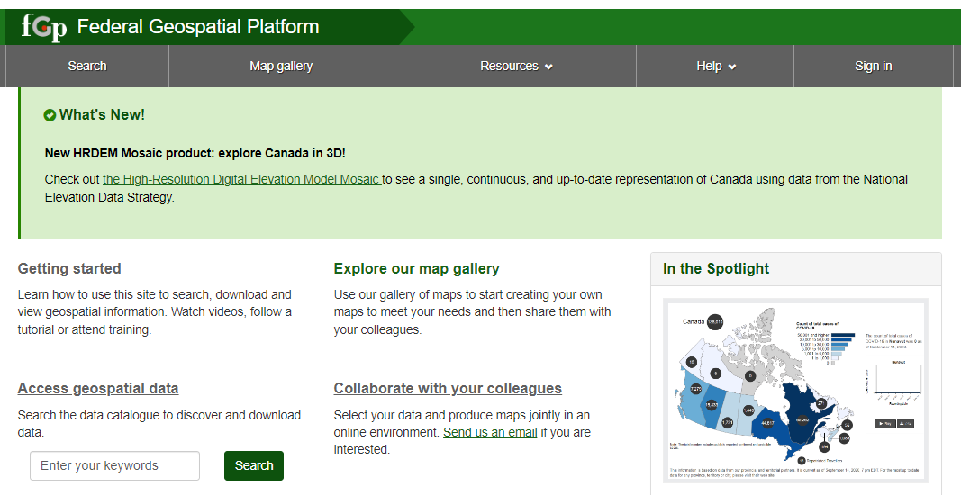
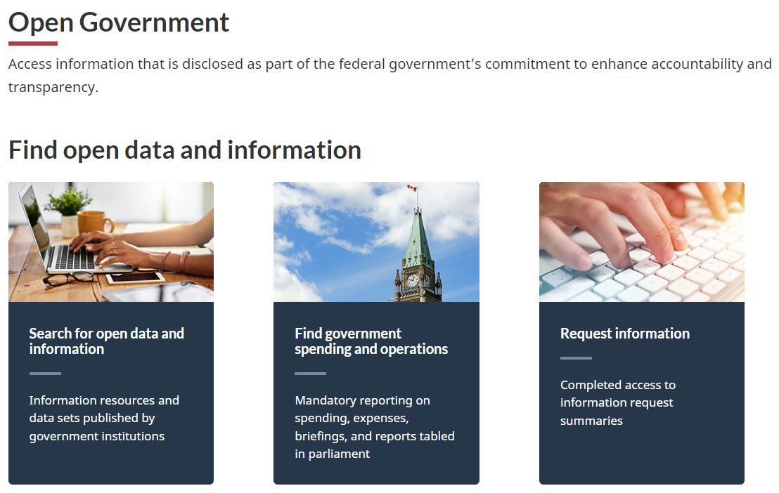
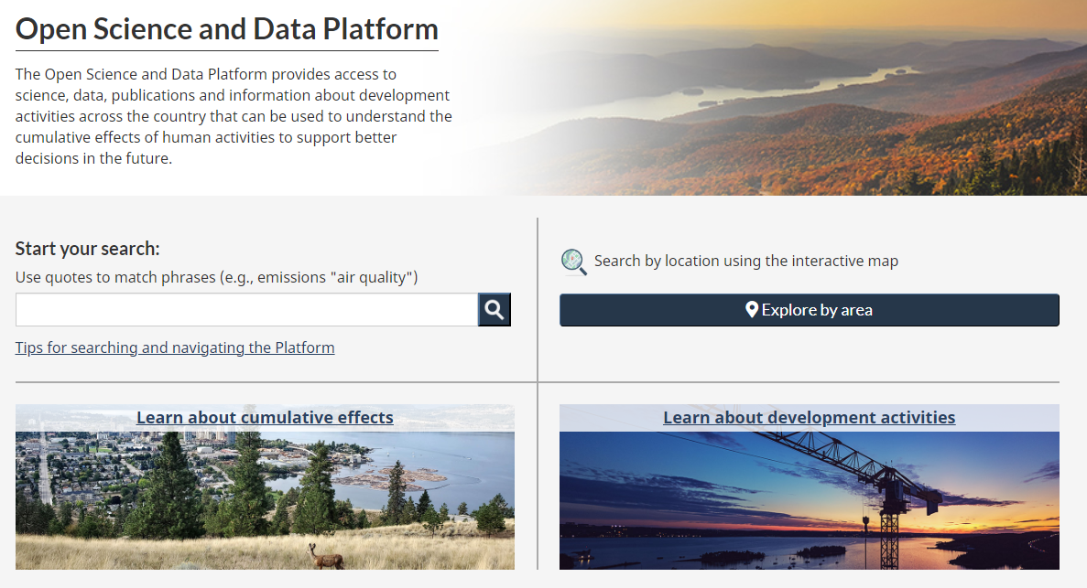
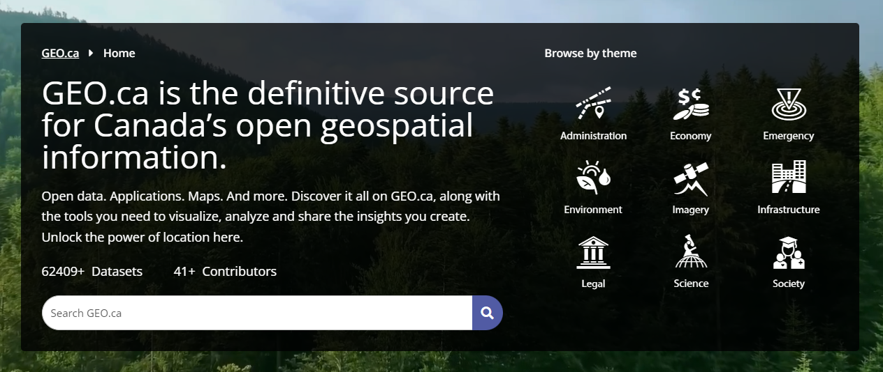
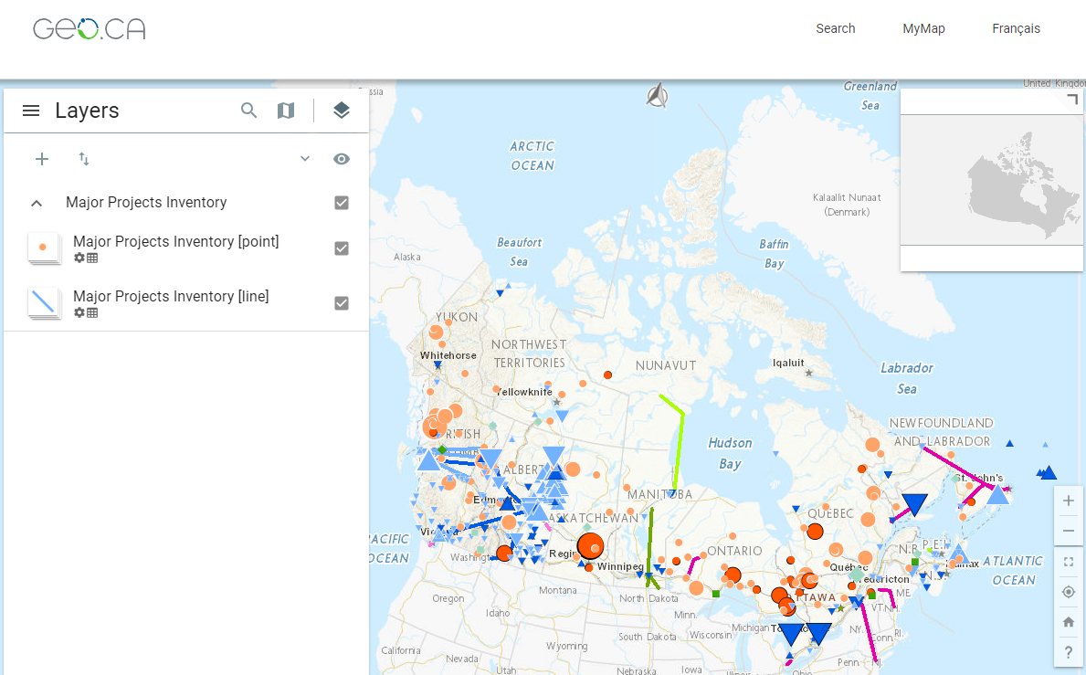
Current publishing process
08
HNAP
metadata
publication
gcgeo.gc.ca
CSW
Contributor
support
Metadata
open.canada.ca
CCRS
CGDI
GeoBase
Harvester
osdp-pdso.canada.ca
Data Dissemination Repository
geo.ca
Server
ArcGIS
DDR
FGDB
ESRI REST
OGC WMS
NRCan
Files
SFTP
Notes:
Our Data Dissemination Repository get set up through tools that run the data through processes that stores copies in ArcGIS Server or the NRCan SFTP.
The contributor space on GCGEO allows partners to contribute their HNAP data which gets harvested to the FGP, Open Canada.ca, OSDP and GEO.ca.

Slide 9
CCMEO Dissemination Toolkit (CDTK)
09
09
GeoDiscovery solution to facilitate Geospatial Data Dissemination for CCMEO
Improvement of current solution (DDR): Standard-oriented, multi-software, external/various sources, flexibility
Deployed in CCMEO IT FRAMEWORK
Output protocols,
data source,
etc.
CDTK
CCRS
CGDI
GeoBase
Dynamic extraction (CZS)
Geospatial APIs
CDTK
OWS
API
GeoView
Near future
MapML
Notes:
The CCMEO Dissemination Toolkit leverages QGIS, pygeoapi, ogc APIs, and OWS. These can be used to dynamically extract (Geospatial APIs) or view the data through GeoView

Slide 10
GEO.ca: Web Content Accessibility Guidelines (WCAG) Implementation
GC Requirements: Standard on Web Accessibility requires web content/pages to meet all five WCAG 2.0 conformance requirements, ensuring content is accessible to a wide range of people who have disabilities and enhancing usability for all users in general.
Assessment: User Interface and User Experience (UI/UX)
Review GEO.ca’s structure, content and features using the newest WCAG checklist:
Perceivable: Content is easy to see (i.e., text alternatives for maps/images; design: colours, contrast, simple layouts, etc.)
Operable: Content is usable by all (i.e., all functionality available via keyboard; navigation cues)
Understandable: Content is easy to understand (i.e., text is readable/clear)
Robust: Compatible with current/future technologies (works across different web browsers and assistive technologies)
Conformance
Assessment
Implementation
Implementation
Implement solutions through coding, content development, design, etc.
Test solutions implemented prior to publishing.
Testing & Reporting
WCAG and UI/UX testing/assessment is ongoing for every release to ensure map components and technologies are designed/developed to comply with requirements. For any issues, we log them on GitHub to be addressed.
GeoView User Testing and Workshops:
Users are recruited to test the UX based on the High-Fidelity Prototypes
Results are analyzed and changes are implemented based on feedback
Testing & Workshops
Notes:
We implement the Web Content Accessibility Guidelines (WCAG) standards by the World Wide Web Consortium to enhance accessibility on GEO.ca. Compliance with WCAG is required as stated in the TBS Standard on Web Accessibility. This process involves three major steps:
First, we assess our user interface and user experience. User interface is like the front door of a house – it’s the look and feel of the site, the buttons, colours, icons and menus – while User experience is like the entire house itself – it is the overall experience users have interacting with the site. We compare GEO.ca’s structure and content to the latest WCAG checklist to make sure content is easy to see, is usable by all, is easy to understand and that the site works across different browsers and systems.
Second, we implement solutions through methods like coding, content development, and design to meet this checklist.
Finally, we test and assess WCAG and User interface and experience for every release to make sure GEO.ca, map components and technologies comply with requirements. We then log any issues on GitHub. We also conduct user testing and workshops for GeoView (our map viewer), and implement changes based on the feedback.

Slide 11
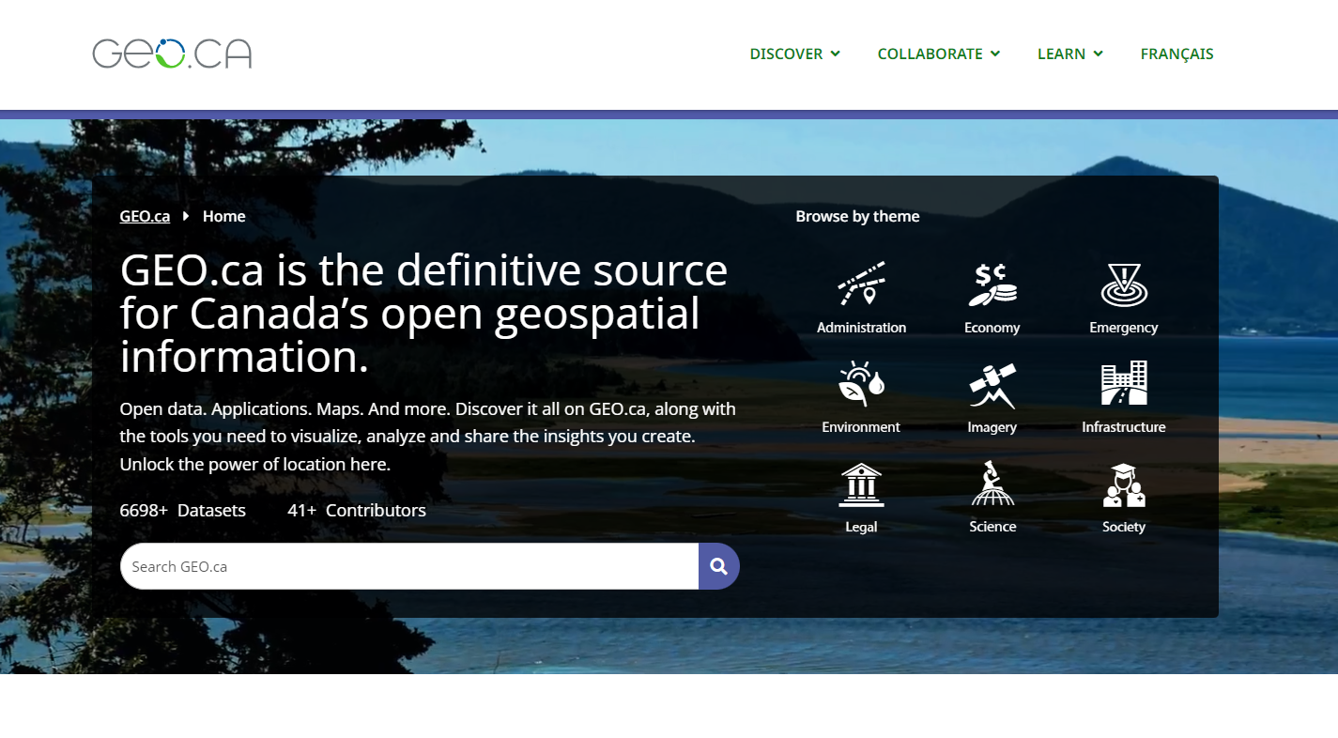
11
UNCLASSIFIED - NON CLASSIFIÉ
GEO.ca is a site for the Canadian public to access, discover and share open geospatial data, applications, maps and other resources. It equips users with the tools to visualize, analyze and share insights created.
Through F/P/T collaboration, GEO.ca: coordinates/curates authoritative geospatial data and content & provides access to leading-edge technology and applications.
41+ Contributors, 7671+ Datasets on past/present features of Canada's land, water, and infrastructure. Over 57,000 Sentinel-1 Records with value-added features for discoverability and display. Data published on GEO.ca is automatically disseminated to TBS Open Data.
Facilitates education, analysis, informed decision-making and policy and program development, to contribute to the economic, social and environmental well-being of Canadians and GC priorities.
The online communities feature enables connection and collaboration with other users to spur interaction and innovation.
Notes:
Now that you hopefully have a better understanding of our current processes and ways to publish geospatial data, we would like to give you some information about our dissemination platform GEO.ca. CCMEO launched GEO.ca in 2021 as a reliable and definitive source for the Canadian public to access, discover and share open geospatial data. This whole of government solution involves collaboration with federal, provincial and territorial stakeholders. GEO.ca has over 41 contributors and a growing catalogue of over 7600 datasets on the past and present features of Canada’s land, water and infrastructure. Recently, we have also added over 57,000 Sentinel 1 records. All data published on GEO.ca is automatically disseminated to TBS Open Data. GEO.ca provides users with ready-to-use interactive map products and also the tools to create their own maps, and visualize, analyze and create insights by layering data.

Slide 12
Why use GEO.ca?
12
Can be leveraged to:
Add value to data and projects by enabling visualization to provide a foundation for informed decision-making and discussion.
Bring individuals and organizations together to share insights and solve issues.
Identify threats, monitor risks, inform resource management, and support emergency planning and informing.
Respond to crises and manage disasters more effectively and with near real time data.
Develop a clear picture of environmental disasters, risks and other emergency data and maps.
Find curated information on disasters, such as: earthquakes, fire seasons, flood maps, and health risks such as flu data.
Adapt to an environment where the public expects timely access to emergency data.
Notes:
GEO.ca adds value to your data and projects by enabling visualization to provide a foundation for informed decision-making, discussion, program and policy development, resource management, disaster response and more. It aims to support the economic, social and environmental well-being of Canadians, in alignment with government priorities.

Slide 13
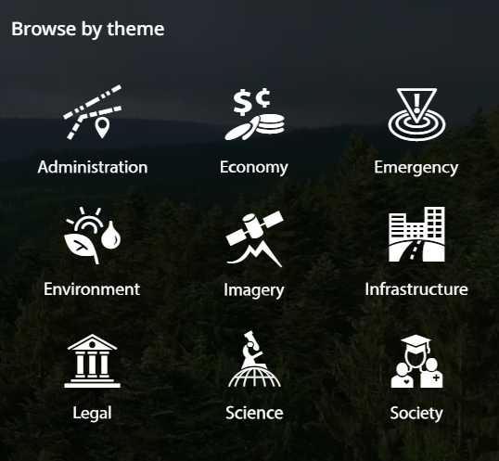
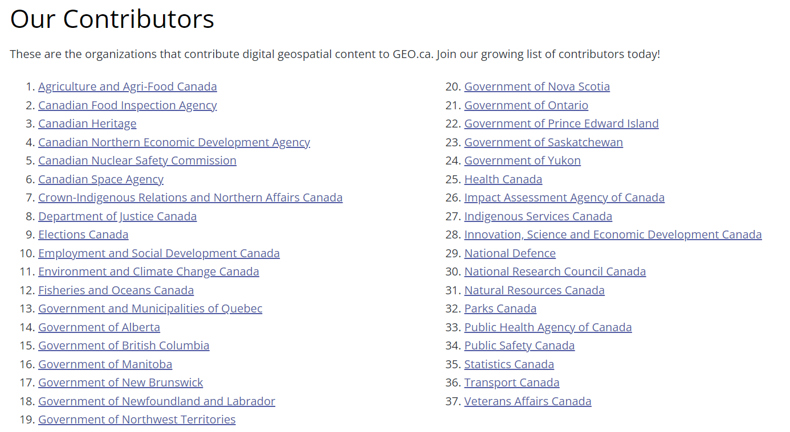
How do I use
UNCLASSIFIED - NON CLASSIFIÉ
13
Find Data
Use the search bar or browse by curated themes or foundation data.
View Data
From the record page, you can view or interact with the data as a map to see the spatial distribution of various data or you can access a detailed metadata record.
I.e., Identify areas with greatest potential for specific critical events
Explore or create your own map!
Explore ready-to-use interactive map products or develop your own.
Combine content to create your own maps to support your specific needs and analysis. Add layers from GEO.ca content or create custom layers by importing your own or another source’s data.
Finish
Export or share your map and findings!
Notes:
GEO.ca is simple to use:
You start off by using the search bar or browsing by our curated themes or foundation data to find content
From the record page you can view or interact with the data as a map to see the spatial distribution of different data or access a detailed metadata record.
You can explore ready-to-use interactive map products or you can also create your own to support your needs by adding layers from GEO.ca content or creating custom layers by importing your own data.
Finally, you can export or share your map to save your findings.

Slide 14
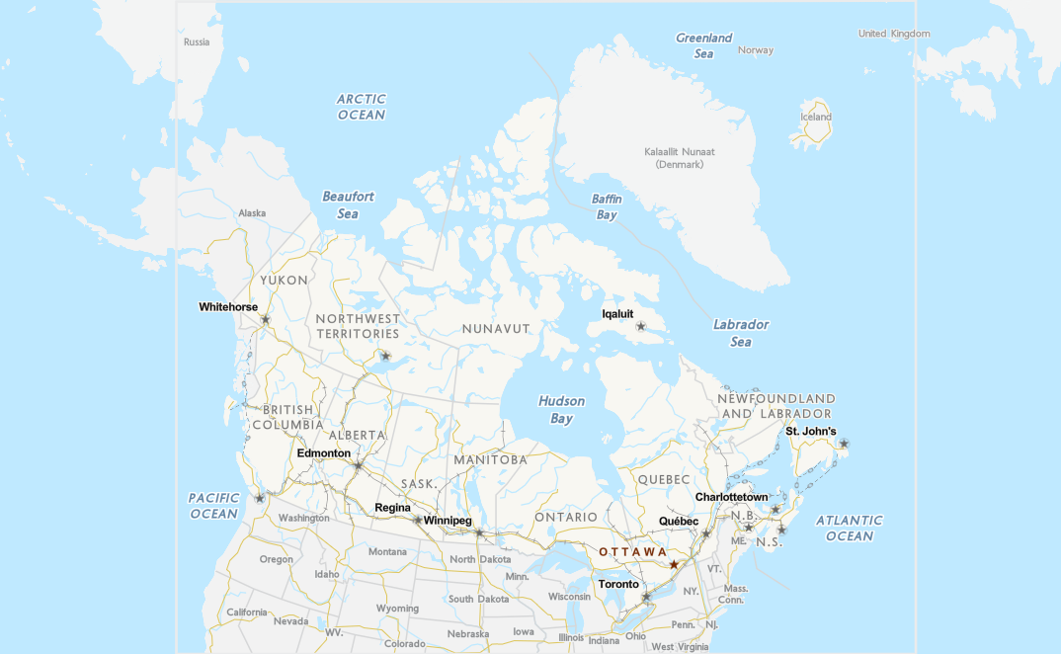
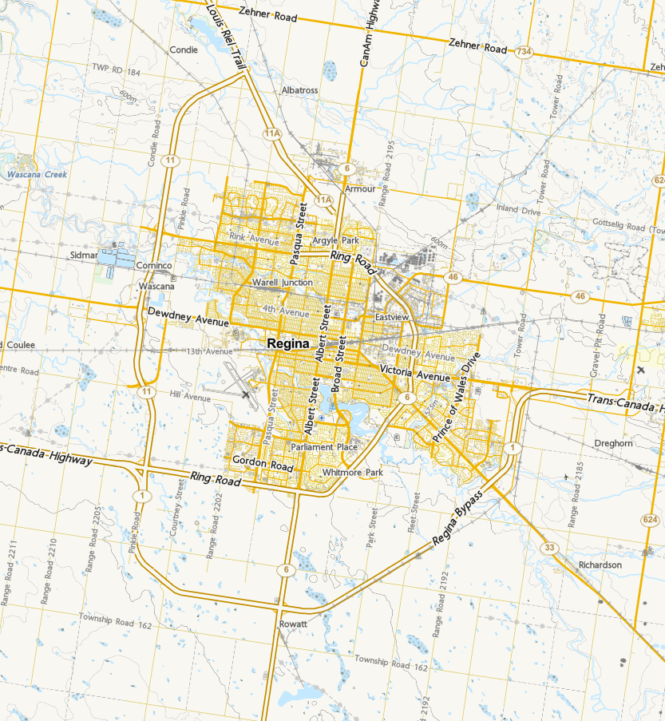
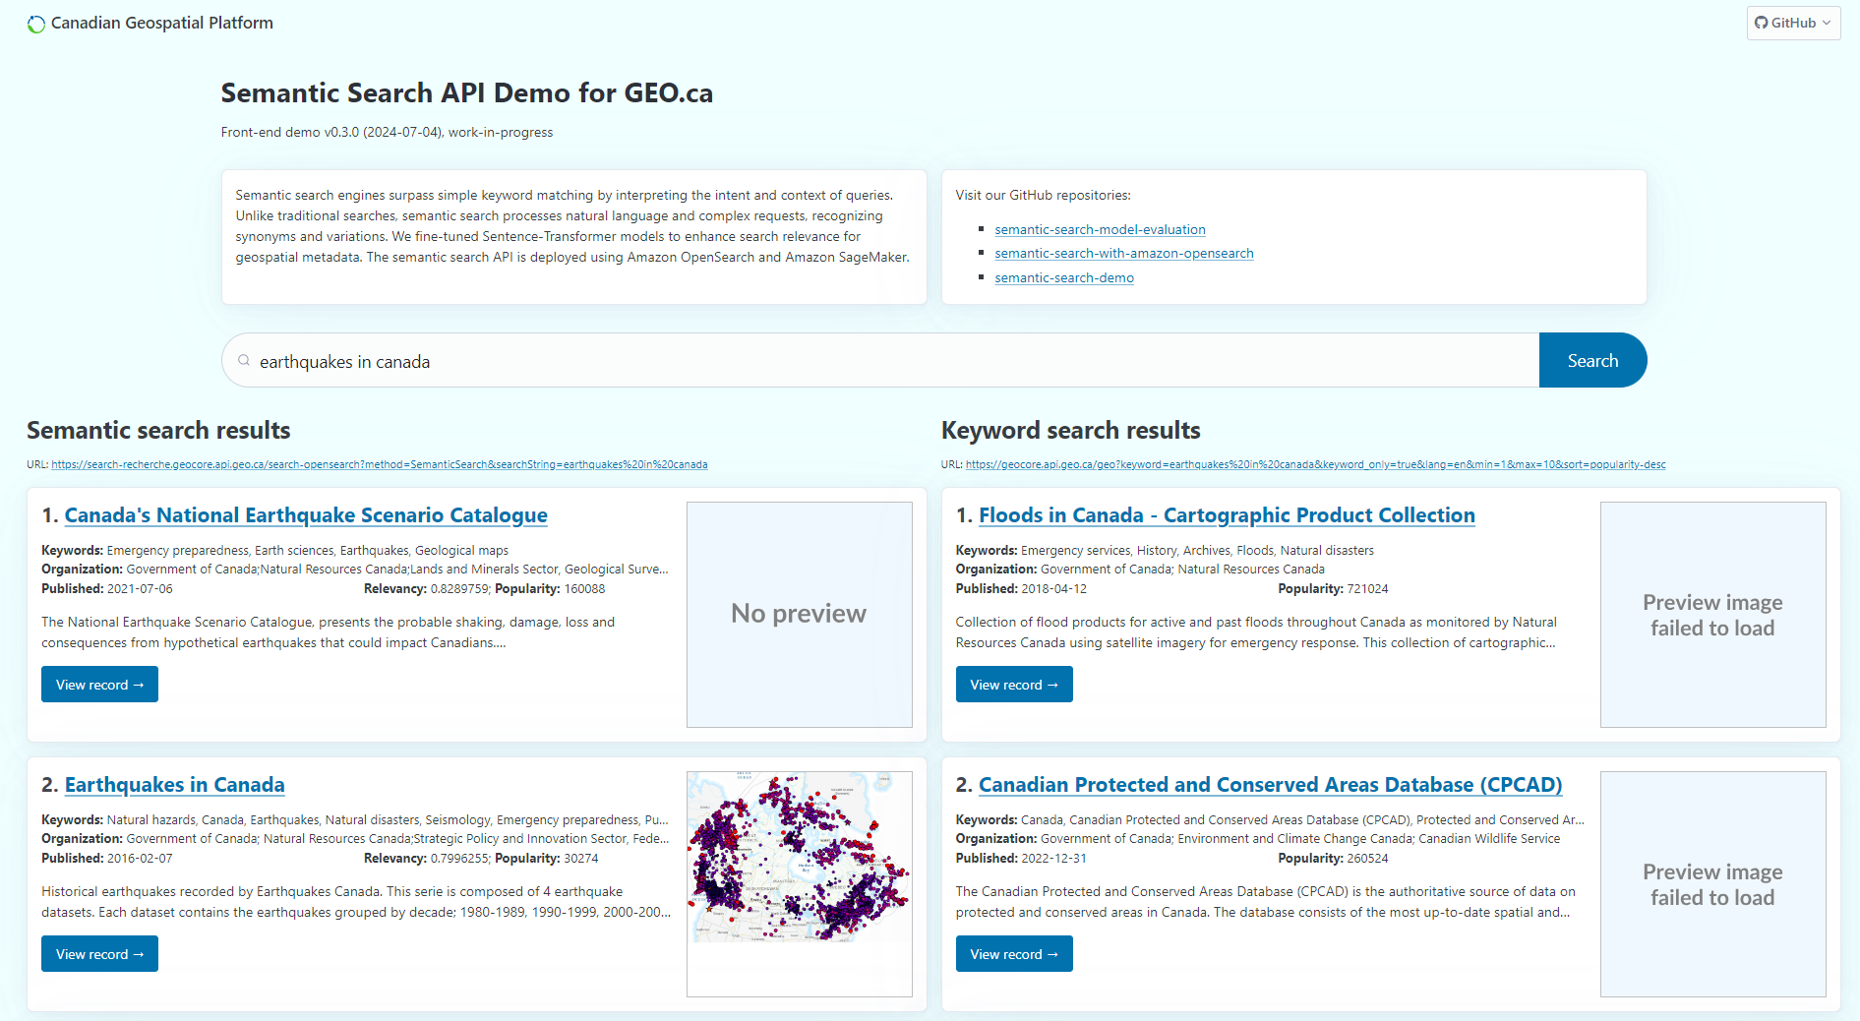
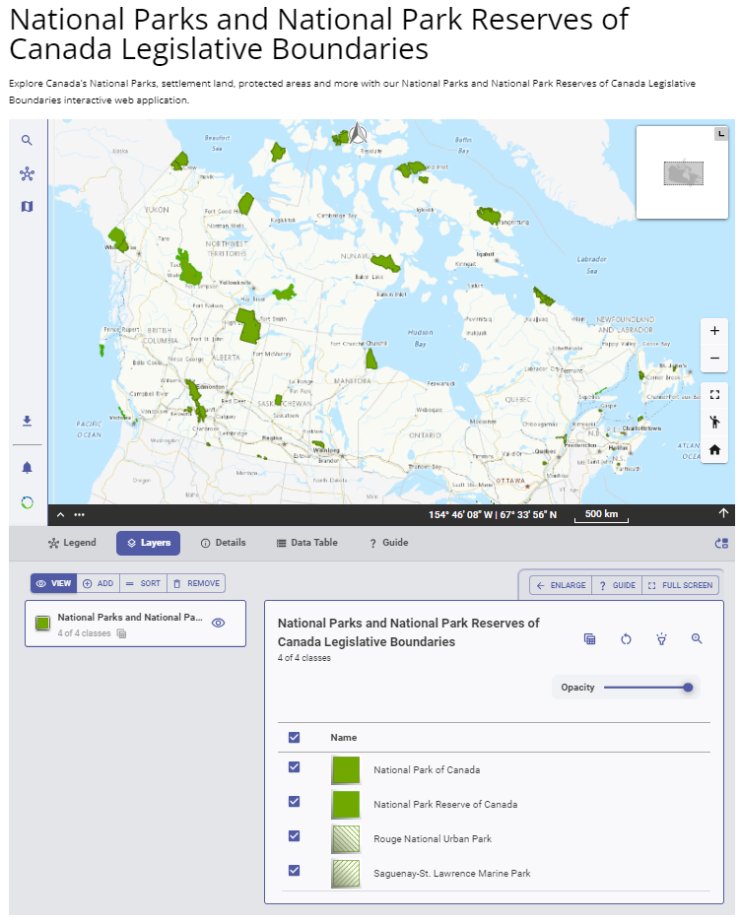
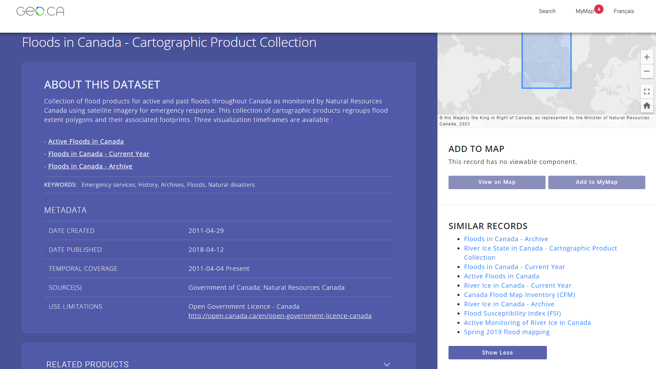
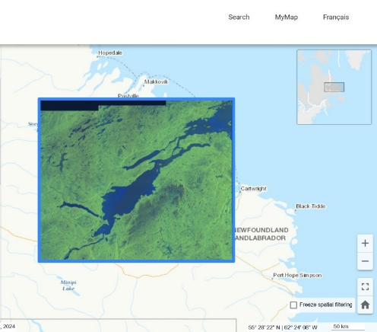
GEO.ca Innovations
Basemap of Canada
Semantic Search Engine
Similarity Engine
EO Data
GeoView
Notes:
We have several innovations and tools that make GEO.ca a great resource.
As mentioned earlier, we develop and maintain the Basemap of Canada. Our new vector tile Basemap will be launched this coming fall.
Version 1 of GeoView has been released on GEO.ca for all the thematic data categories.
Our latest GEO.ca release included the publishing of over 57,000 Sentinel 1 records with value-added features for discoverability and display. Thumbnail previews are also available for EO data. The next Earth Observation series we plan to add is the RadarSat Constellation Mission.
Finally, we have applied AI and Natural language processing machine learning models to create a similarity engine. It analyzes text similarity in metadata records to suggest related datasets and improve exploration of geospatial data. We have also developed the Semantic Search Engine to replace traditional keyword searches. It understands the context and meaning of searches for faster and more precise results. Our semantic search engine will be integrated into GEO.ca in December; however, we have released a demo page that allows users to test it out.

Slide 15
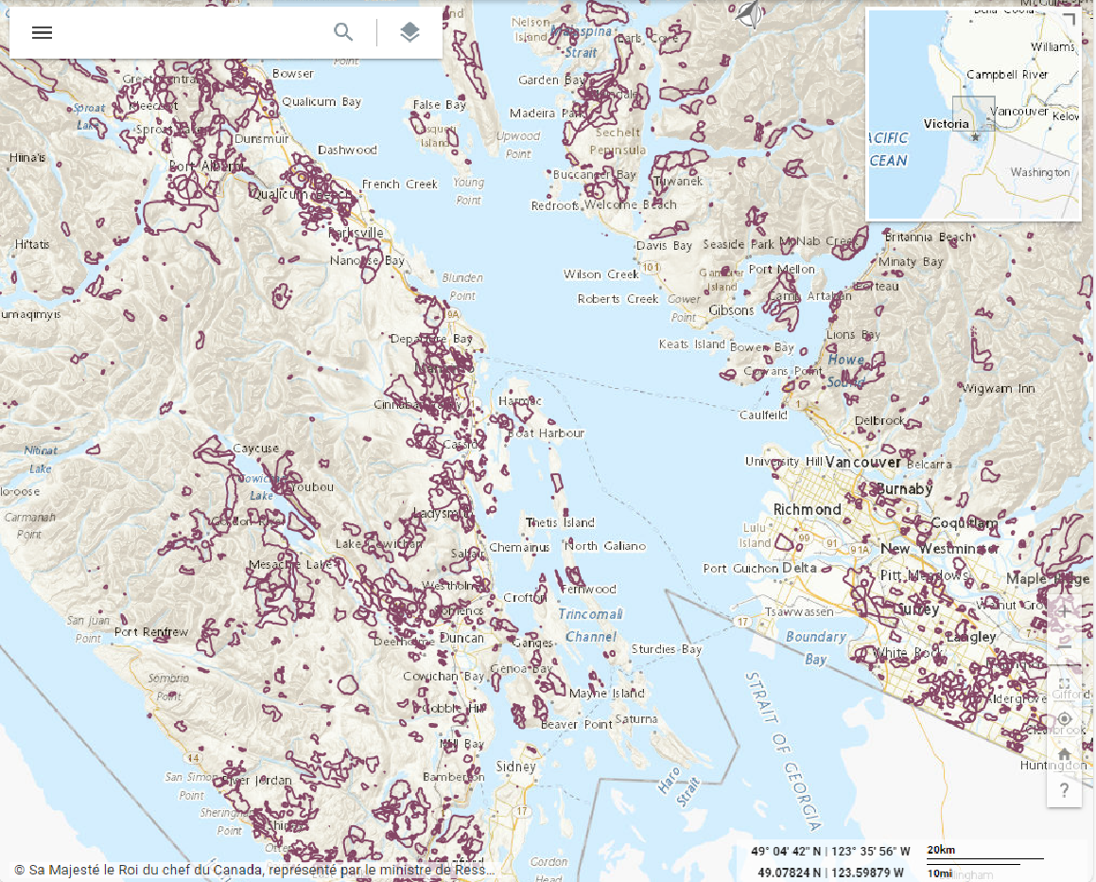
Emergency Datasets on GEO.ca
BC Wildfire Fire Perimeters, British Columbia
16
Since 2016: we have onboarded ~ 89 datasets with 6 contributors, under the theme of Emergency, to GCGeo, making them available on Canada.ca, GEO.ca and the OSDP.
There are many other NRCan and F/P/T datasets available on GEO.ca that are relevant to our emergency theme, such as datasets on air quality, natural disasters, historical data, natural hazards, etc.
Notes:
Since 2016, we onboarded about 89 datasets to GCGeo, making them available on Canada.ca, GEO.ca and the OSDP. There are also vast amounts of NRCan and other federal, provincial and territorial datasets that are available on GEO.ca that are relevant to the Emergency Theme priorities.

Slide 16
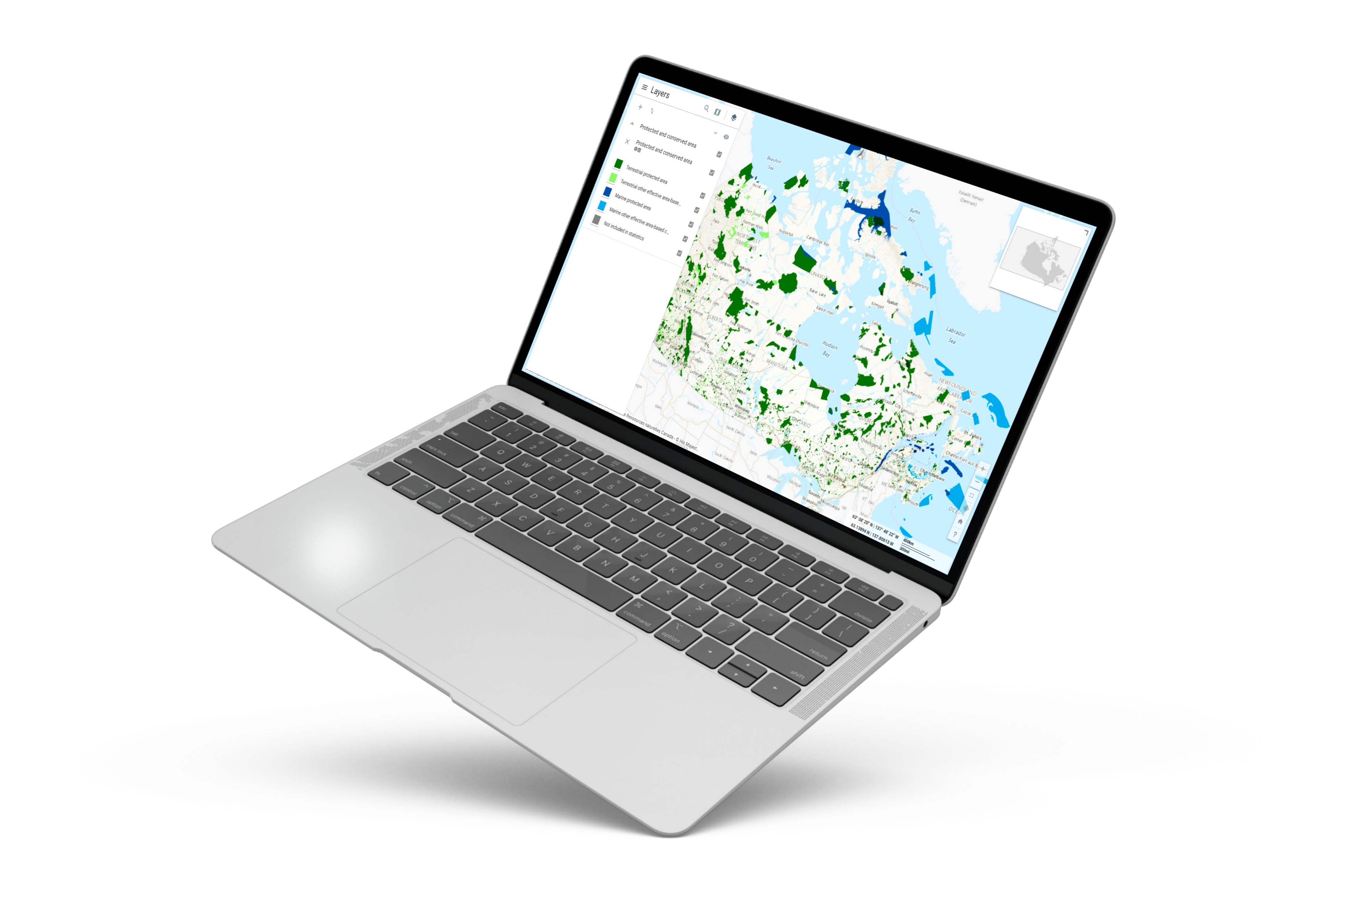
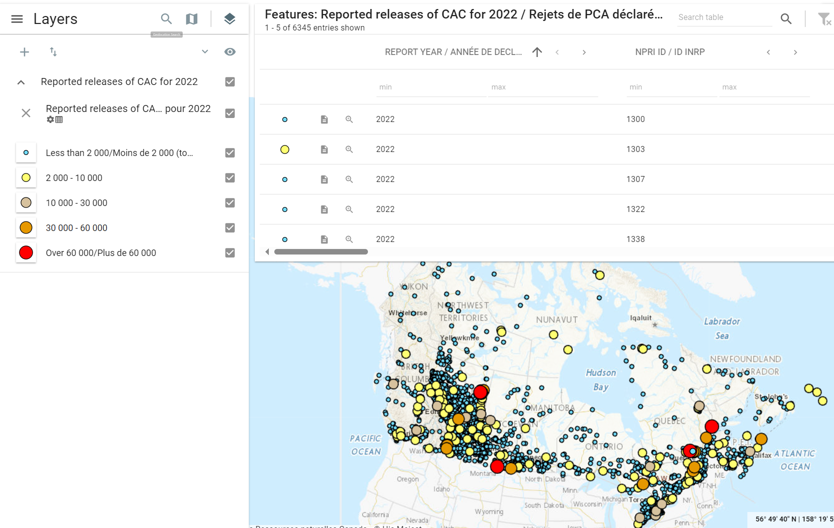
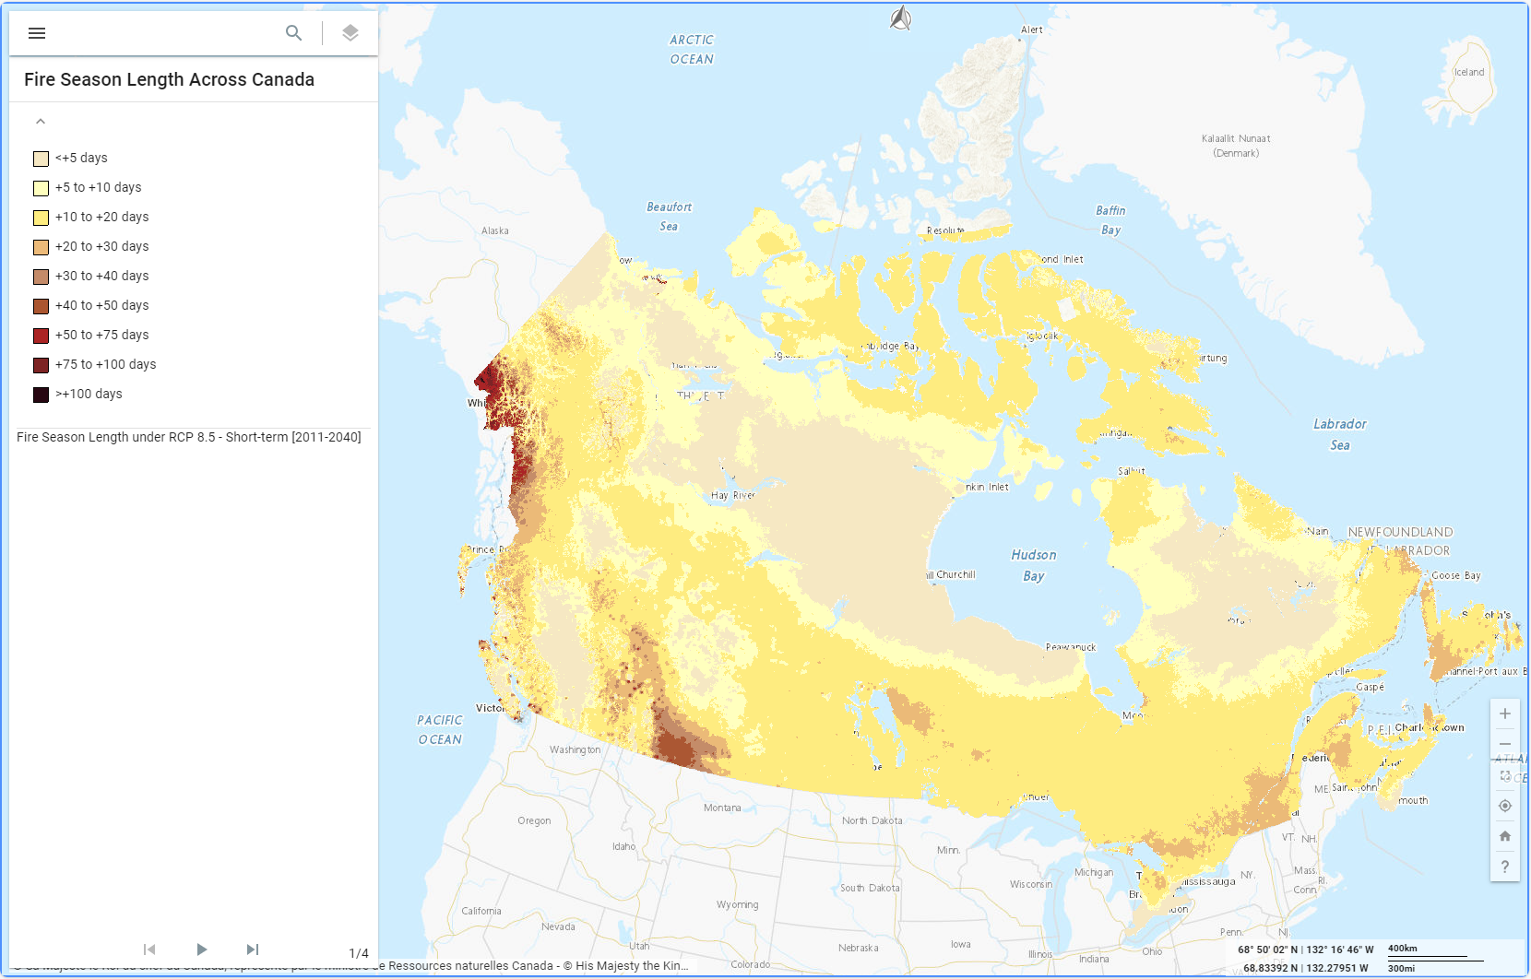
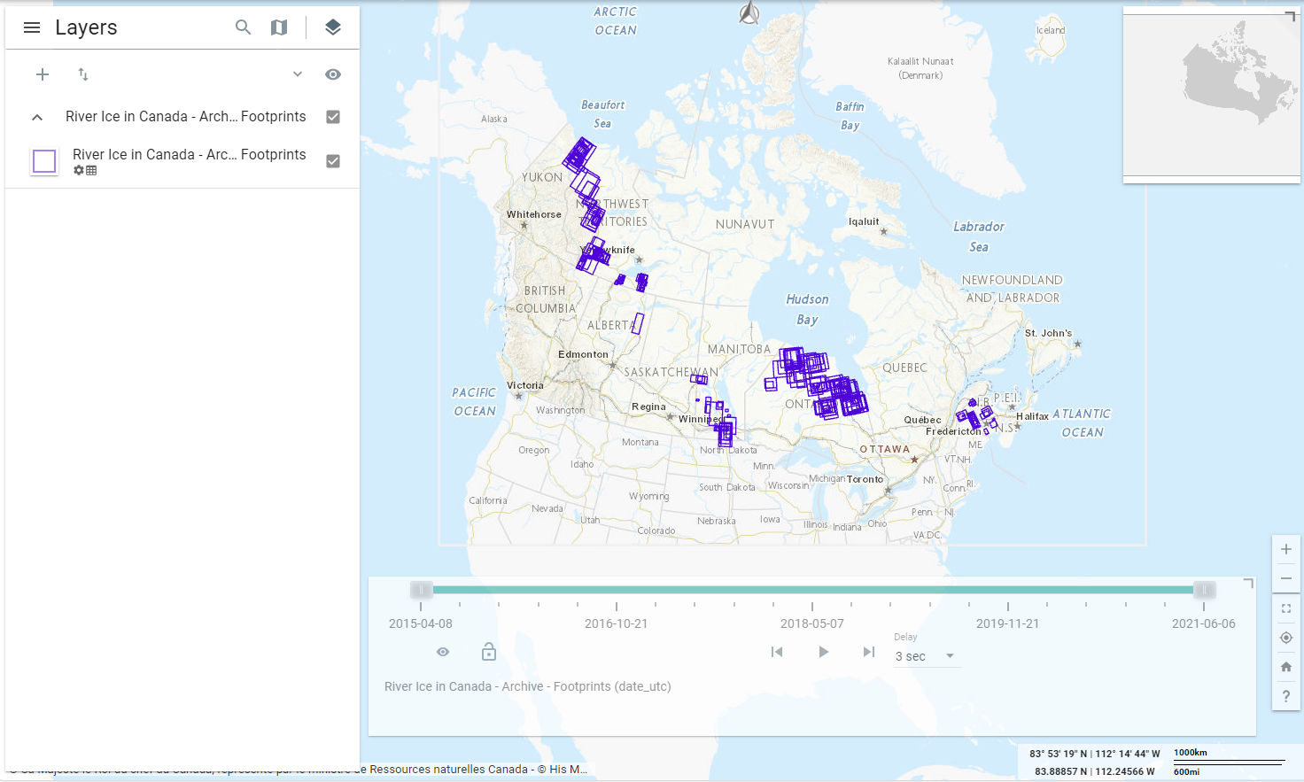
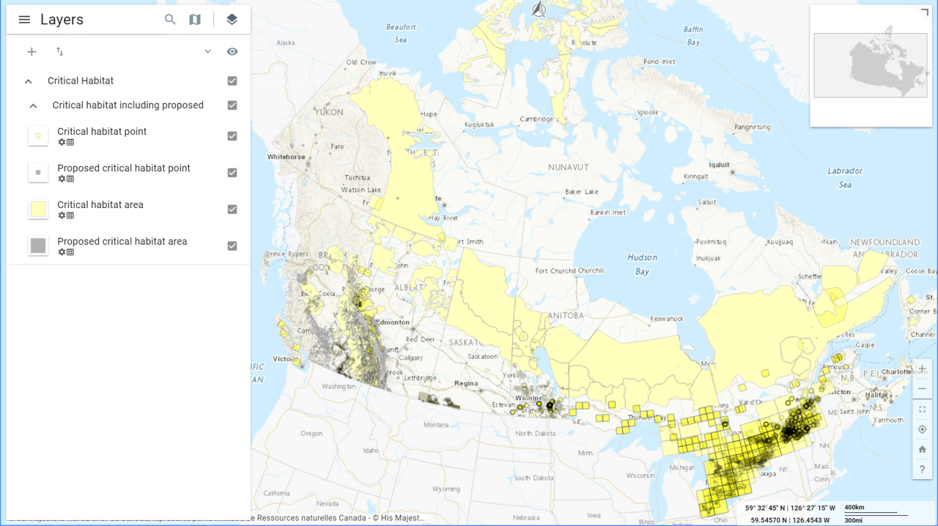
Examples of Viewable Environmental Disasters Datasets on GEO.ca
17
Canadian Protected and Conserved Areas Database (CPCAD), ECCC, Canadian Wildlife Service
Fire Season Length Across Canada, Natural Resources Canada, Federal Geospatial Platform
River Ice in Canada, Natural Resources Canada, Emergency Geomatics Services
Notes:
Here are just a few examples of the many Emergency datasets that are already accessible on GEO.ca for viewing, layering or analysis on our map viewer.

Slide 17
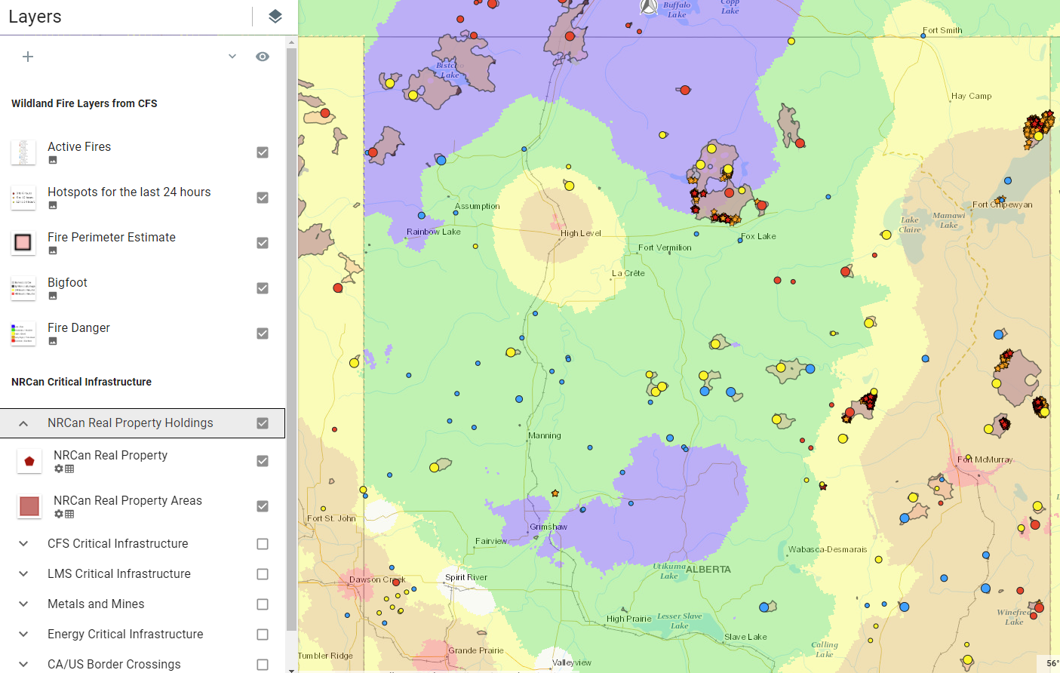
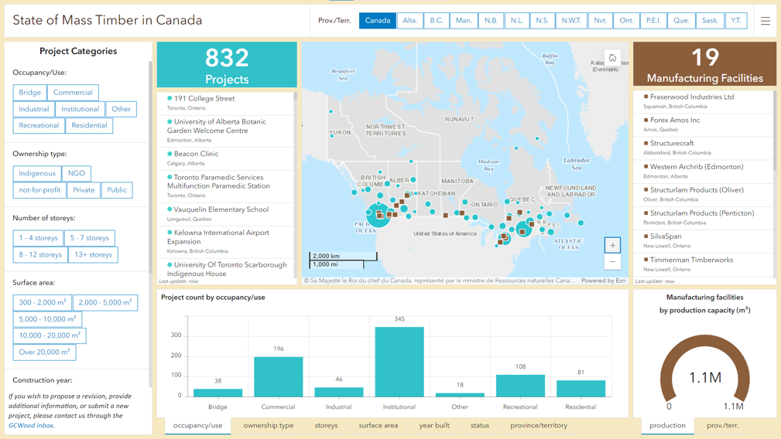
18
Other opportunities for collaboration: How can we support you?
Provide guidance or collaborate on:
Wildfires for DEOC
GeoProducts team delivery in season
Creation of custom mapping products
The mapping workflow
Geospatial software options
Workflows
Map Design
Flood Susceptibility in Canada: Swipe Map Classed from low to high susceptibility on the right (0-100)
Project collaboration
Data Sharing
State of Mass Timber in Canada
Map, Database and Dashboard for Canadian Forest Service, NRCan
Sharing of Basemap of Canada and support on integration in your applications/projects
Sharing of geospatial knowledge
Notes:
Moving forward, there are other ways we can collaborate or support you depending on your needs, the scope and our capacity. For example, depending on resources, we create custom mapping products, designs, dashboards, story maps and more. We also provide support for data sharing and support to integrate the Basemap of Canada into your applications. This slide showcases just a few examples of some of the custom map products we have created.

Slide 18
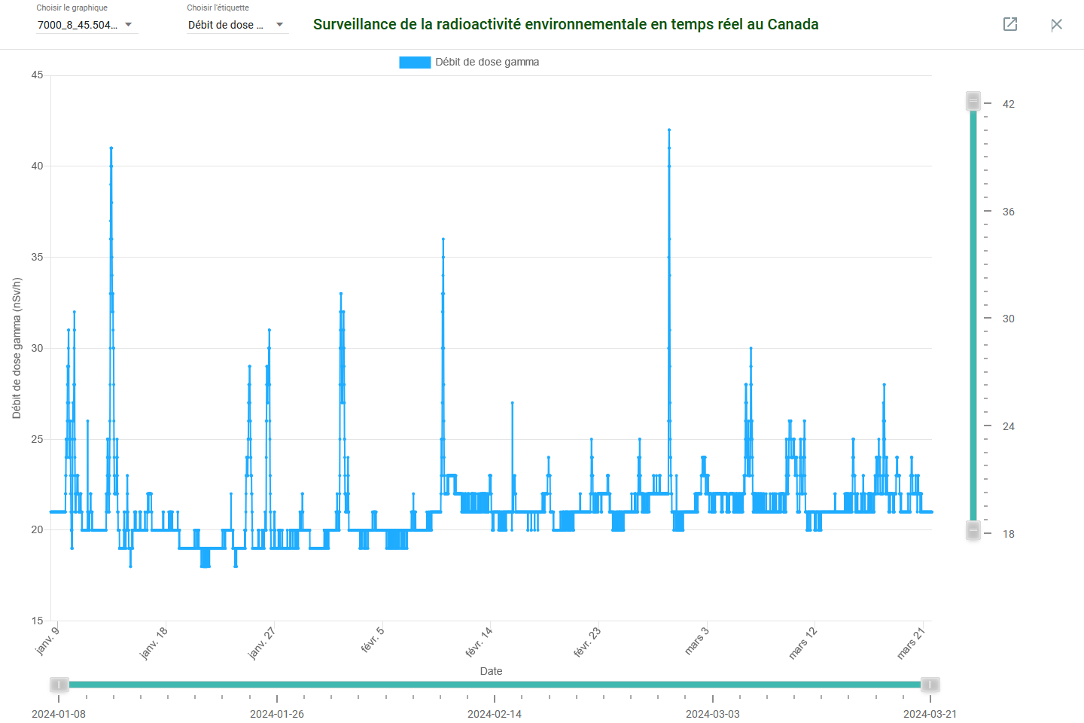
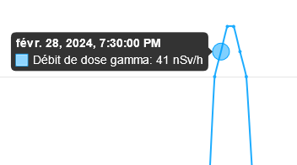
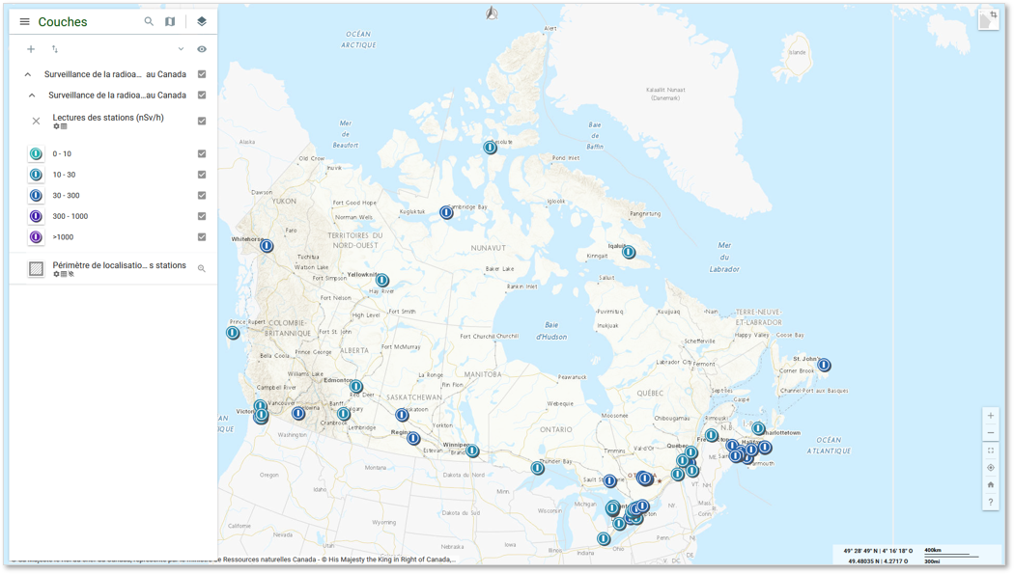
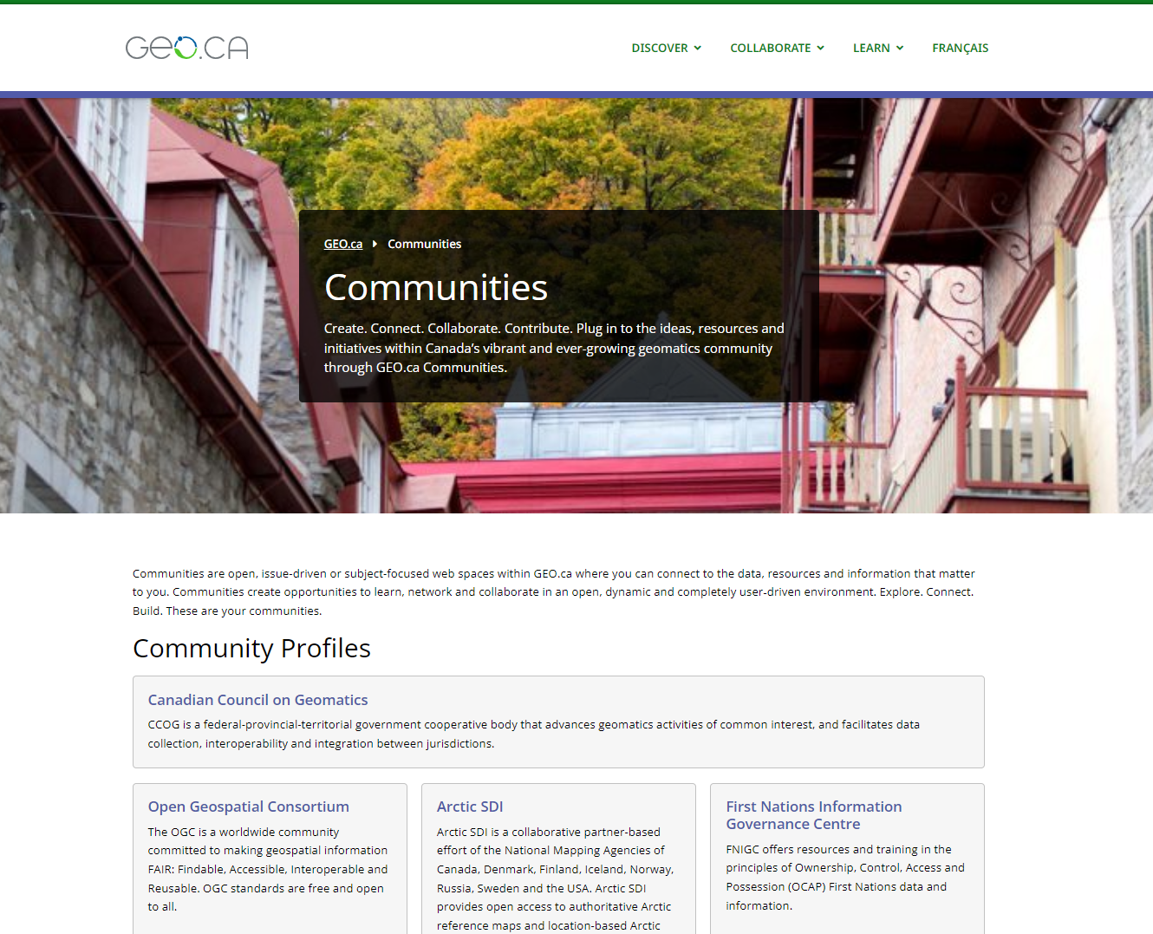
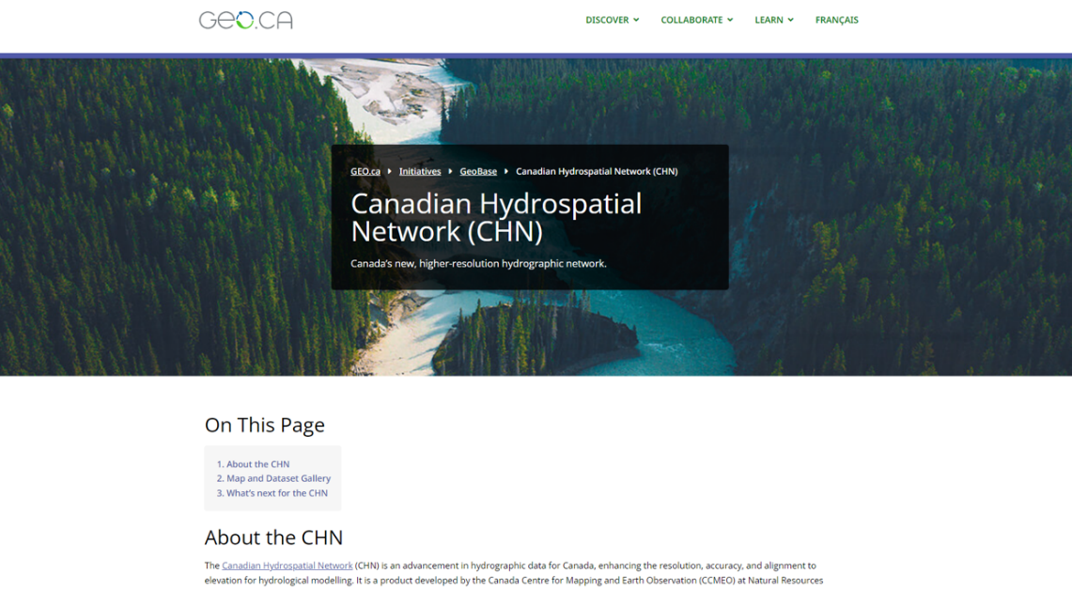
Collaboration Opportunities
19
HC “Real-time Environmental Radioactivity Monitoring Dataset
Real-Time Web Mapping Collaboration with Health Canada
HC collaboration agreement to publish the “Real-time Environmental Radioactivity Monitoring” dataset to GEO.ca, Canada.ca, OSDP.
First near-real-time web mapping service – updates and displays radioactivity measures from sensors across the country every 15 min.
Expanded our capabilities in displaying/visualizing near real-time data.
Exploring opportunities to apply these skills to other data sources that generate data regularly and replicate the near real-time mapping process, in support of NRCan priorities.
90 days
GEO.ca Initiative Pages & Communities
Initiative Pages: Featured geospatial initiatives on GEO.ca:
Communities: Open, issue/subject-focused web spaces in GEO.ca where you can connect to data, resources and information – to spur interaction and innovation.
Increase exposure of your work by reaching a broader audience
Enhanced visibility: Provide direct links to your key pages, promoted through social media
Align with GC priorities: Open data/government
Advanced visualization: GeoView and Basemap of Canada
Authoritativeness of GEO.ca
GEO.ca Initiative Pages & Communities
Spotlighted on GEO.ca’s Homepage
Notes:
This slide demonstrates a couple of other potential ways we collaborate with others.
Recently, we entered into an agreement with Health Canada to publish their “Real-time Environmental Radioactivity monitoring” Dataset onto GEO.ca, Canada.ca and the OSDP. It is the first near real-time web mapping service and it updates and displays radioactivity measures from sensors across the country every 15 minutes. We are looking to explore opportunities to leverage the skills we gained in displaying and visualizing near-real-time data by connecting with other data sources that generate data regularly.
We also have initiative pages and a communities section on GEO.ca.
Initiative pages highlight specific geospatial projects/initiatives, featuring information, datasets, custom maps, links and more.
Communities are open web spaces on GEO.ca, managed by a group, and focused on specific subjects to access data resources and information.
These opportunities can increase the exposure and visibility of your work, allow you to benefit from our enhanced visualization tools and innovations, and to leverage the credibility of GEO.ca, which hosts authoritative F/P/T data.

Slide 19
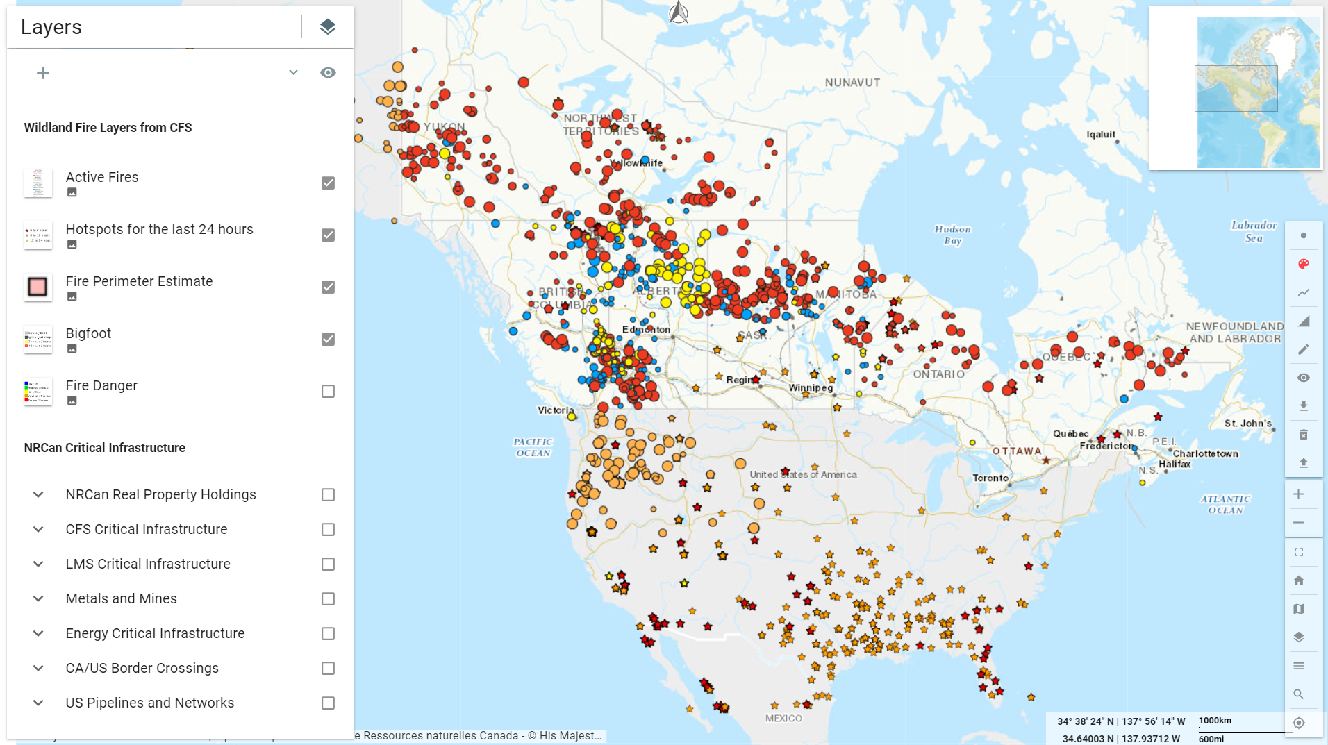
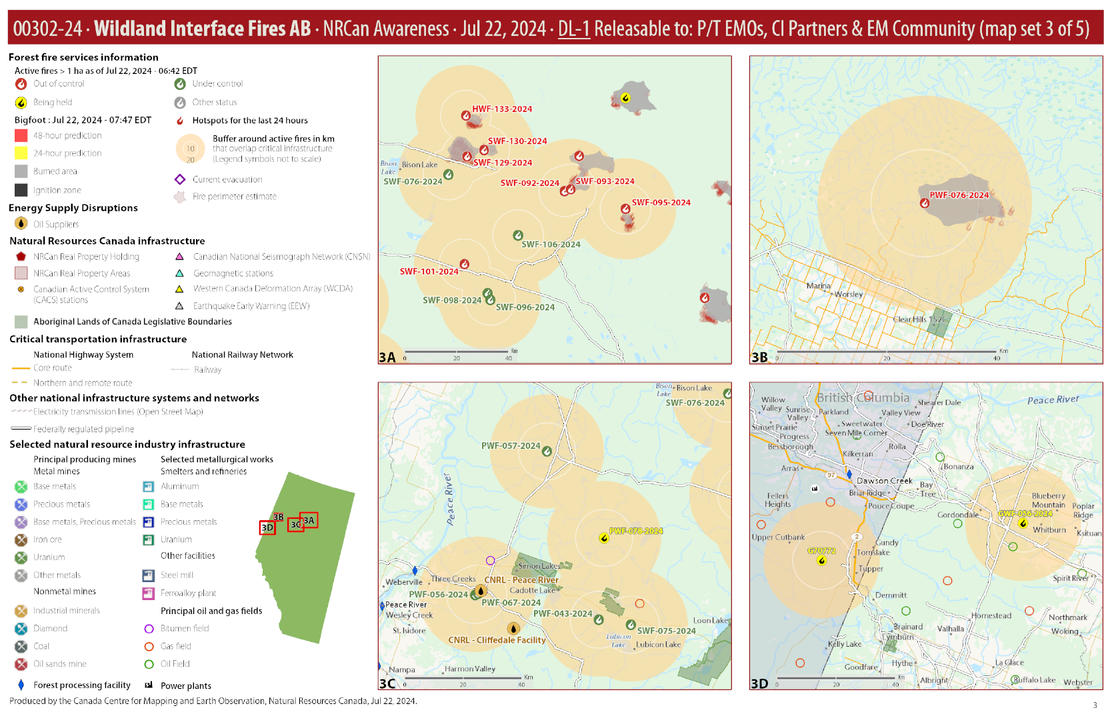
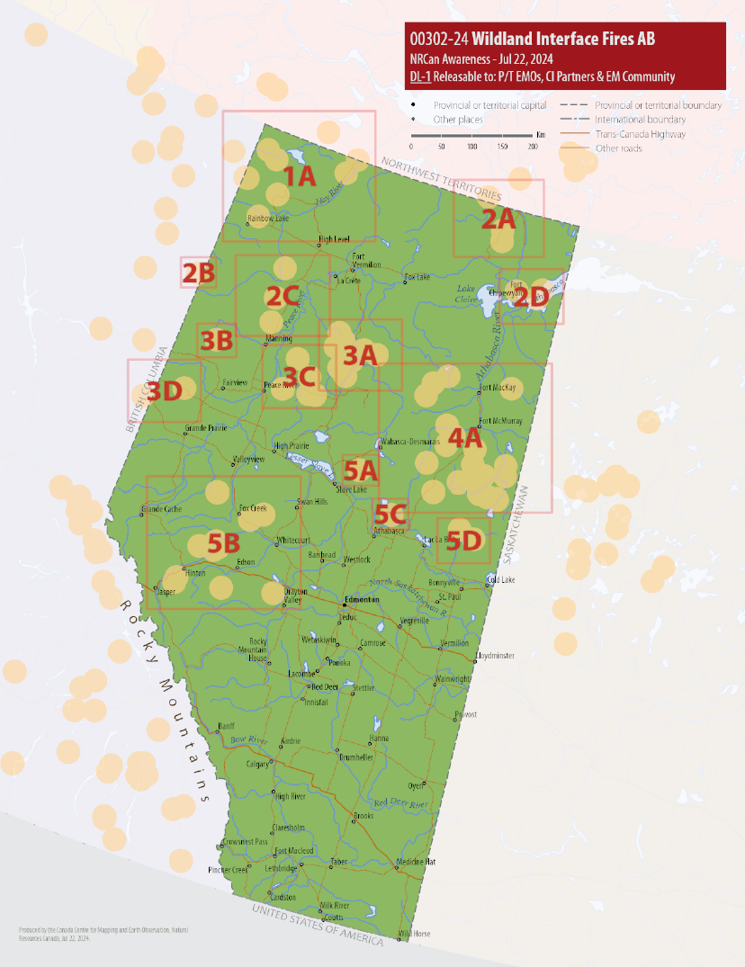
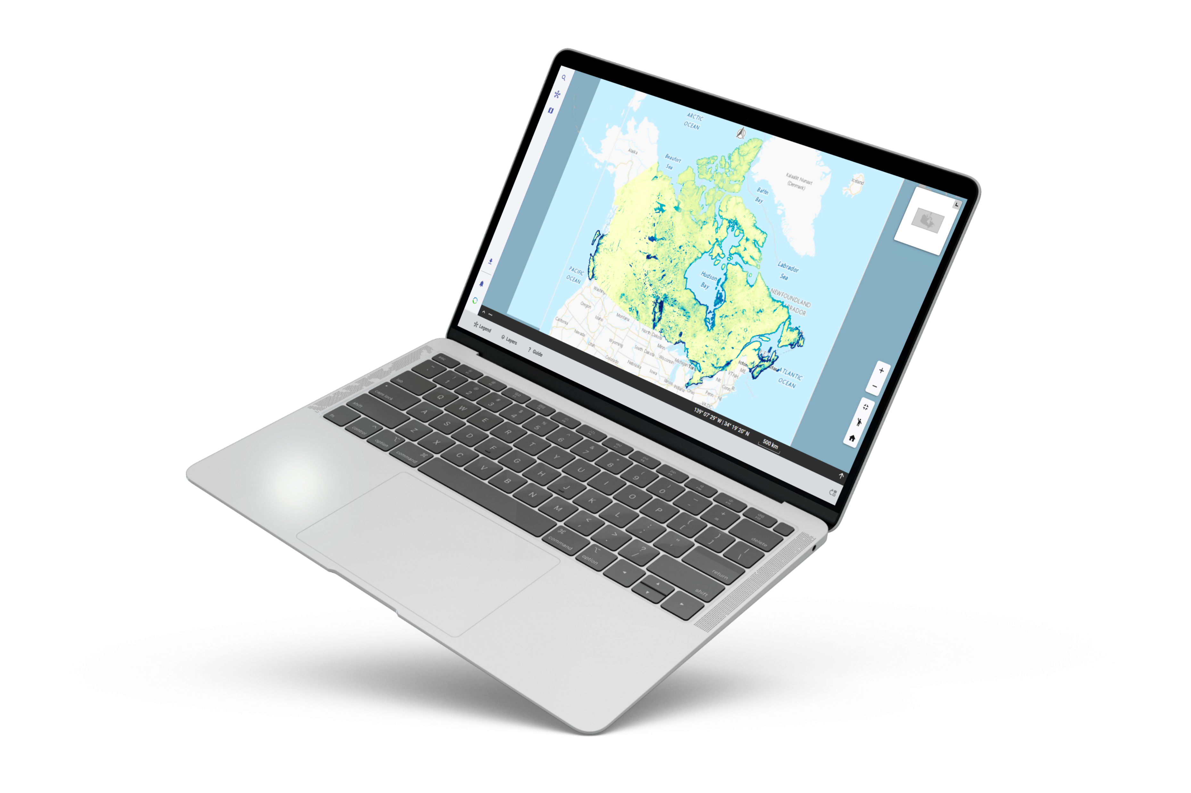
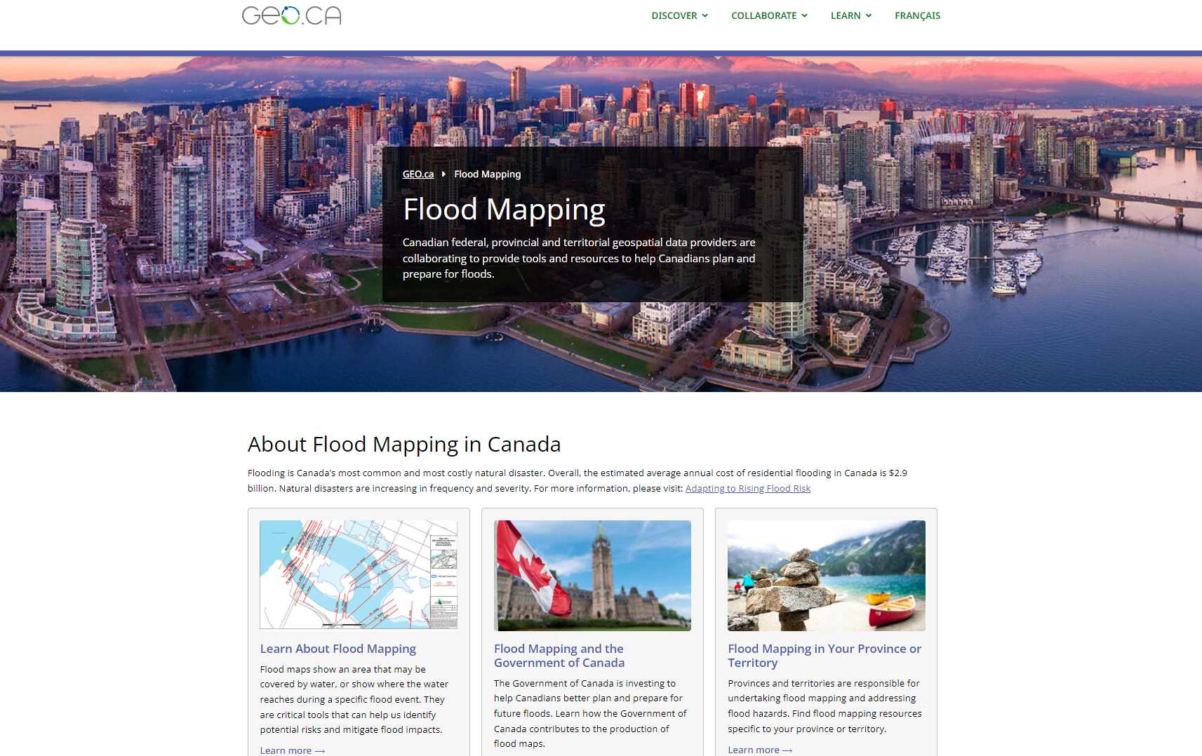
GeoDiscovery: Emergency Geomatics Management, Products & Services
In collaboration with other CCMEO divisions, NRCan sectors and GC Depts., we support various emergency management and response activities.
Data integration
Our Data Integration Team leads geospatial data onboarding and infrastructure in support of key priorities and programs (i.e., EGS, FHIMP, etc.).
Data Dissemination
In collaboration with CCMEO’s GeoBase division, our Online Application Technologies (OAT) and Content & Engagement Teams develop, design and maintain FHIMP’s web presence & content on GEO.ca and disseminate FHIMP datasets.
The OAT Team delivers geospatial applications/technology to support CCMEO’s platforms and initiatives such as FHIMP and EGS (see our new visualization tool GeoView on the right displaying the Flood Susceptibility Index Map).
On-Demand Custom Value-Added Natural Hazard Mapping Products/Services
The GeoProducts Team supports DEOC, CCRS/EGS and others, by developing custom natural hazard risk mapping products (i.e., wildfires, floods, etc.). This analyzed-ready data supports NRCan, GoC departments., emergency responders, critical infrastructure partners and the public. Our expertise in GIS, geomatics and cartography enable the production of reliable near real-time situational awareness maps, with detailed views of high-risk areas and of NRCan’s critical infrastructure and assets. Products include static & interactive maps (i.e., PDF map books, geospatial info for map viewers/analysis tools, etc.). GeoProducts won a SPI Sector Merit Award for our work during Canada’s record-breaking wildfire season in 2023.
GeoProducts develops/maintains the Basemap of Canada – the critical foundational layer for location context, it is essential for the visualization and analysis of any emergency/hazard map. Our Basemap is very popular, with over 1.4M visitors per month. Our renewed OSM-Integrated Vector Tile Basemap will be launched this fall for others to integrate into their applications/processes. It has improved data currency, performance, quality, etc. and supports official languages and place names, Indigenous place names and authoritative administrative boundaries.
Notes:
GeoProducts team produces wildfire maps and develops the basemap of Canada.
Data integration team leads geospatial onboarding and infrastructure in support of key priorities and programs, ie EGS and FHIMP.
Our Online Application and Technologies team and Content and Engagement Teams develop design and maintain FHIMPs web presence and content on GEO.ca
Ithe OAT team also delivers geospatial applications/technology to support CCMEO’s platforms and initiatives such as FHIMP and EGS.

Slide 20
Scope of our Services
UNCLASSIFIED - NON CLASSIFIÉ
20
Our Capabilities: Potential Areas for Engagement & Support
Access open data and disseminate/publish through a standardized publishing environment
Synchronize data from departments and link to/publish metadata
Provide support in data dissemination and visualization tools
Develop curated client-focused products and services
Provide access to web services, maps and apps
Share best practices
Leverage interoperable standards
Constraints
Developing new technologies from scratch
Human resource availability
Financial resources and budget
Time (duration) of projects
Notes:
To summarize, GeoDiscovery’s capabilities and potential areas for engagement include assessing and disseminating open data through a standardized publishing environment, synchronizing data from departments and publishing metadata, providing support through our dissemination and visualization tools, developing curated mapping products, providing access to web services, maps and applications and sharing best practices. Some of our constraints include human resource availability, financial resources and budget, and the length of projects.

Slide 21
Conclusion CCMEO: Innovative Geospatial Solutions
21
CCMEO leverages domestic & international, public & private collaboration across sectors to advance Earth Observation, Spatial Data Infrastructures, and geospatial data development activities.
Our products address policy priorities, such as climate change, disaster preparedness, emergency response, management of natural resources, etc.
They are disseminated as open data through ready-to-use platforms like GEO.ca, Canada.ca, the OSDP and Arctic SDI.
Innovative efforts include:
Custom APIs, map viewers, plug-ins, AI/ML search engines.
AI Data Pipeline to automate extraction and mapping of key features – e.g., roads, forests, buildings, water - generating products and analysis-ready data such as the GeoAI GeoBase Data Series.
Advancing innovative regional flood modelling techniques.
CCMEO contributes to Indigenous reconciliation efforts:
CCMEO-created interactive maps and public exhibits to share Indigenous knowledge and cultures.
Appointments of Indigenous advisors to the Geographical Names Board of Canada.
Basemaps that support both Official Languages, Indigenous languages, and official place names.
Publication of a best practices handbook to help Indigenous communities repatriate their own place names.
Notes:
To conclude, CCMEO advances earth observation and geospatial data to address important Government and NRCan priorities like the management of natural resources, emergency response and climate change. We disseminate this data through our ready-to-use platforms like GEO.ca. We also contribute towards Indigenous reconciliation through initiatives like publishing a best practices handbook to support Indigenous communities in repatriating their open place names and supporting Indigenous place names in the Basemap of Canada.
We would love to open the floor now to gather more information about your needs, any questions you may have or to explore any of the opportunities we presented. Thank you!

Slide 22
© His Majesty the King in Right of Canada, as represented by the Minister of Natural Resources, 2022
Thank you!

Slide 23
23
ANNEX

Slide 24
24
Our Role in Open Government
GEO.ca
Federated Open Data Search
GEO.ca launches in Fall 2022, a result of 7 years of F/P/T collaborative effort, to enable geospatial data accessibility and discoverability via a single platform.
TBS Open Maps
Federated Open Data Search continues with a commitment under Canada’s 5th National Action Plan.
Open Maps is launched with hundreds of authoritative geospatial data.
2013
2018
2021
2023
Open Government
Expanded Data Scope
Open Science and Data Platform (OSDP)
Federated Search Completed
GC initiates commitment to Open Government and Open Data to enhance accountability, transparency and data sharing, and to avoid duplication, and support innovation.
2017
Scope expands to integrate open P/T data, leading to beginning of Federated Search Project.
CCMEO contributes to Canada’s 4th National Action Plan on Open Government by assessing quality of hundreds of geospatial datasets on Open Maps.
2020
2022
The OSDP launches March 2021, to provide access to science, data, publications and information about development activities across Canada to understand cumulative effects of human activities on projects.
The Federated Open Data Search is completed - enabling access to open geospatial data from all F/P/Ts in a centralized location.
Ongoing data additions to Canada.ca, GEO.ca and OSDP.
Notes:
CCMEO was an early adopter of Open Data and has contributed to Canada’s National Action Plans on Open Government. For example, in 2017 and 2018 we were able to assess and contribute hundreds of authoritative and high-quality geospatial data to the newly launched TBS Open maps on Canada.ca and this year we completed the Federated Open Data Search – this project enables access to all open provincial and territorial geospatial data in unified hubs - Canada.ca, OSDP and GEO.ca. We have also launched or supported other data dissemination platforms such as GEO.ca and the Open Science and Data Platform.

Slide 25
The Open Science and Data Platform
25
Co-led by NRCan and ECCC, the OSDP facilitates access to information to increase understanding of cumulative effects and support better decision-making.
More than 150,000 cumulative effects-relevant records from 29 government providers (17 F; 10 P; 2 T).
Themes: water, air, land, biodiversity, climate, human health, society & culture, economy & industry.
Scientific publications, geospatial datasets, monitoring station data, development activities via regulatory registries, content collections in regions of interest.
Search by keyword or region of interest; advanced search filters (i.e., date, provider).
Features interactive maps, datasets, and thematic curated searches.

Slide 26
CCMEO Data Dissemination Portals
26
GEO.ca
Canada.ca
GEO.ca
Atlas of Canada
Canada.ca
Audience: Geo-specialists and experts
Audience: Canadian general public, learners, educators
Audience: General Public
Vision: Open data, applications, maps, and more. Discover it all on GEO.ca, along with the tools you need to visualize, analyze and share the insights you create. Unlock the power of location here.
Vision: A modern and innovative suite of geographic products telling the stories of Canada, accessible to all Canadians.
“Discover Canada through geography”
Description: Provides information on CCMEO programs & services using Canada.ca architecture, explains link b/w CCMEO activities and NRCan priorities. Links to Atlas, GEO.ca, provides access to content, maps, reports, publications, etc.
Content: The Data and Science
Content: The Maps
Content: The Overview
Metadata catalogue (metadata publication process).
Initiatives and topics of benefit and/or interest to CCOG.
Data and science information and innovations (technical and scientific).
Interactive maps that do not fall under Atlas of Canada themes and principles (ex. HRDEM mosaic map: coverage too sparse, not curated relief map).
All content must be related to data/services published on GEO.ca or technology leveraged by GEO.ca
Value-add curated cartographic products and tools falling under the Atlas themes (ex. forest fire time-enabled map, Toporama).
Historical maps falling under Atlas themes.
Educational and learning resources for non-experts/beginners (ex. geography facts, tutorials etc.).
Services and information (complete a task, answer questions about services, reports, guides, digital services or databases).
Program and policy development
Corporate information.
Campaigns and promotions leading to services and information or program and policy development.
News (backgrounders, media advisories, news releases, speeches…).
Notes:
This slide shows our three main data dissemination portals, which are GEO.ca, Canada.ca and the Atlas of Canada. The Atlas of Canada has a rich history as an official and trusted source of Canadian maps, data and geographic information. Currently, we are in the process of renewing the Atlas to become a modern, digital suite of geographic products that educate and share the stories of Canada with the public.

Slide 27
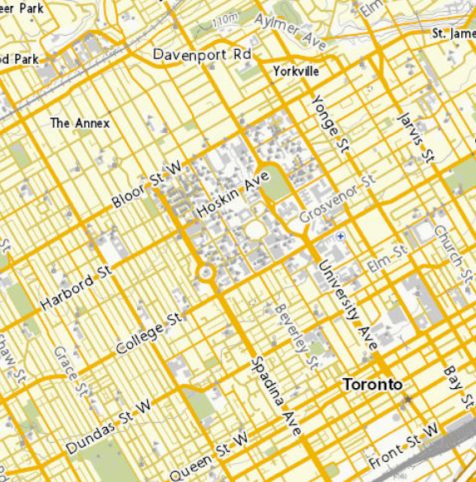
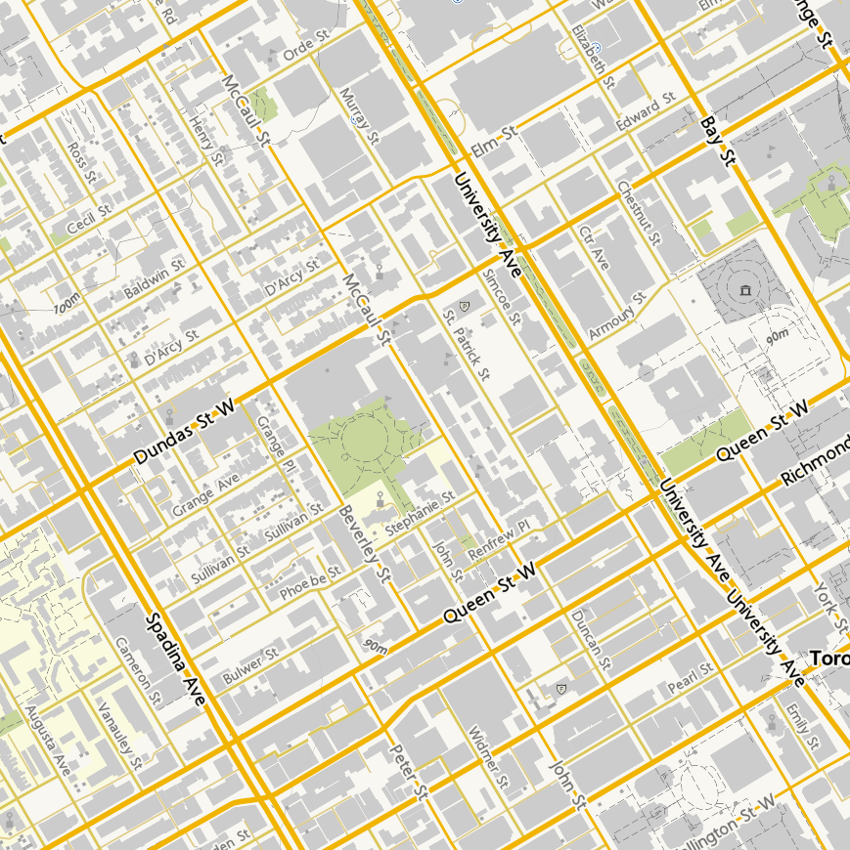
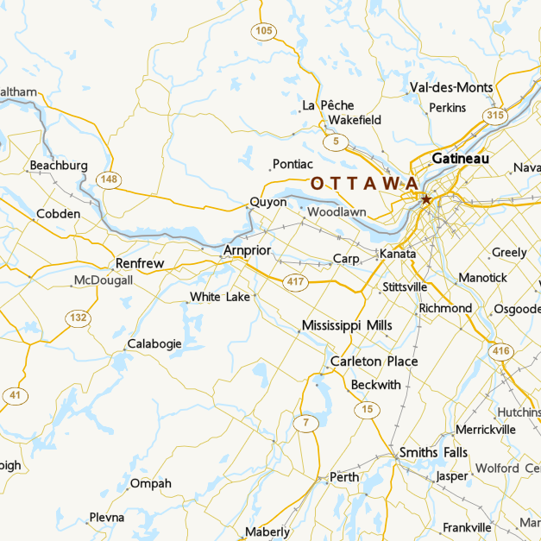
Basemap of Canada
27
CCMEO maintains the Basemap of Canada
The foundational layer that provides a location reference to provide user context. Essential for visualization and analysis when constructing maps, adding layers and data.
Widely used and highly valued
CCMEO Basemaps are broadly used across NRCan, OGDs, P/T govts., industry and the public - one of the most used Web products, with 1.4M unique visitors per month​.
Fully supports both Official Languages and Canadian place names, Indigenous languages and place names, and authoritative administrative boundaries. It is web accessible and provides better coverage in rural, remote and northern areas of Canada than most private sector Basemap offerings. ​
CCMEO is currently renewing the Basemap
To improve: data currency, data maintenance, frequency of updates, enhanced performance, creation speed and quality, style flexibility, up-to-date Indigenous place names and vector tiles output.
Open Street Maps integrated Vector Tile Basemap, in both French and English, will be ready for soft launch for collaborators and public to integrate into their applications and processes by September 2024.

Slide 28
28
Prospectivity Model
NRCan’s Major Projects Inventory
Curated Mapping
Products
Flood Susceptibility in Canada: Swipe Map Classed from low to high susceptibility on the right (0-100)
Stories from the land
Indigenous Place Names in Canada on GEO.ca

Slide 29
GeoDiscovery CCMEO Products, Applications and Services
29
GeoView
Basemap of Canada
Near Real-Time
Innovation (Similarity Engine, Semantic Search)
90 jours
https://gcgeo.gc.ca/viz/index-en.html?keys=f0d1c3a9-cf78-4b07-af55-9e8d4303449e
What We Serve
Open Science and Data Platform (OSDP)
NRCan Enterprise Investment Fund (EIF)
Flood Hazard Identification and Mapping Program (FHIMP)
SPI/CCMEO Web Presence
Notes:
As mentioned, here are some of our core products, applications and services.
GeoView is our newly developed lightweight viewer for geospatial data and maps with enhanced mapping capabilities.
The Basemap of Canada is the foundational layer or background map that provides a location reference and is essential for mapping data. By giving the user context, it is essential in constructing other types of maps and when adding layers and specific data, to enable visualization and analysis. CCMEO’s basemap is broadly used across NRCan, other GC departments, P/T governments, industry and the Canadian public. The basemap contributes towards data support, geographical context, official place names and authoritative administrative boundaries. It also supports both official languages. CCMEO is currently in the process of implementing and advancing a renewal of the Basemap to improve several aspects including data accuracy, data details, and rendering speed and quality.
Near-real time services
GeoDiscovery is consistently enhancing services with technological innovation. For example, the Similarity Engine applies natural language processing machine learning models on GEO.ca to improve searchability and discoverability of geospatial assets and earth observation data from various sources.
These products and applications are designed to serve the four main programs/initiatives listed on the slide.

Slide 30
30
GeoAI Data Series
150K km2 released October 2023
100K km2 coming February 2024
CCMEO leveraging GeoAI to deliver on its mandate to maintain Canada’s foundational geospatial data
Spatio-temporal data series created using artificial intelligence.
A collection of geographic features that are:
natural or artificial, like roads, buildings, lakes and rivers, and more
identified from various sources such as aerial or satellite images
automatically extracted by machine learning algorithms
Enables the ability to identify trends and changes over time to provide a wealth of opportunities to data users.

Slide 31
How we support initiative pages through Social Media
Posts on Critical Minerals Initiative page on GEO.ca
Facebook:
EN:https://www.facebook.com/291828829612329/posts/916073590521180
FR:https://www.facebook.com/260058766139220/posts/797224035756021
LinkedIn
EN:https://www.linkedin.com/feed/update/urn:li:share:7171230451943096321
FR:https://www.linkedin.com/feed/update/urn:li:share:7171230871906160641
LinkedIn
EN:https://www.linkedin.com/feed/update/urn:li:activity:7171939980326457346
FR:https://www.linkedin.com/feed/update/urn:li:activity:7171939387176275968
Twitter (X)
EN:https://twitter.com/NRCan/status/1766174283317821716
FR:https://twitter.com/RNCan/status/1766173691971358827
Notes:
With support from CPS, GeoDiscovery also released social media posts on Facebook, LinkedIn and Twitter(X) to promote the new critical minerals initiative page.

