Slide 1
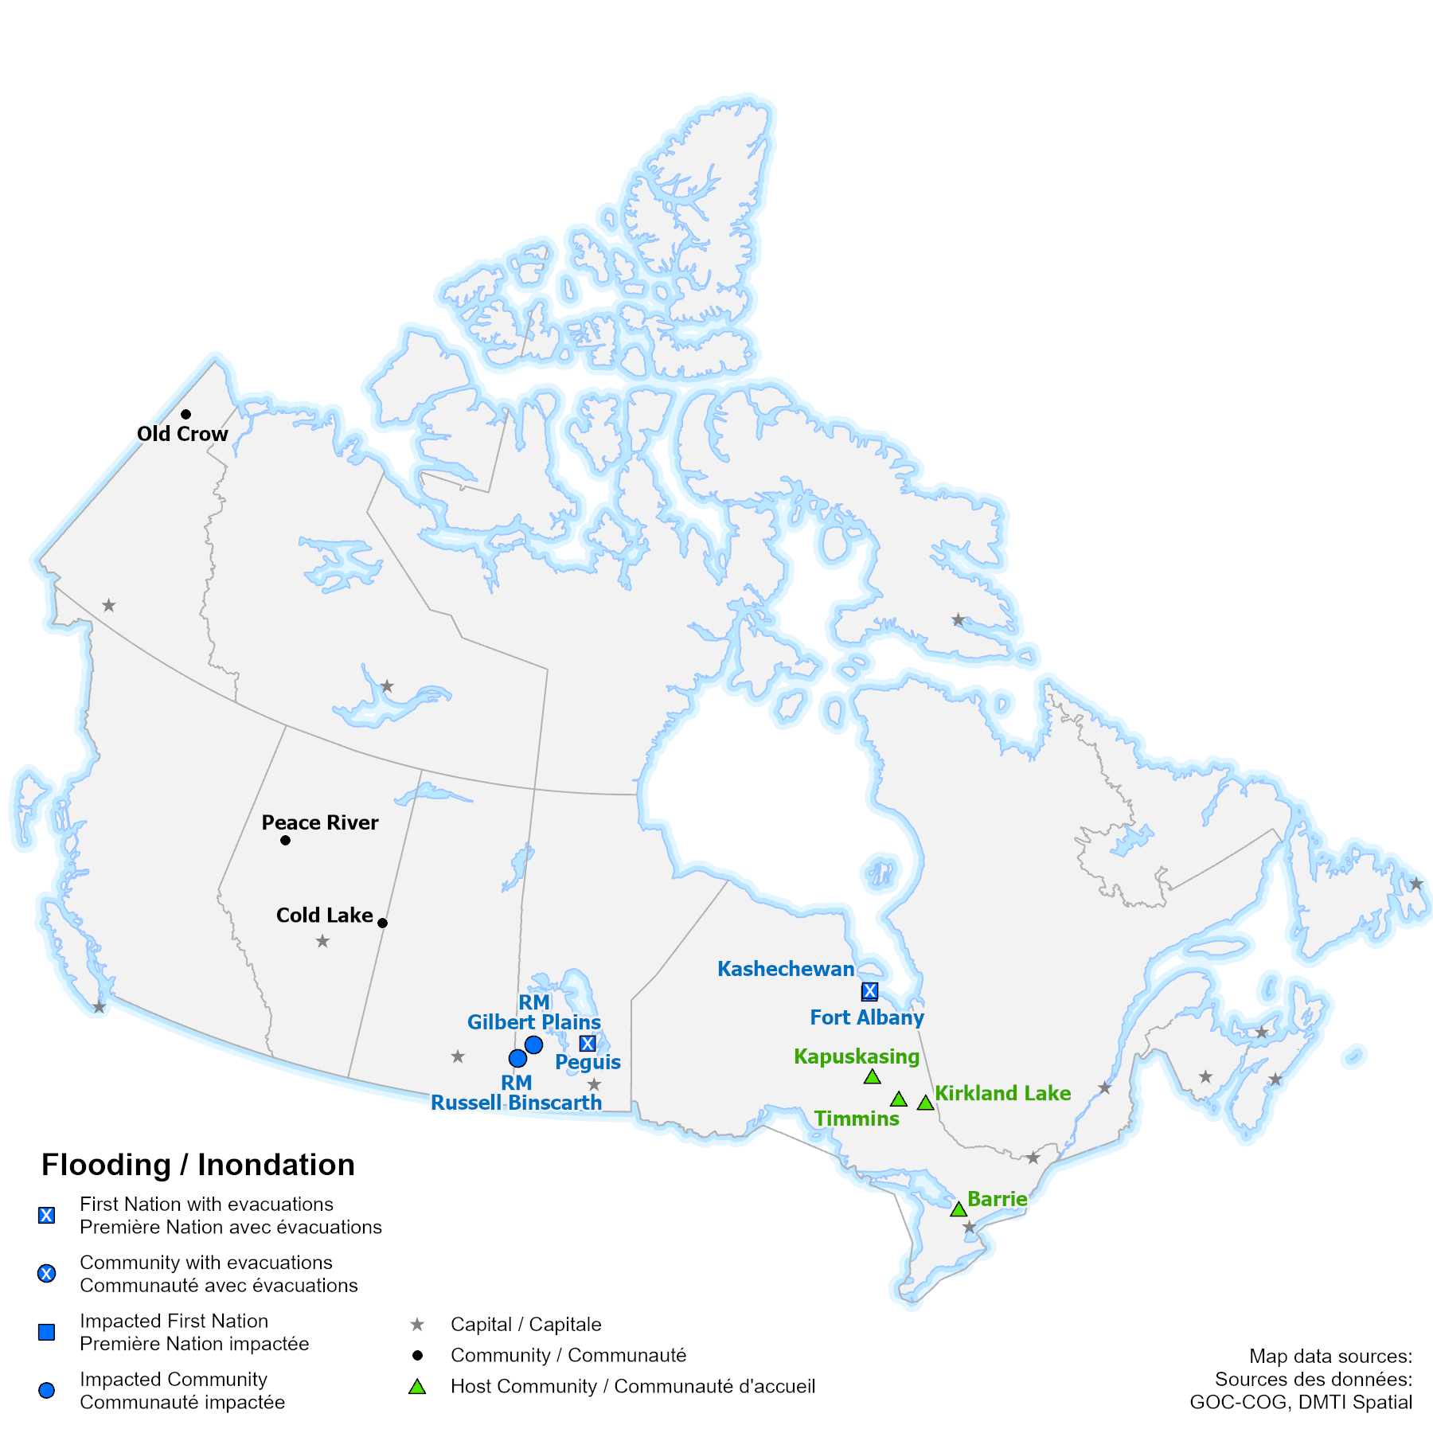
Cyclical Events National Common Operating Picture – 30 Apr 2024
DL-1
BLUF
As of 01 May, all flood and fire incidents are being managed at the local level. As of 01 May, repatriation for Kashechewan FN is in progress.
Floods
YT
Old Crow, a fly-in only community with a population of 221, is at high risk for a 1:200-year flood event due to a record high snowpack in the Porcupine River Basin. Preparation and mitigation activities are underway by local authorities, the YT government, and federal partners.
ON
Kashechewan FN is aiming to have the return of precautionary evacuees commence on 01 May. As of 29 Apr, the risk of spring flooding for Fort Albany FN has passed, with all local alerts to be lifted on 30 Apr.
Wildland Fires
Active Fires: 94 Out of control: Six
The majority of active fires are currently located in BC and AB.
National Preparedness Level: 1
BC
As of 29 Apr, an Evacuation Alert for the Burgess Creek Area in the Cariboo Regional District has been rescinded, with the fire now classified as Being Held.
Federal Engagement
Relevant federal and territorial partners are engaged in preparedness activities for the impending flooding event in Old Crow, YT.
Non-Governmental Organizations
CRC is working with ON host communities to support Kashechewan evacuees, and with both the Yukon Health and Social Services and the Government of Northwest Territories to arrange support if evacuations to Inuvik occurs.
Request(s) for Federal Assistance
None anticipated at this time.
9” X 9” SPACE TO REMAIN RESERVED FOR GEOMATICS MAPPING AT ALL TIMES. THIS SPACE WILL INCLUDE A NATIONAL MAP, EVENT ITEMS AND AN ASSOCIATED LEDGEND.
GEOMATICS PRODUCT PROVIDED MUST INCLUDE TITLE/LEDGEND WITH MAP WITHIN THIS SPACE.
Sources: PS ROs, MB EMO, MB HFC, EMOs, ON MNRF, ISC, CRC, Open Sources
Current as of: 01 May 2024 09:00 EDT GOC Webmap Hub: https://goc-cog-pscanada.hub.arcgis.com/

Slide 2
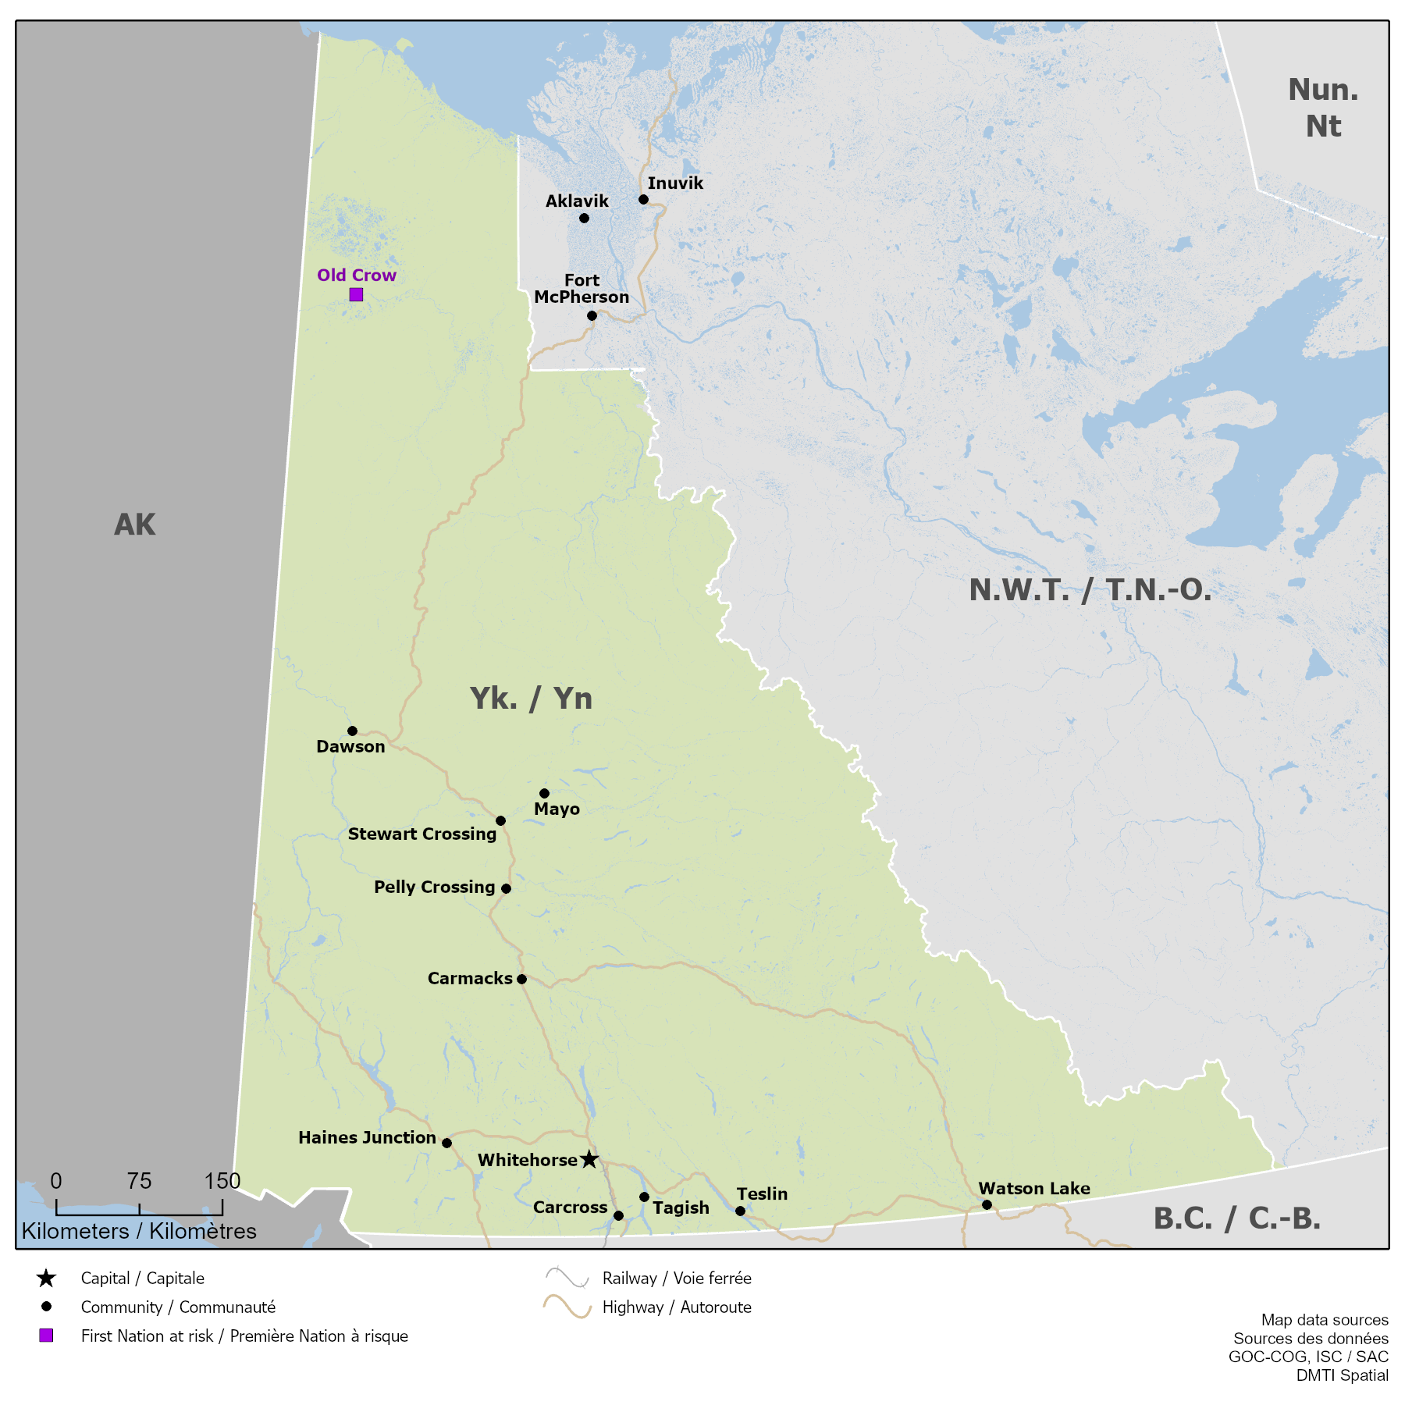
Territorial Impacts YT – 30 Apr 2024 – National Flooding (00211-24)
DL-1
Level 3 YT EMO
(Moderate)
Level 2 Yukon ECCC
(Enhanced Monitoring)
Level 2 PS Pacific RO
(Risk Assessment and Planning)
9” X 9” SPACE TO REMAIN RESERVED FOR GEOMATICS MAPPING AT ALL TIMES. THIS SPACE WILL INCLUDE A NATIONAL MAP, EVENT ITEMS AND AN ASSOCIATED LEDGEND. GEOMATICS PRODUCT PROVIDED MUST INCLUDE TITLE/LEDGEND WITH MAP WITHIN THIS SPACE.
Territorial Overview
Communities in the Klondike Valley, including Dawson (pop. 1,557), are at a moderate-high risk of flooding through to Jun; however, Dawson is listed as low risk for flooding due to mitigation and preparedness activities supported by the YT EMO. As of Apr 29, a Flood Warning has been issued for the Klondike River. An Evacuation Alert remains for the Klondike River Valley, from the confluence (where the Klondike River meets the Yukon River) to Henderson Corner.
Old Crow is at high risk for a 1:200-year flood event due to a record high snowpack in the Porcupine River Basin. Severe flooding is expected over the coming weeks and evacuation is very likely. The event would flood Old Crow in its entirety, with extensive damage to infrastructure. Old Crow is a fly-in only community with a population of 221, the majority of whom are Gwich'in, belonging to the Vuntut Gwitchin First Nation.
On 29 Apr, the PS Pacific RO activated to level 2 (Risk Assessment and Planning) for the Yukon Freshet event. The Yukon ECCC remains activated to level 2 (Enhanced Monitoring) and the Yukon EMO is activated to level 3.
Impacts
The Vuntut Gwitchin FN community's airstrip is highly vulnerable to flooding. Loss of airstrip would implicate rotary wing assets for evacuation and would impact food and healthcare delivery services. The likely evacuation route for community would involve evacuation to Whitehorse using fixed wing air assets if the Old Crow airstrip is useable, or a potential evacuation to Inuvik using rotary wing assets if the Old Crow airstrip is not useable.
The community is assessing commercial options to transport flood mitigation equipment into Old Crow, developing shelter in place/evacuation plans and requests for various supports for consideration by the Yukon EMO.
Potential CI impacts to Old Crow may include sewage and wastewater, air transport infrastructure, telecommunication, health services and energy transmission systems.
YT EMO has engaged engineering firm, 'Stantec', to advise on CI protection options.
Pacific PS RO is coordinating with YT EMO for response planning, and with Yukon Health and Social Services in coordinating potential evacuation of Old Crow. Bilateral arrangements with the CRC are being discussed in the context of potential ESS supports.
CIRNAC is involved in funding support for both Old Crow and Dawson related to flood mitigation and preparedness.
Sources: PS Pacific RO, ISC
Current as of: 01 May 2024 09:00 EDT GOC Webmap Hub: https://goc-cog-pscanada.hub.arcgis.com/

Slide 3
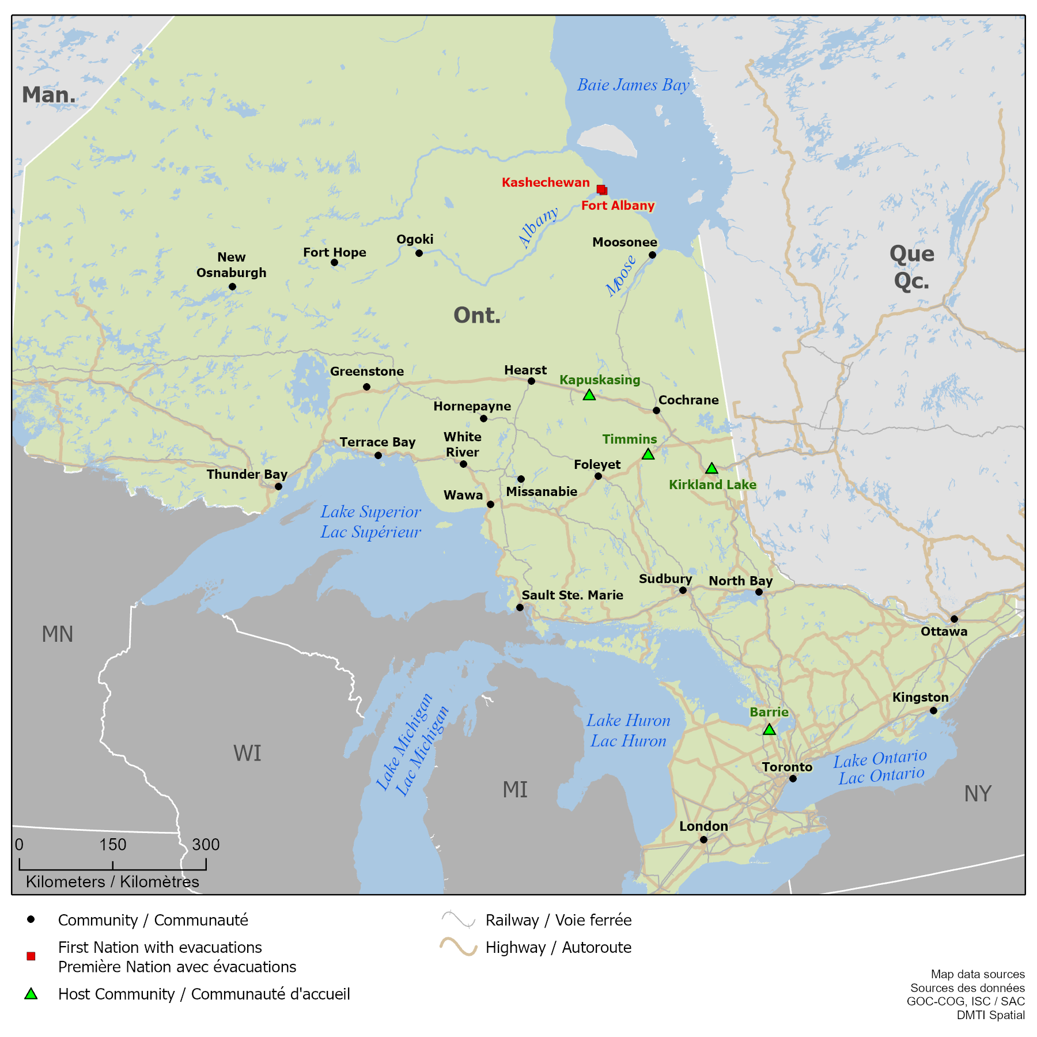
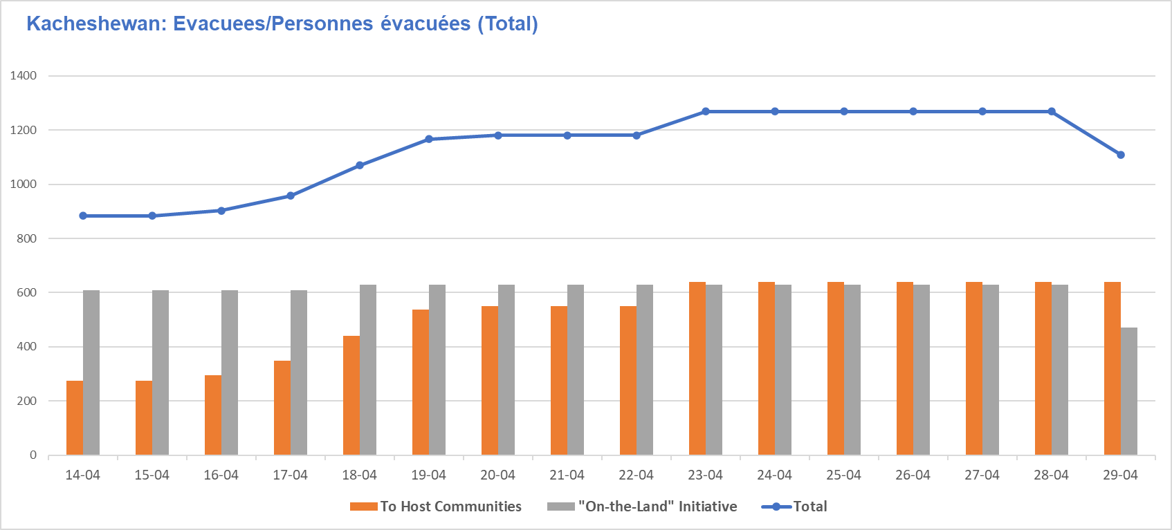
Provincial Impacts ON – 30 Apr 2024 – National Flooding (00205-24)
DL-1
Level 1
PEOC Activation
(Enhanced Monitoring)
9” X 9” SPACE TO REMAIN RESERVED FOR GEOMATICS MAPPING AT ALL TIMES. THIS SPACE WILL INCLUDE A NATIONAL MAP, EVENT ITEMS AND AN ASSOCIATED LEDGEND. GEOMATICS PRODUCT PROVIDED MUST INCLUDE TITLE/LEDGEND WITH MAP WITHIN THIS SPACE.
Provincial Overview
As of 01 May, the Provincial Flood Watch for Ontario remains in effect. As of 01 May, 10 (-4) Flood Watch messages have been issued across central ON and 4 Flood Warnings remain issued across the province. No major impacts or further federal involvement are expected.
As of 29 Apr, potential ice jam flooding is at low-moderate risk of flooding for the FN communities of Fort Albany and Kashechewan.
Impacts
As of 01 May, MEOC report Forecast rainfall over the next 5 days is expected to cause flooding east of Lake Superior and further exacerbate those areas already experiencing flood conditions, particularly those communities in the Northeast.
As of 29 Apr, apx. 626 community members remain evacuated form Kashechewan First Nation; while apx. 470 community members were relocated within the community through the "On-the-Land Initiative“.
Kashechewan is aiming to commence repatriation of precautionary evacuees on 01 May, with two repatriation flights (apx. 100 pax) from host site Barrie.
As of 29 Apr, Fort Albany FN has determined that the risk of spring flooding has passed, with river levels being reported as low. All local alerts to be lifted on 30 Apr.
Sources: PS ON RO, Open Sources
Current as of: 01 May 09:00 EDT GOC Webmap Hub: https://goc-cog-pscanada.hub.arcgis.com/

Slide 4
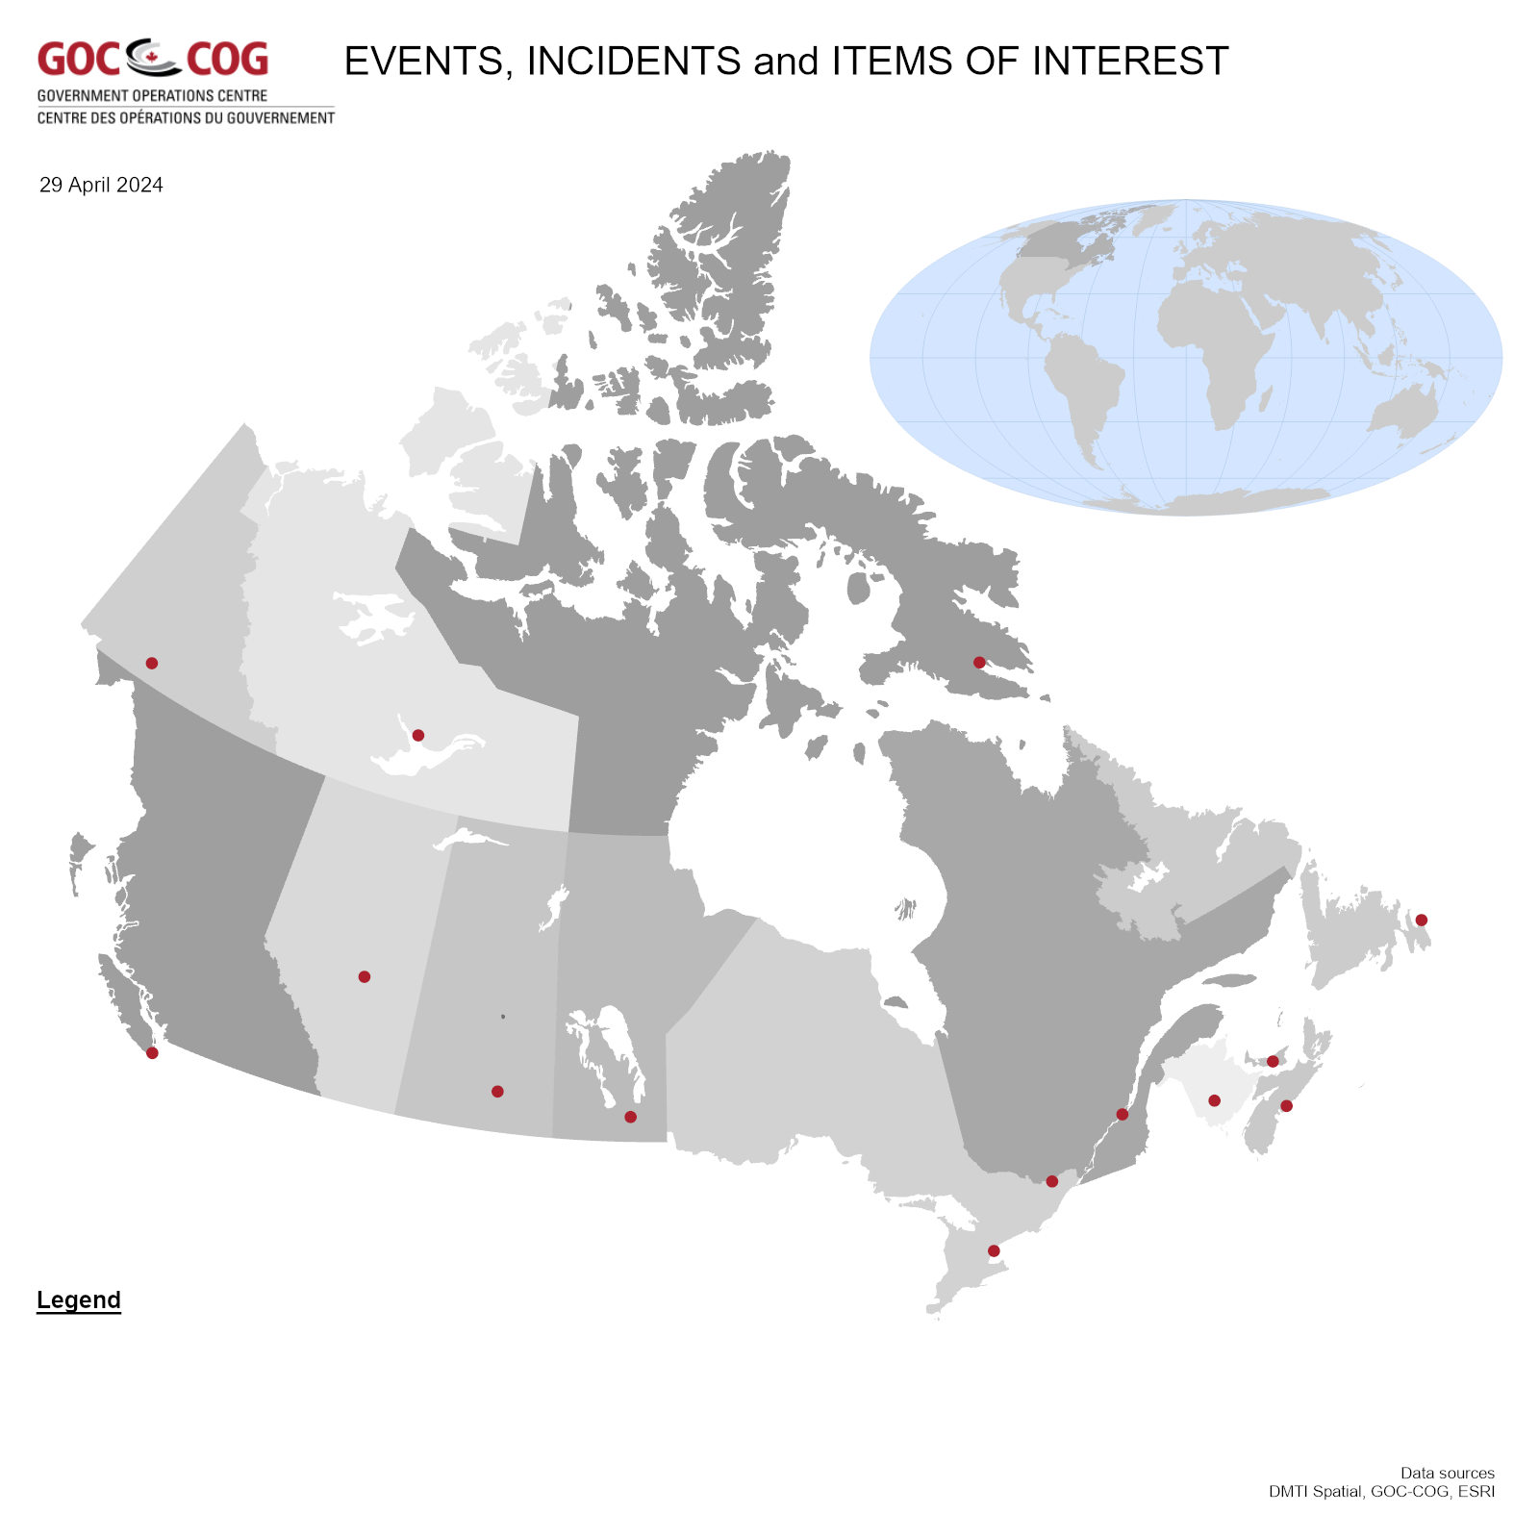
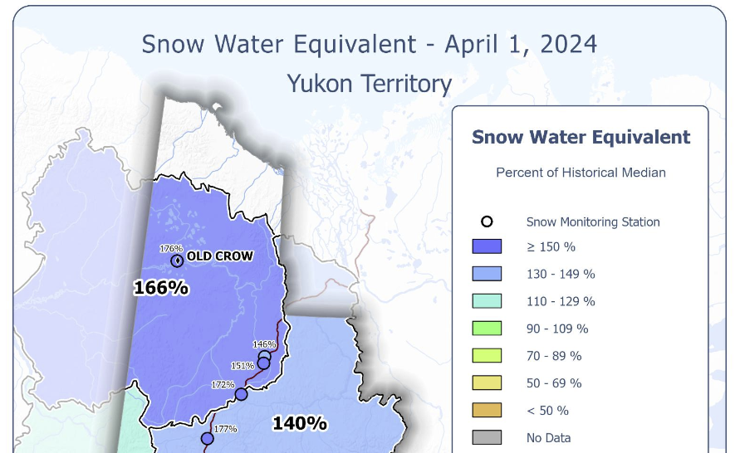
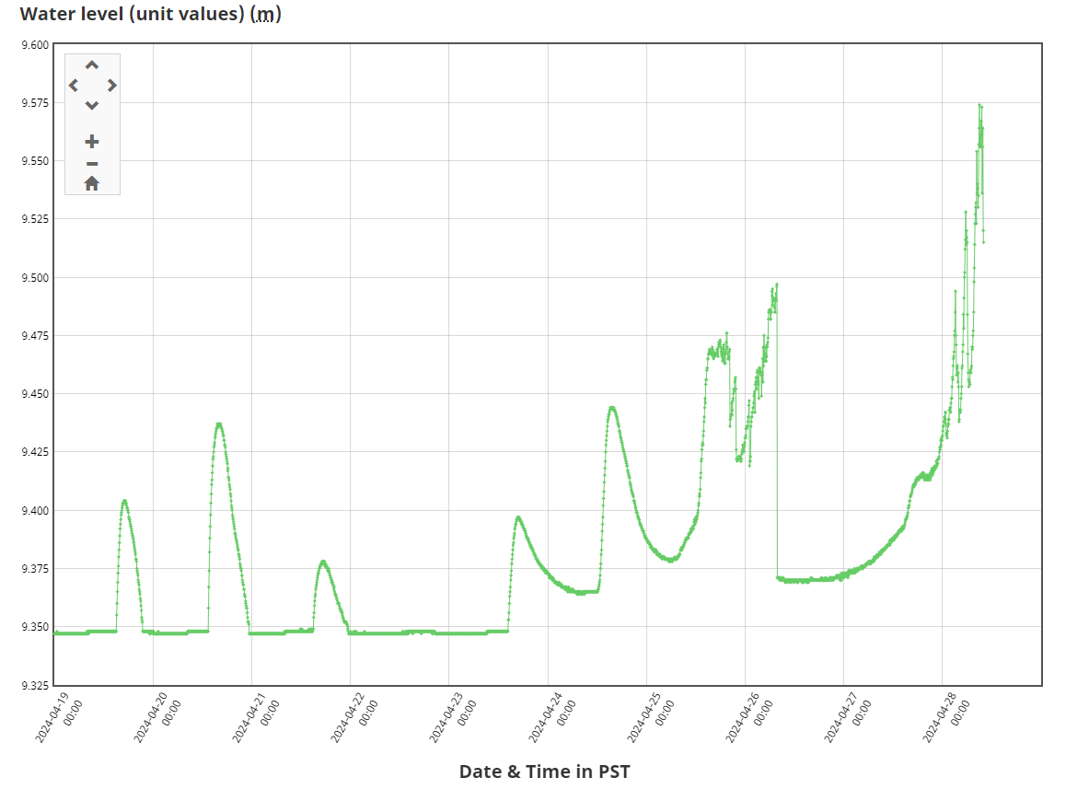
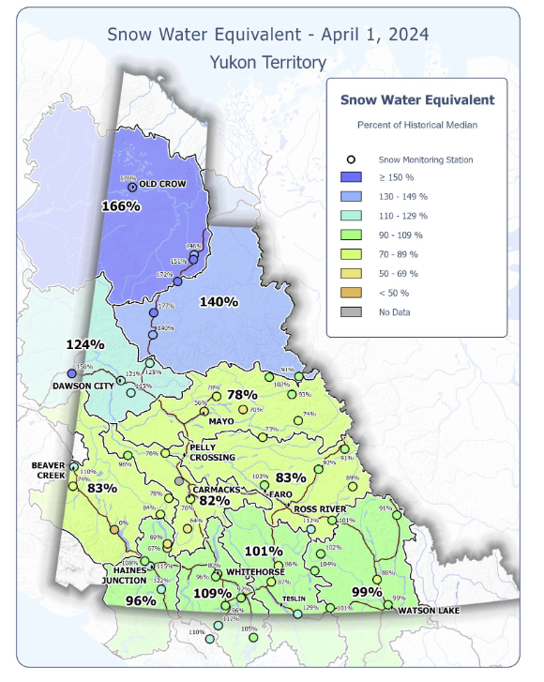
National Weather and Risk Overview – 30 Apr 2024 – National Flooding (00200-24)
DL-1
National Weather Overview in the Context of Floods
In YT, for Porcupine River, temperatures are forecast to remain below freezing over the next week. Solar radiation will still be able to generate some melt, but runoff will be minimal over the coming week and the ice decay will be slow. Current forecasting indicates the Porcupine River near Old Crow may break up in the next 1-2 weeks.
P/Ts at Highest Risk
Yukon, Ontario.
P/T-Specific Risk and Outlook
YT
Old Crow is at high risk for a 1:200-year flood event due to both ice jam and freshet as a result of a record high snowpack in the Porcupine River Basin. A full evacuation of the community is very likely with the possibility of a partial or complete airport closure and severe impacts to the waste-water system. Extensive planning efforts are underway by the Territory, including CI protection activities involving municipal, territorial, and federal partners. Communities in the Klondike Valley are at high risk for flooding until June due to a risk of an ice jam. at the Klondike Highway Bridge. As of 28 Apr, an Evacuation Alert is in place for the Klondike River Valley, from the confluence (where the Klondike River meets the Yukon River) to Henderson Corner.
ON
For Ontario, stream flows are still high but receding in many of the watercourses. In the north, ice breakup is occurring or will begin within the week. The flood risk along the Attawapiskat river is moderate and low for Moose river. The flood risk along the Albany river is low to moderate. The Province will cease regular daily river surveillance flights and Flood Watches will remain in effect up until expiry on 03 May.
National Incidents Map
YT – Snow Water Equivalent
River Forecast Map – Old Crow River, YT
Sources: CIFFC Dashboard | GOC Web Maps | ECCC Weather Outlook
Sources: Manitoba Transportation and Infrastructure; YT Flood Site and PS YT RO Sitrep; Real Time Hydrometric Data
Current as of: 01 May 2024 09:00 EDT

Slide 5
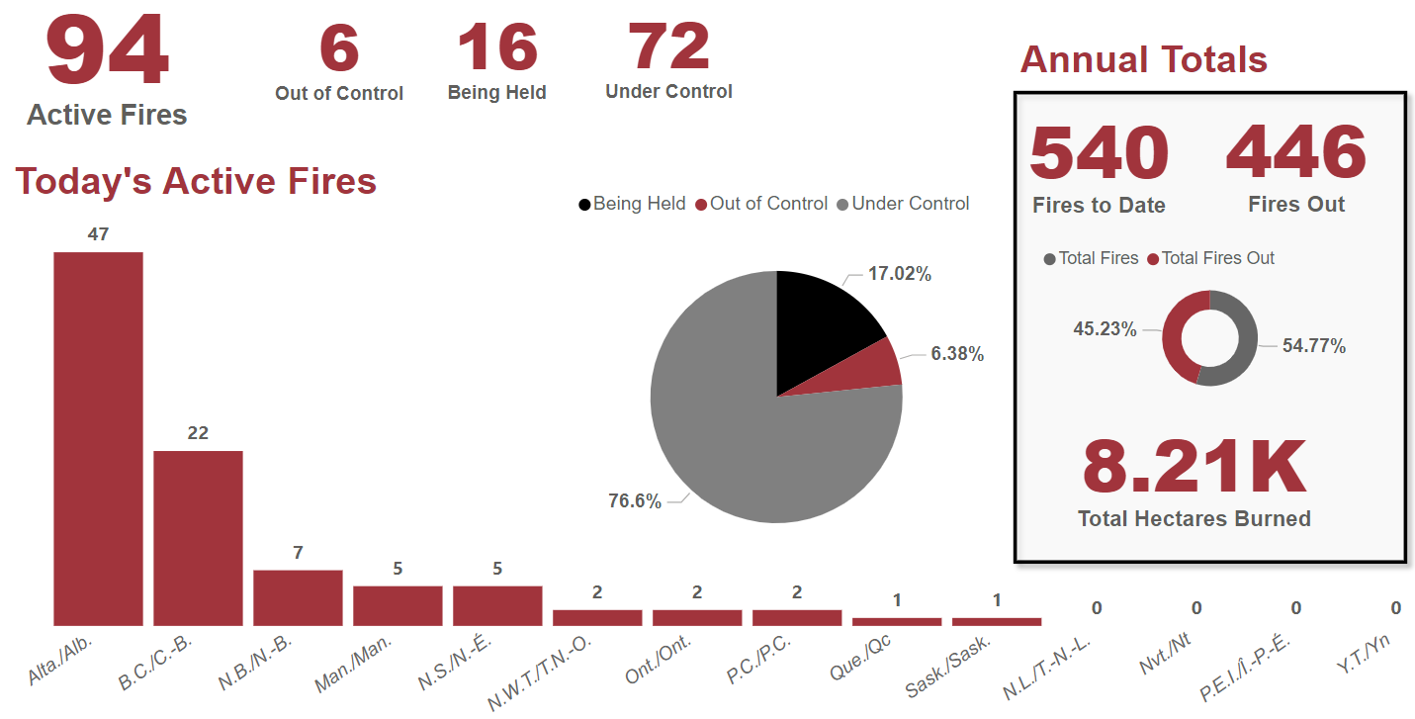
Situational Awareness Overview – 30 Apr 2024 – Wildfires (00300-24)
DL-1
Smoke Risk Assessments: https://apps.esri.ca/smoke/, Home - FireSmoke.ca
Sources: Canadian Interagency Forest Fire Centre (CIFFC).
Current as of: 01 May 2024 09:00 EDT

Slide 6
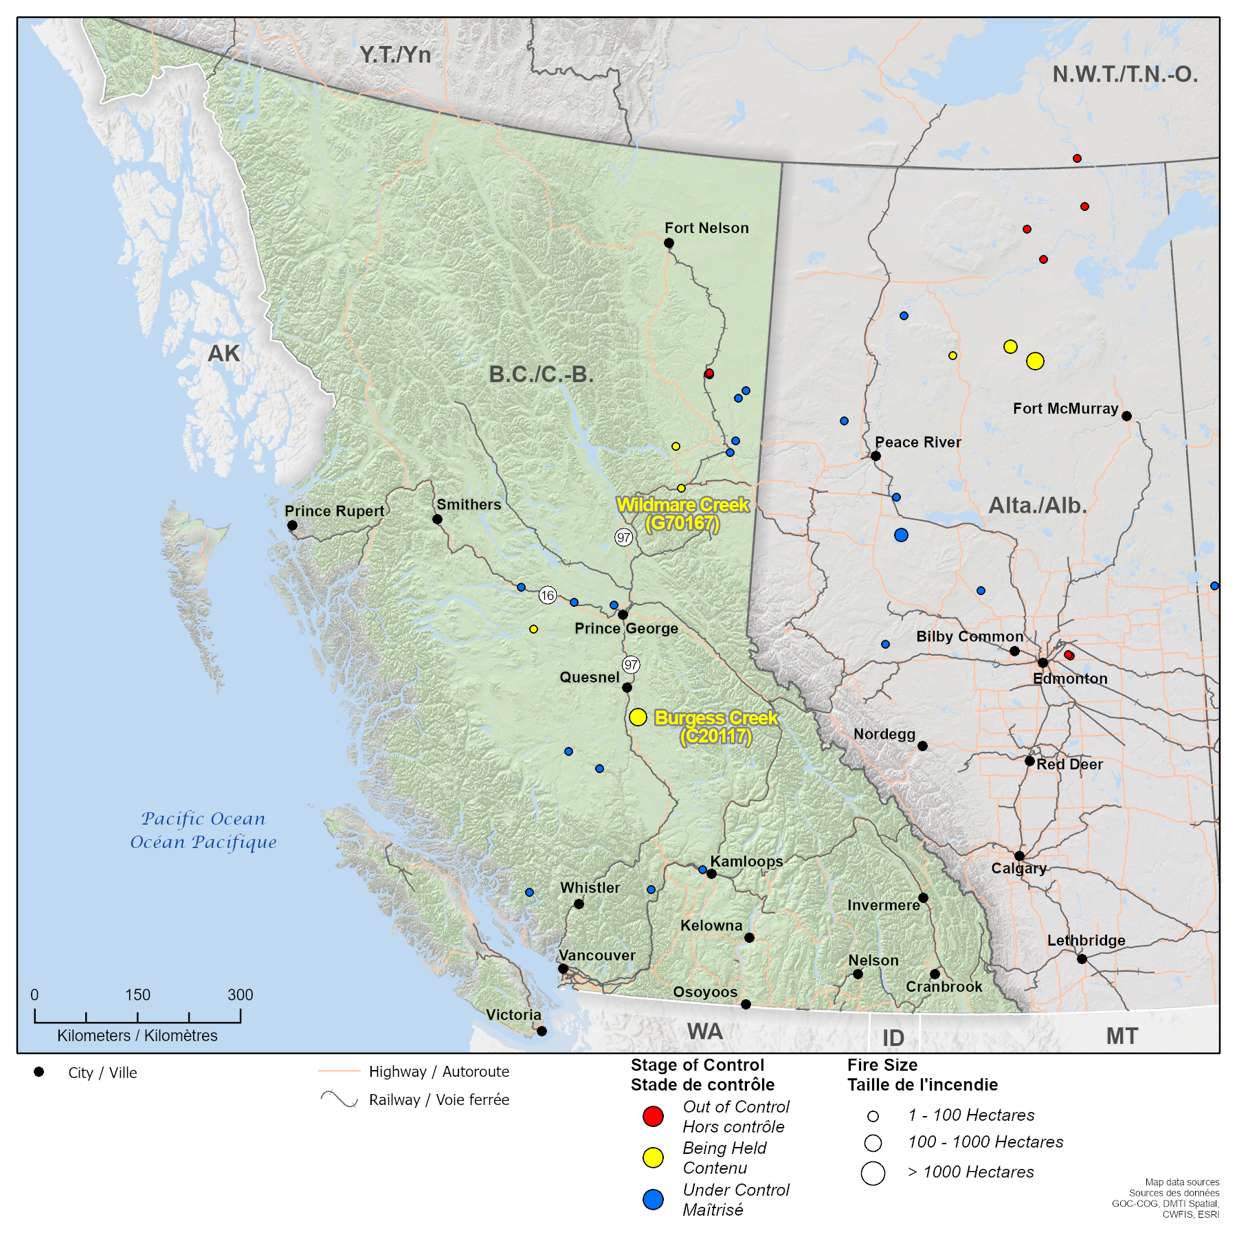
Provincial Impacts BC – 30 Apr 2024 – Wildfires (00301-24)
DL-1
9” X 9” SPACE TO REMAIN RESERVED FOR GEOMATICS MAPPING AT ALL TIMES. THIS SPACE WILL INCLUDE A NATIONAL MAP, EVENT ITEMS AND AN ASSOCIATED LEDGEND. GEOMATICS PRODUCT PROVIDED MUST INCLUDE TITLE/LEDGEND WITH MAP WITHIN THIS SPACE.
Incident Overview
Provincial APL:
BC: 1
As of 29 Apr, there are no Evacuation Alerts in BC due to wildland fires.
As of 29 Apr, air quality is not affected on a regional scale.
Impacts
Burgess Creek Wildfire, BC (Being Held):
As of 29 Apr, the Evacuation Alert issued by the Cariboo Regional District for the Burgess Creek has been rescinded.
As of 26 Apr, the fire remains at 1800 ha and is classified as Being Held. The fire is currently 45km from Quesnel BC and five km north of Ben Lake. Currently it is visible from Highway 97 and surrounding communities.
BCWS crews are responding with aviation resources and heavy equipment.
Sources: PS Pacific RO, CIFFC, BC Wildfire Service, ISC, Open Sources
Current as of: 01 May 2024 09:00 EDT
GOC Webmap Hub: https://goc-cog-pscanada.hub.arcgis.com/

Slide 7
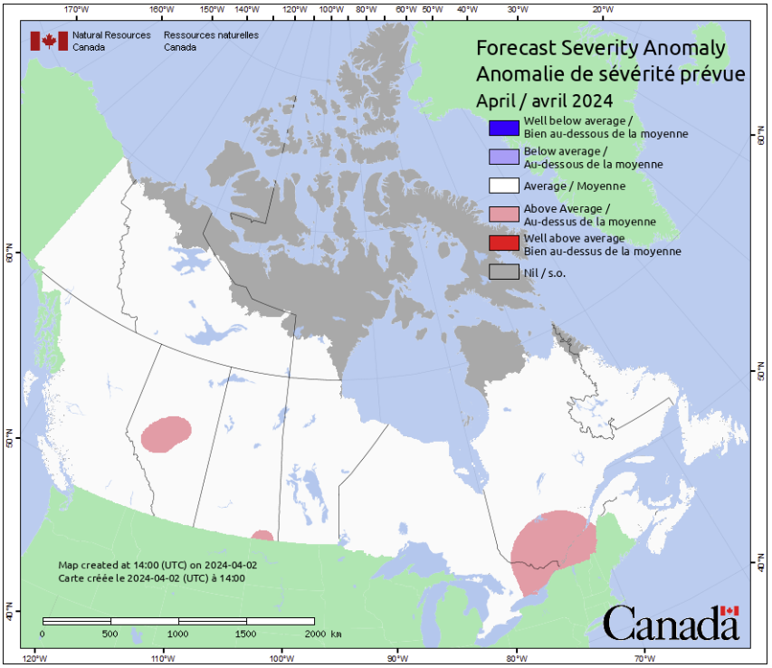
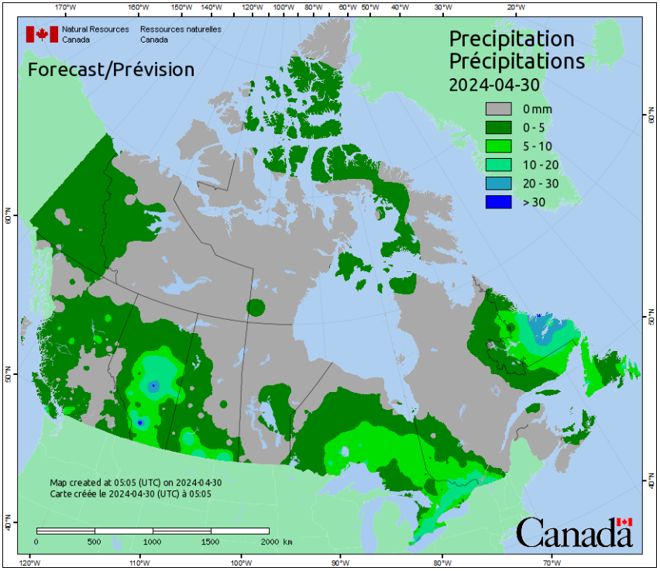
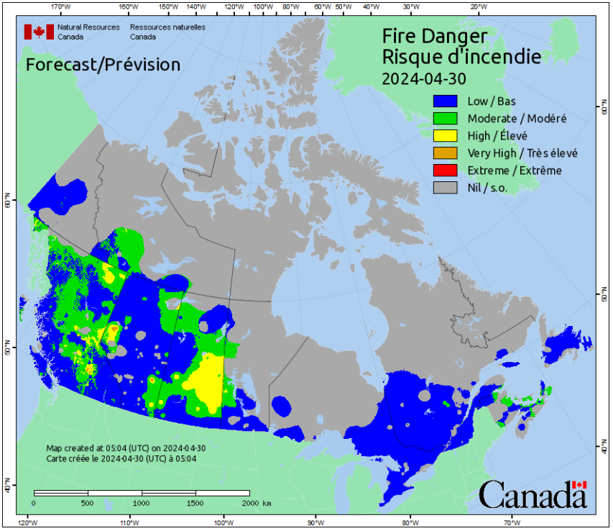
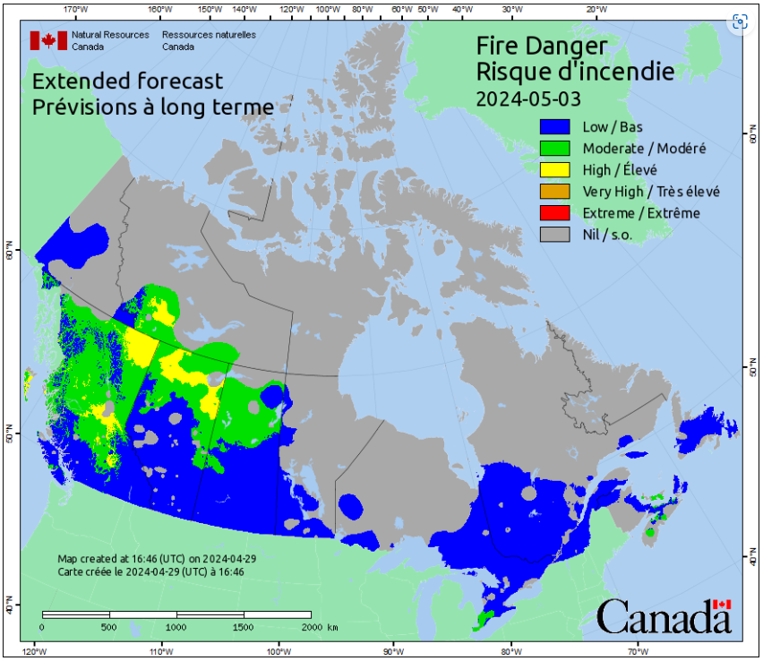
National Weather and Risk Overview – 30 Apr 2024 – Wildfires (00300-24)
DL-1
National Overview in the Context of Wildfires
Preparations by key partners, including Provinces and Territories, are well underway.
The Wildfire Season Risk Assessment will be released in early May at which time a more in-depth analysis will be provided.
CIFFC has commenced its daily sitreps as of 29 Apr.
On 23 Apr, ECCC reported that large-scale precipitation in the next week is likely to occur along the Pacific Coast and over the central and eastern regions of the country. Unfortunately, the areas that currently show wildfire activity (mostly the BC Interior and AB) are unlikely to get much sustained precipitation in the next seven days. There is a good chance of some upslope precipitation along the Rocky Mountains, but the lower elevations and the plains are most likely going to remain relatively dry.
Next report will be available from ECCC, 30 Apr.
P/Ts at Highest Risk
British Columbia, Alberta.
Areas Requiring Close Monitoring
The Prince George and Cariboo fire centres of BC.
Risk Assessment and Outlook
The current situations in BC and AB are being handled at the local level.
CIFFC remains at a National Preparedness Level of 1.
Currently, low risk for an RFA.
Forecast Severity Anomaly - April
Forecasted Precipitation
Current Fire Danger
Fire Danger – Extended Forecast (3 days)
CIFFC Agency Preparedness Levels
P/T | BC | YT | AB | NT | SK | MB | ON | QC | NL | NB | NS | PE | Parks Canada
APL | 1 | - | 2 | - | 2 | 1 | 1 | 1 | - | - | 1 | 1 | 1
Level 1 |  | Level 2 |  |  | Level 3 |  |  |  | Level 4 |  |  | Level 5
Sources: GOC Web Maps | ECCC Weather Outlook
Smoke Risk Assessments: https://apps.esri.ca/smoke/, Home - FireSmoke.ca
Sources: Canadian Wildland Fire Information System; ECCC - Canada Wildfire Potential Report
Current as of: 01 May 2024 09:00 EDT

Slide 8
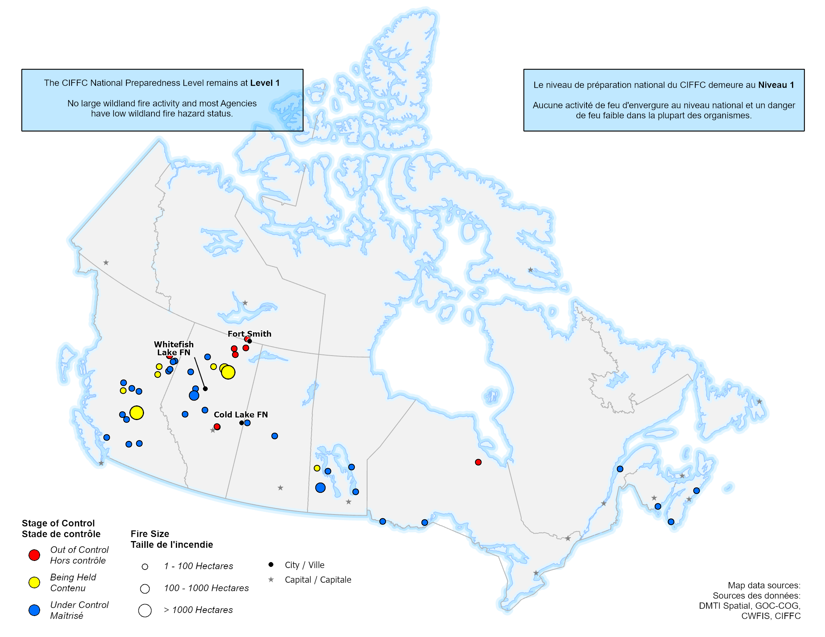
National Wildfire Overview – 30 Apr 2024 – Wildfires 00300-24
DL-1
9” X 9” SPACE TO REMAIN RESERVED FOR GEOMATICS MAPPING AT ALL TIMES. THIS SPACE WILL INCLUDE A NATIONAL MAP, EVENT ITEMS AND AN ASSOCIATED LEDGEND. GEOMATICS PRODUCT PROVIDED MUST INCLUDE TITLE/LEDGEND WITH MAP WITHIN THIS SPACE.
Provincial Overview
BC
On 25 Apr, the Peace River Regional District downgraded the Evacuation Order to an Evacuation Alert for the Pine River Area.
AB
On 25 Apr, the evacuation order for the Municipal District of Peace no. 135 was rescinded as the Shaftesbury Trail Fire is now classified as Being Held.
Wildfires of Note
Burgess Creek Wildfire (Out of Control) 1800 ha
CI Impacts
As of 30 Apr, there are no significant CI impacts.
Active RFA(s) in Province
No RFAs are expected at this time.
Agency Preparedness Levels
 | BC | YT | AB | NT | SK | MB | ON | QC | NL | NB | NS | PE | Parks Canada
APL | 1 | - | 2 | - | 2 | 1 | 1 | 1 | - | - | 1 | 1 | 1
Level 1 |  | Level 2 |  |  | Level 3 |  |  |  | Level 4 |  |  | Level 5
Sources: Canadian Interagency Forest Fire Centre (CIFFC).
Current as of: 01 May 2024 09:00 EDT

Slide 9
Federal Support – 30 Apr 2024 – Flooding (00200-24)
DL-1
Organization | Current Issue and Support Provided | Next Steps
Indigenous Services Canada (ISC) | MB: As of 23 Apr, ISC remains in contact with Opaskwayak Cree Nation, the MB Public Safety Regional Office (PS RO) and MB Emergency Office (EMO) concerning a localized fuel leak from underground storage tanks. ISC continues to support the Lake Manitoba FN in water pumping and culvert streaming activities. ON: As of 23 Apr, Kashechewan FN has evacuated vulnerable community members to the host communities of Kapuskasing, Timmins, Kirkland Lake, and Barrie as part of the On The Land initiative. An issue with the community’s water treatment plant was reported. ISC has supported the purchase and delivery of 1,000 18 L water jugs into the community while the water issue is being investigated. The ON PS RO, the ON EMO, ISC and other provincial and regional partners are holding daily coordination calls to coordinate efforts and mitigate gaps. | MB: The Office of the Fire Commissioner and the Environmental Emergency Response Team continue to monitor the situation. Community leadership will call the ISC Duty Officer should any additional immediate needs arise. ON: ISC and other provincial and regional partners are participating in daily coordination calls to coordinate efforts and mitigate gaps.
Crown-Indigenous Relations and Northern Affairs Canada (CIRNAC) | CIRNAC is coordinating the purchase of tiger dams and communications equipment (radios and repeaters). In addition to supporting both emergency snow removal measures and staging of helicopter fuel for readiness should there be a helicopter evacuation in Old Crow, YT. | Pacific Regional Office is initiating bilaterial meetings with CIRNAC regional partners.
Innovation, Science and Economic Development Canada | ISED has provided StarLink units to YT Government, one of which will be deployed to Old Crow, YT.
Public Health Agency of Canada (PHAC) | PHAC continues to be in close contact with Yukon Health and Social Services (HSS).
Public Safety Communications | Currently preparing to coordinate the federal communications response to the upcoming flooding season. Communications products including the media relations protocol and evergreen media lines are being updated. The Spring Floods landing page will act as a single point of reference for Canadians to learn more about the federal flooding resources. | Once the situation warrants it, PS Comms will begin holding interdepartmental communications coordination calls. These calls will provide an awareness of the flooding situation across Canada, as well as the related communications activities of implicated departments and agencies.
Sources: Canada Red Cross, SARVAC, St John Ambulance, The Salvation Army
Sources: Public Safety Canada, PS ON RO, PS MB RO
Current as of: 01 May 2024 09:00 EDT

Slide 10
NGO Support – 30 Apr 2024 – Flooding (00200-24)
DL-1
NGO PARTNER CAPABILITIES
St John Ambulance
Inactive
Next Steps / Projected Resources Nil
CANADIAN RED CROSS
Assist with coordination of logistics to support federal response;
Participate in and support the Federal Government for readiness and planning activities;
Assist with the coordination of logistics in support of this plan;
Provide Emergency Social Services to affected populations as requested by government authorities (municipal, P/T, federal);
May provide recovery assistance to affected populations.
May coordinate the ground evacuation and lodging of community members from Manitoba FNs; and
May assist host communities for First Nations from any First Nation in Ontario or Manitoba.
ST JOHN AMBULANCE
May provide Clinical personnel (Doctor/Nurse).
May provide certified medical first responders.
May provide anticipated impact and staging areas for rapid response.
May provide psychosocial support personnel, in person and virtual mental health support, and therapy dogs.
SEARCH AND RESCUE VOLUNTEERS OF CANADA
May assist in general duty support.
May assist in wellness checks.
May assist in physical/community support.
May assist in the coordination of logistics.
May provide minimal supplies vehicles, communication devices (radio and satellite communication devices), and command posts, trailers etc.
THE SALVATION ARMY
May provide psychosocial support personnel, virtual & on location.
May deploy Community Response Units within 48h and spread out across the country.
Canadian Red Cross
Active (Ontario and Yukon) As of 29 Apr, ~626 community members remain evacuated to the host communities of Kapuskasing, Timmins, Kirkland Lake, and Barrie. Since 12 Apr, the Canadian Red Cross (CRC) is present at the host communities to assist in preparation efforts to accommodate arrival of evacuees. The CRC continues to work with Yukon HSS and the Government of Northwest Territories to arrange support if evacuations to Inuvik occurs. CRC is also working with Yukon HSS on planning for longer-term sheltering options and is in Dawson City preparing to offer supports.
Next Steps / Projected Resources CRC will continue to support the host communities to accommodate the arrival of evacuees.
The Salvation Army
Inactive
Next Steps / Projected Resources Nil
Search and Rescue Volunteers of Canada
Inactive
Next Steps / Projected Resources Nil
Team Rubicon
Inactive
Next Steps / Projected Resources Nil
Heavy Urban Search and Rescue (HUSAR)
Inactive
Next Steps / Projected Resources Nil
Sources: Public Safety Canada, PS ON RO
Current as of: 01 May 2024 09:00 EDT

