Slide 1
UNCLASSIFIED
Requesting
Geomatics & Surveillance
services
DATE: February 12, 2020
RDIMS No.: 3507098

Slide 2
Outline
Role of GOC Geomatics
Our partners in emergency management mapping
Our products
Process for requesting Geo products and services
Us
Them
What
How

Slide 3
GOC Geomatics
Role
  To enhance the GOC capabilities in providing strategic coordination and advice on managing current and upcoming events that have the potential to impact national interests through the provision of geomatics products and information.

Slide 4
Who we work with
We directly support
Indigenous Services Canada (ISC)
Public Safety Canada (PS)
Canada Border Services Agency (CBSA)
Immigration, Refugees and Citizenship Canada (IRCC)
Innovation, Science and Economic Development (ISED)
Prime Minister’s Office and Privy Council Office (PMO & PCO)
Canada Food Inspection Agency (CFIA)
Provinces and Territories

Slide 5
Who we work with
We collaborate with and receive support from
Natural Resources Canada (NRCan EGS)
Indigenous Services Canada (ISC)
Canadian Space Agency (CSA)
National Defence (DND MCE and CJOC)
Environment and Climate Change Canada (ECCC CIS, MSC, NEEC)
Transport Canada (TC NASP)
Provinces and Territories
US Federal Emergency Management Agency (US FEMA)

Slide 6
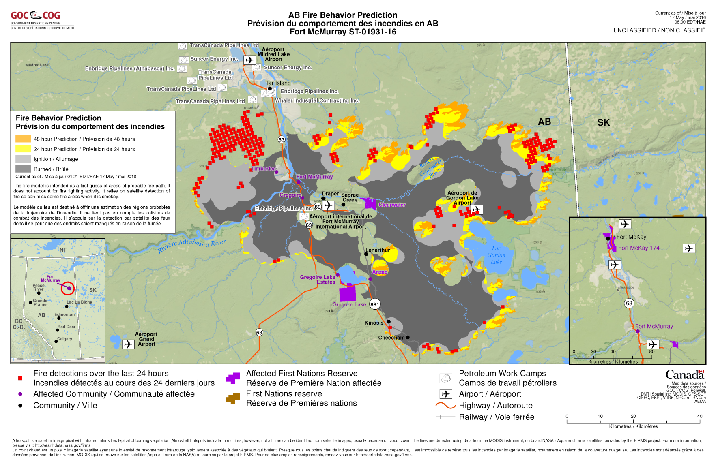
Our Products
During Events
Maps accompanying Operations Centre reports

Slide 7
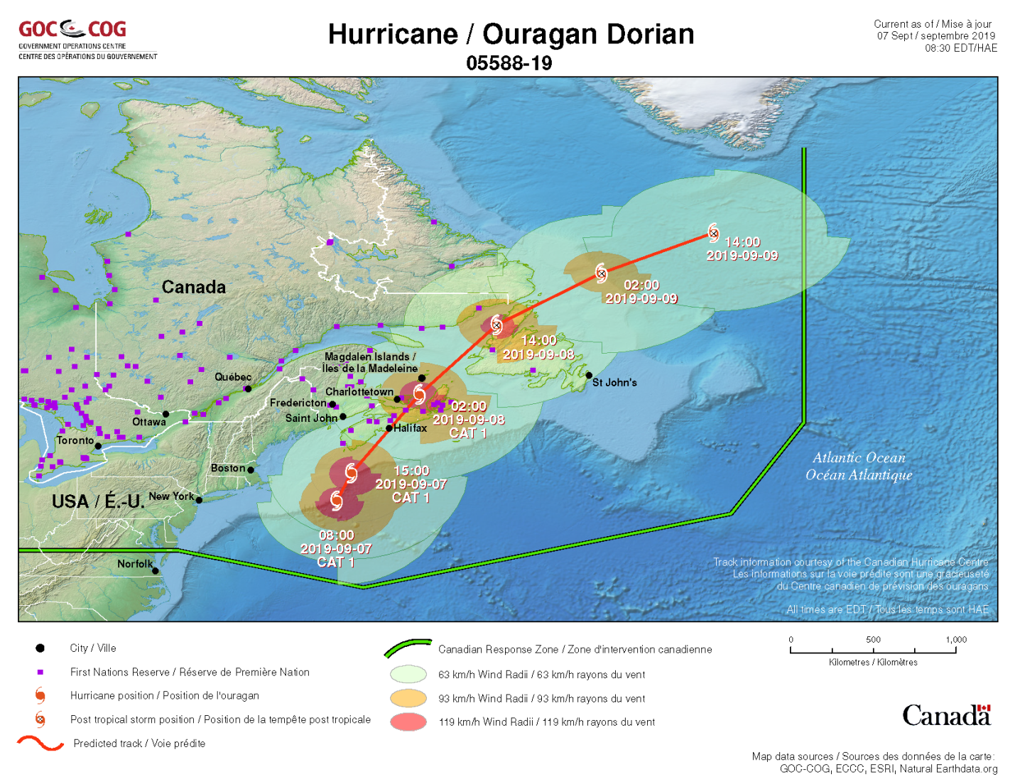
Our Products
During Events
Maps accompanying Operations Centre reports

Slide 8
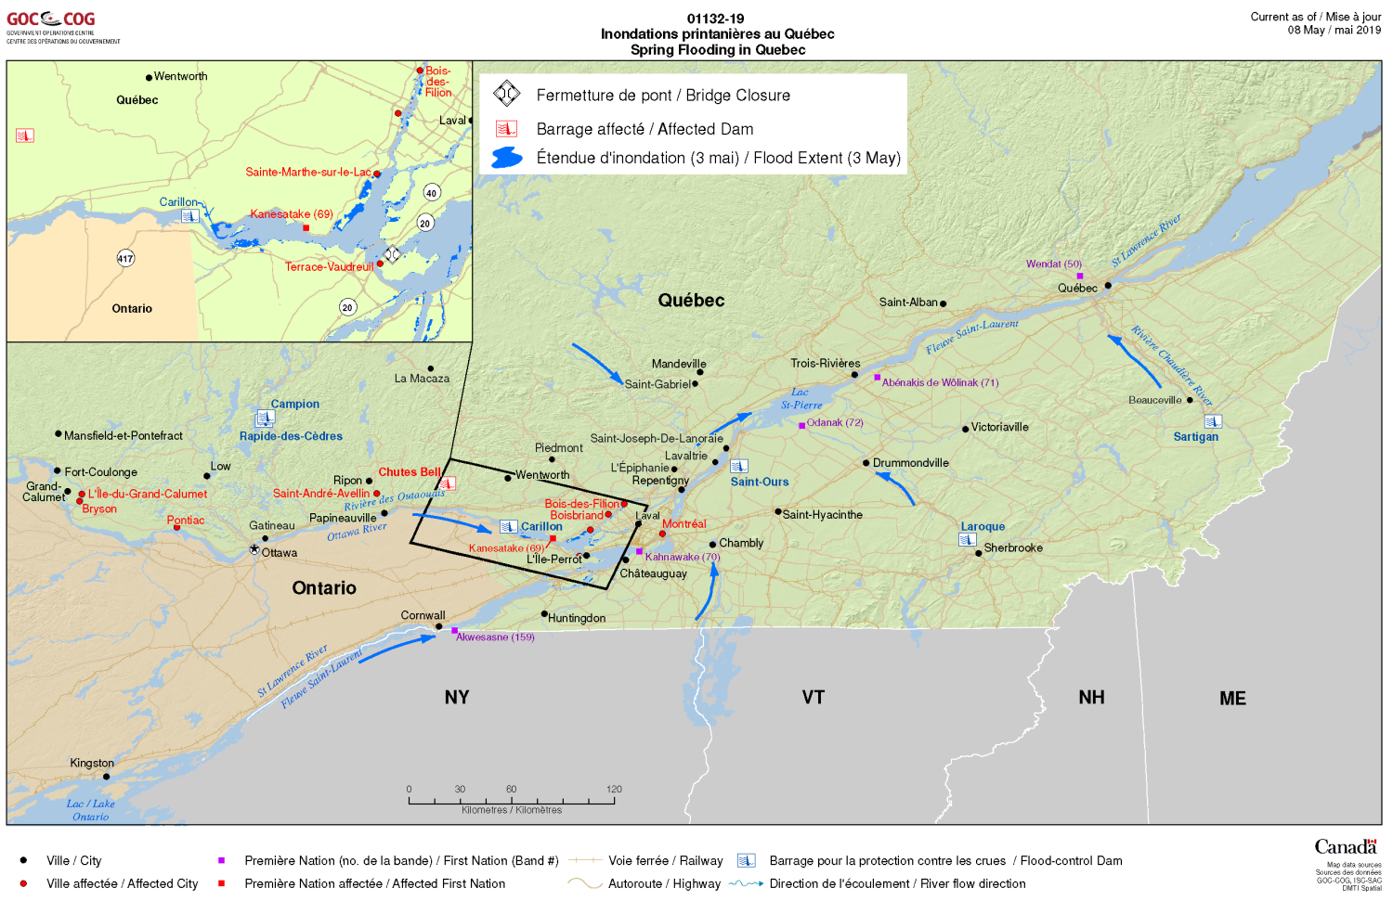
Our Products
During Events
Maps accompanying Operations Centre reports

Slide 9
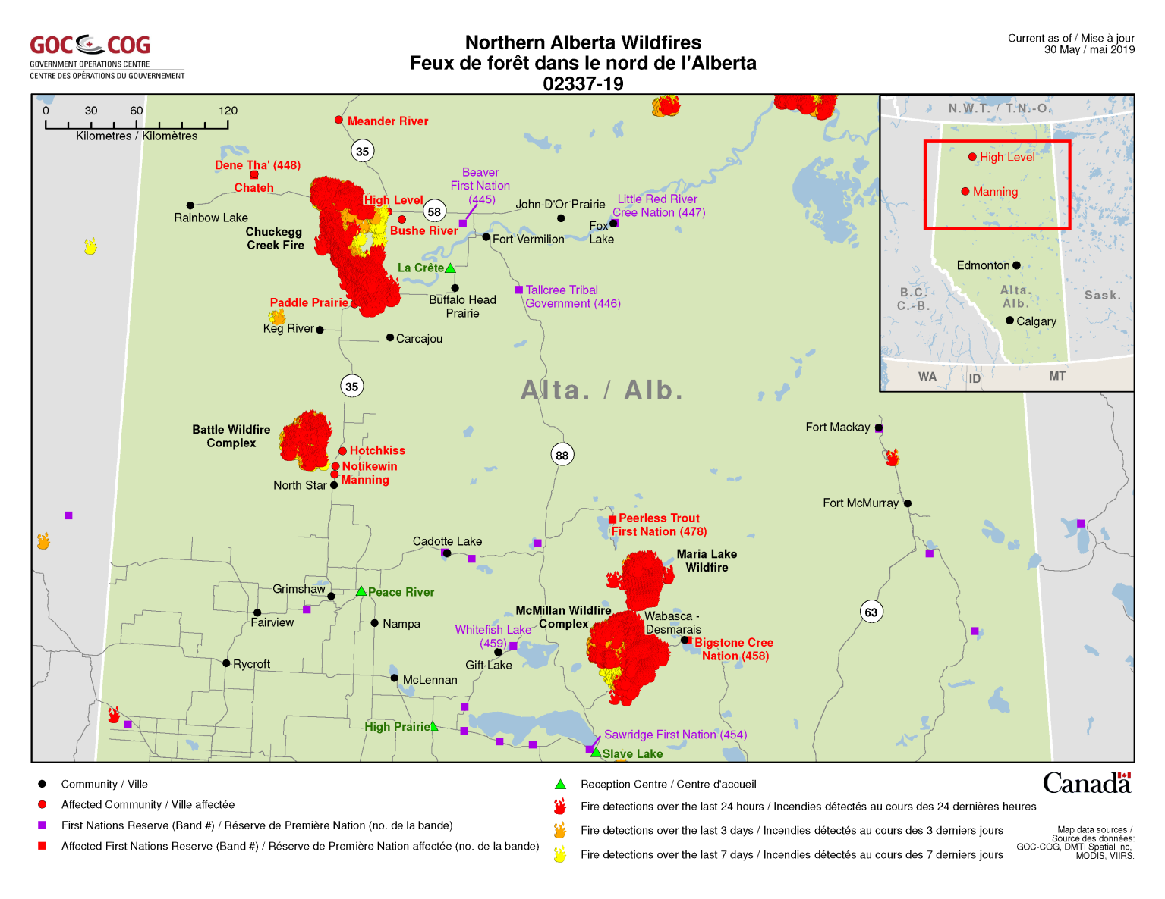
Our Products
During Events
Maps accompanying Operations Centre reports

Slide 10
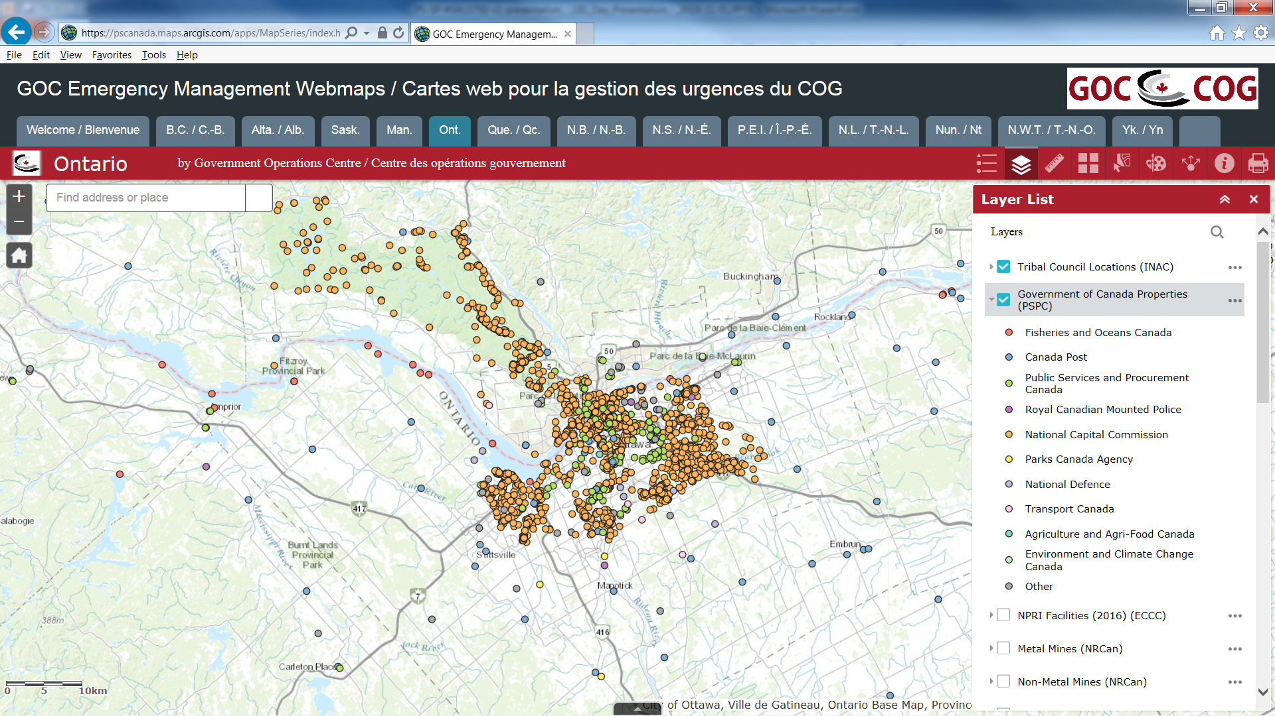
Our Products
During Events
Dynamic Webmaps
https://arcg.is/0zjKuf

Slide 11
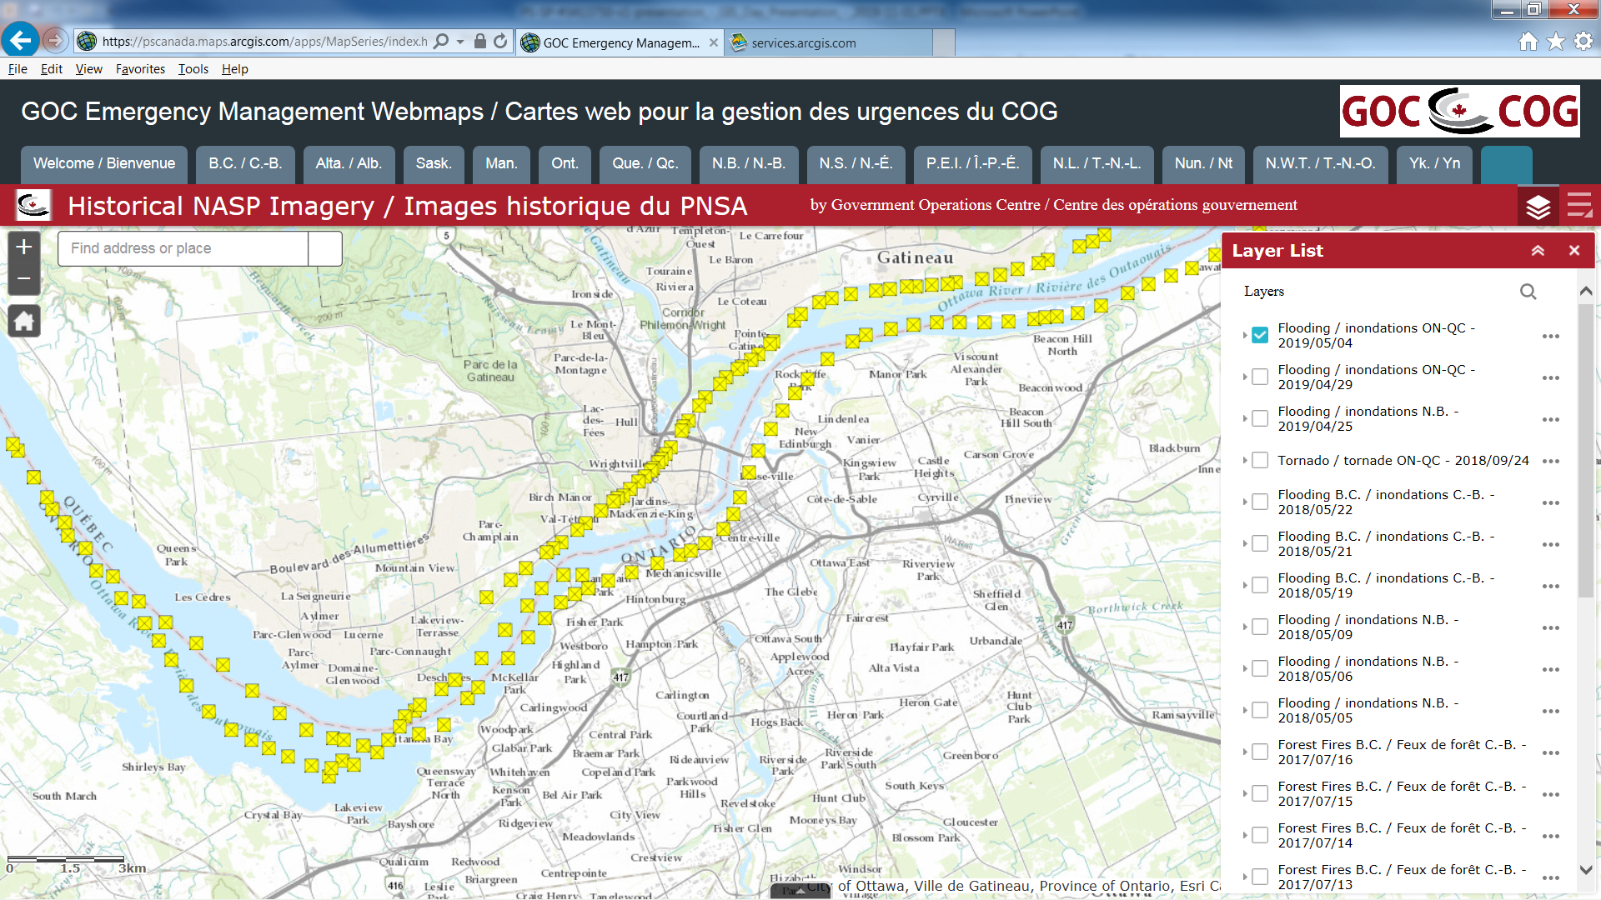
Our Products
During Events
Dynamic Webmaps – NASP Imagery
https://arcg.is/0zjKuf

Slide 12
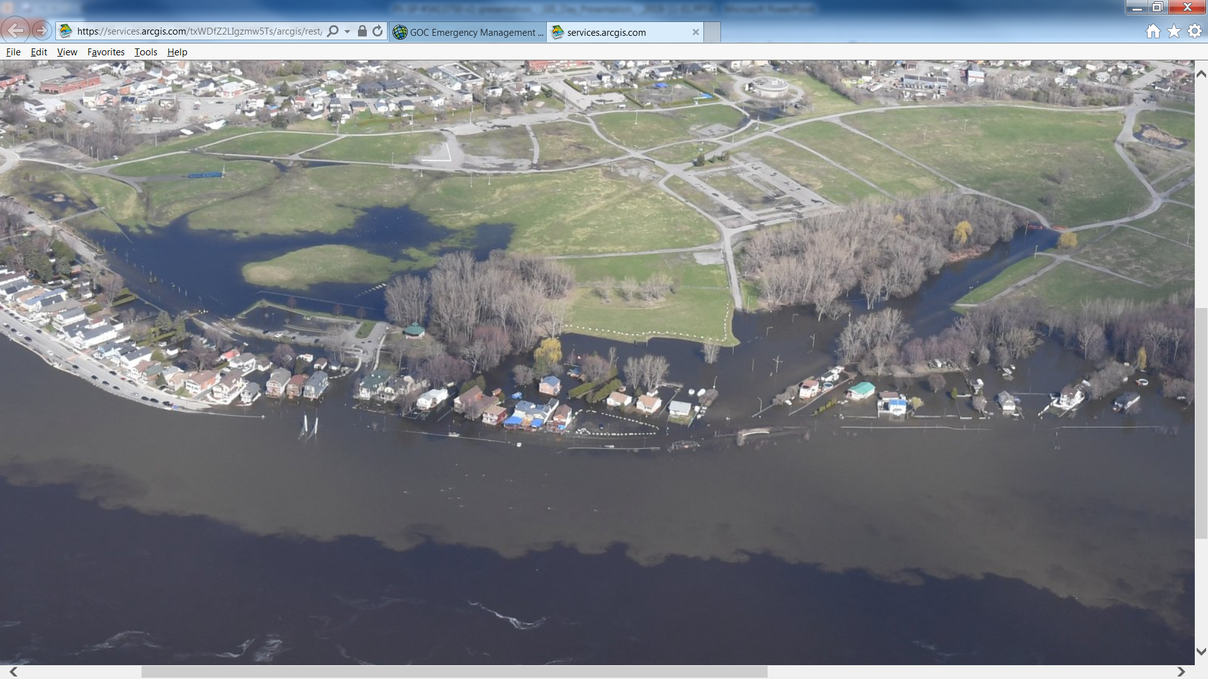
Our Products
During Events
Dynamic Webmaps – NASP Imagery
https://arcg.is/0zjKuf

Slide 13
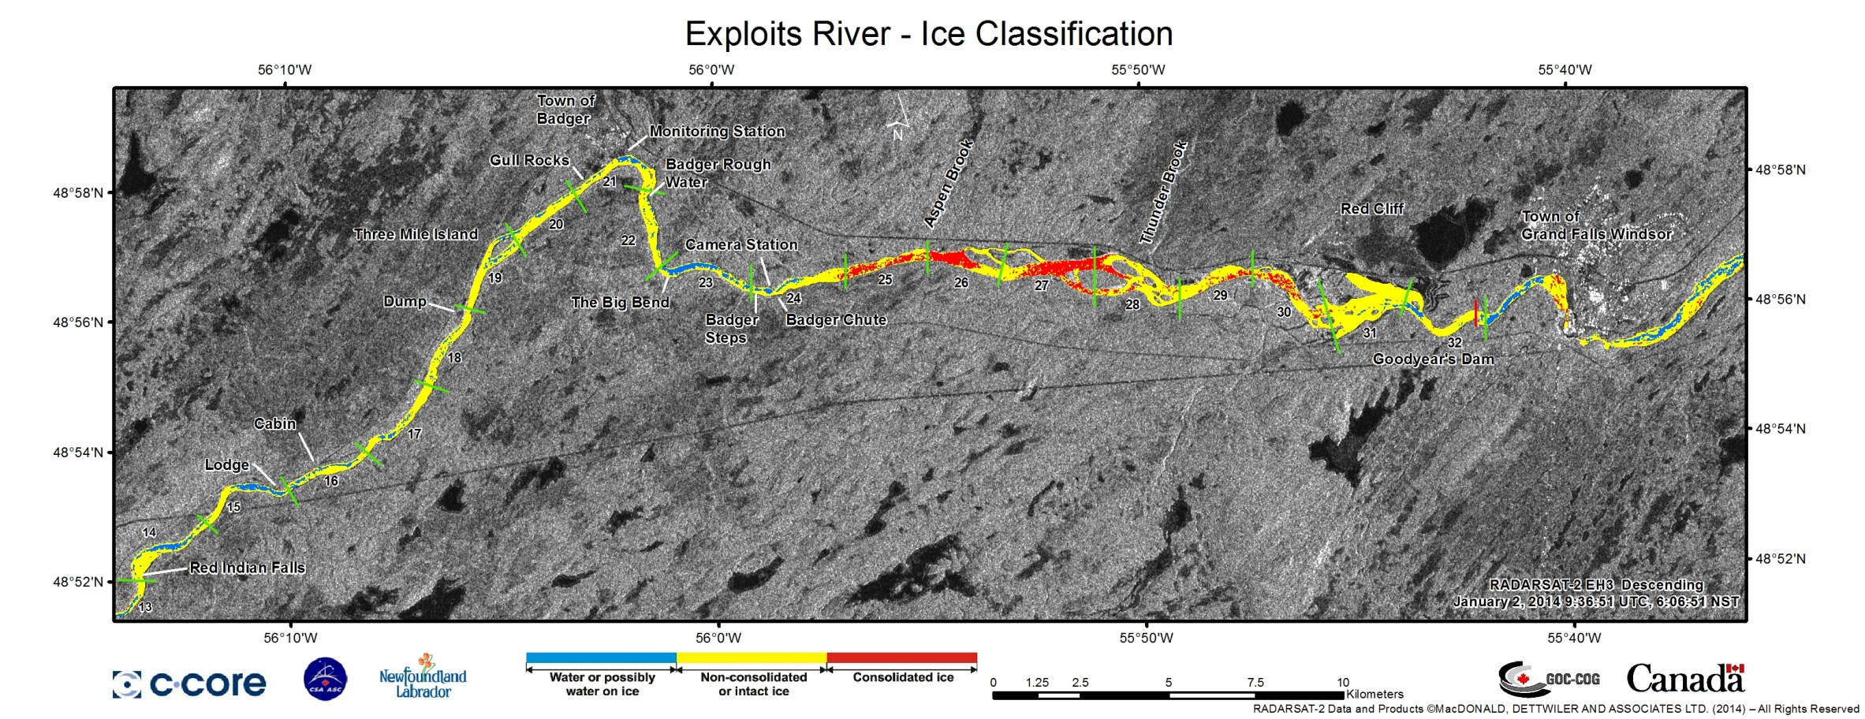
Our Products
During Events
Satellite Imagery - RADARSAT

Slide 14
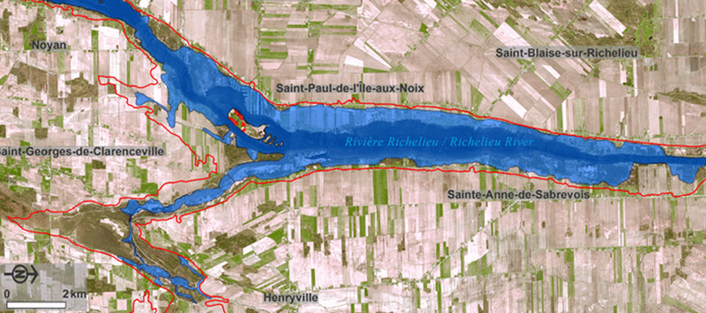
Our Products
During Events
Satellite Imagery - RADARSAT

Slide 15
How to request Geomatics support
Geospatial or Surveillance Services Required
Public Safety Regional Offices and Provincial/Territorial Requests are sent to the GOC Inbox
Federal OGD Requests are sent directly to GOC Geomatics with a CC to the GOC Inbox
GOC Geomatics will analyze the request, seek more information or clarification if necessary.
GOC Geomatics prepares the product(s) and if applicable, conducts the necessary analysis.
Provincial/Territorial: Products will be sent to the requestor with a CC to the PS RO and the GOC Inbox
Federal OGD and PS RO: Products will be sent to the requestor with a CC to the GOC Inbox

Slide 16
GOC Geomatics
Cameron Bouchard
Technical Lead – Geomatics
Government Operations Centre
Ottawa, Canada
Cameron.Bouchard@canada.ca
PS.GOCGeomatics-GeomatiqueCOG.SP@canada.ca
Webmap →
https://arcg.is/0zjKuf

